Slide 1
Data Modeling and SQL
It is a capital mistake to theorize before one has data
Sir Arthur Conan Doyle

Slide 2
Programmer productivity
In the 1970s, Codd laid out a plan for improving programmer productivity and accelerating systems development by improving the management and processing of data
The relational model
Shift from record to set (table) processing

Slide 3
Data modeling and SQL
Relational model is very popular
Successful use of the relational model requires skills in
Data modeling
SQL

Slide 4
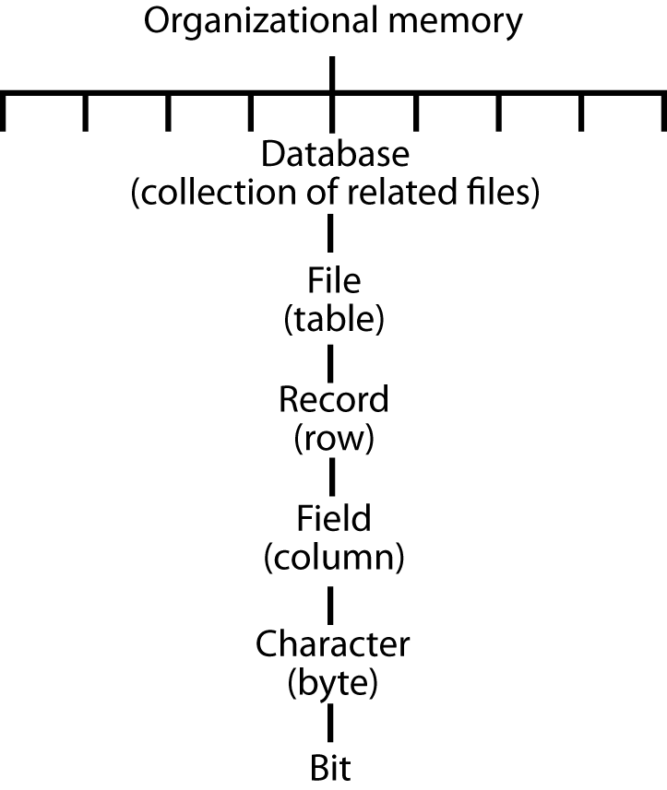
Organizational memory hierarchy

Slide 5
Key database design questions
What collection of files should a database contain?
How are these files related?
What fields should each file contain?

Slide 6
Learning strategy
Incremental, parallel development of
Data modeling
SQL

