Slide 1
SQL Playbook
Play so that you may be serious
Anacharsis

Slide 2
SQL Queries
SQL’s capability is often underestimated because students do not get exposure to a wide variety of simple and complex queries
Lacroix and Pirotte’s test set of 66 queries

Slide 3
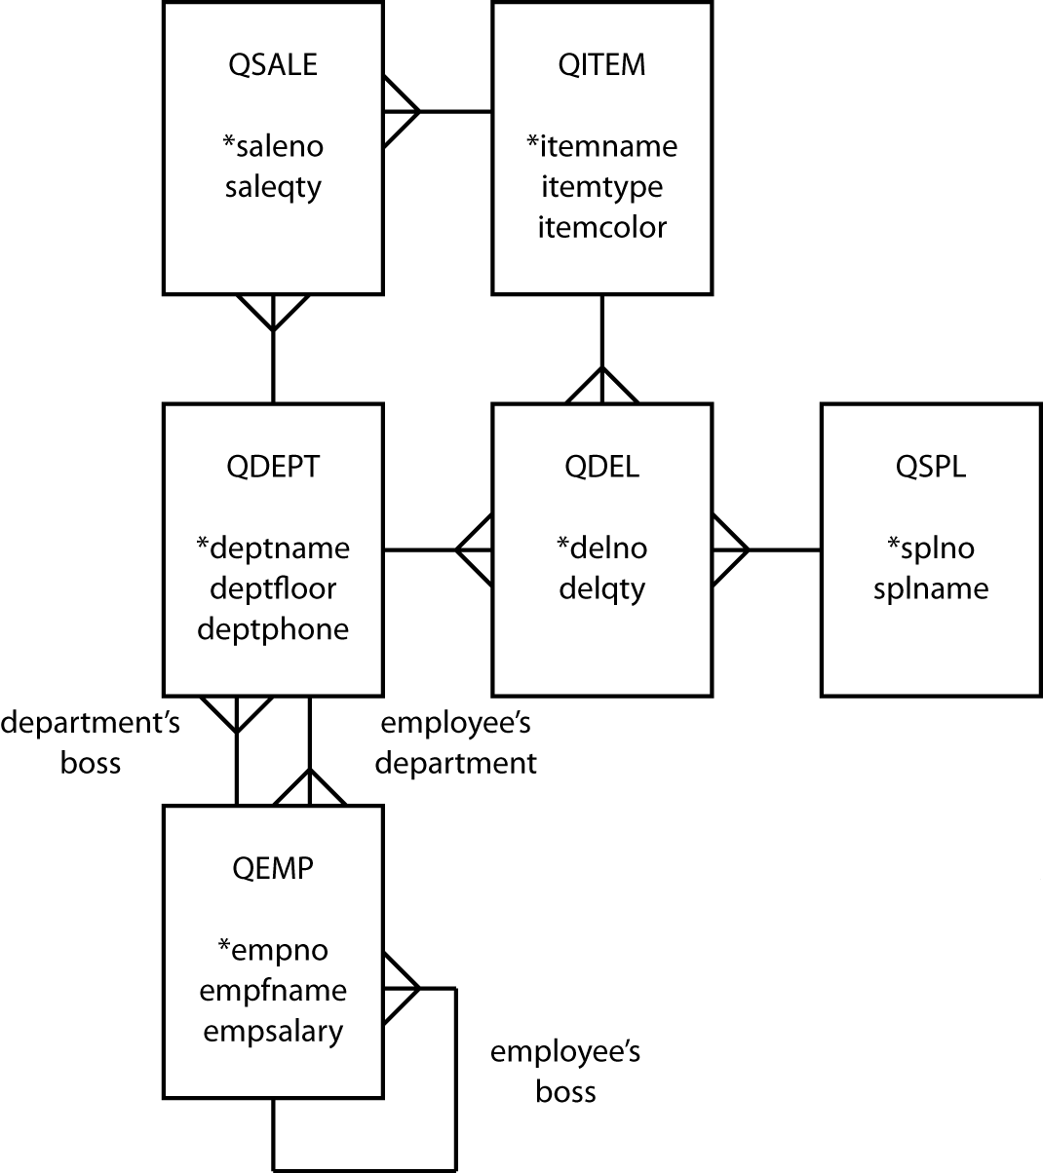
Data model

Slide 4
Relational tables
qsale
saleno | saleqty | itemname | deptname
qitem
itemname | itemtype | itemcolor
qdel
delno | delqty | itemname | deptname | splno
qspl
splno | splname
qdept
deptname | deptfloor | deptphone | empno
qemp
empno | empfname | empsalary | deptname | bossno

