Slide 1
Basic Structures
Few things are harder to put up with than the annoyance of a good example
Mark Twain

Slide 2
Basic structures
One entity
Two entities
Relationship descriptors as identifiers
A tree structure

Slide 3
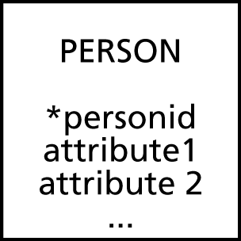
One entity
No relationships
person
*personid | attribute1 | attribute2 | …

Slide 4
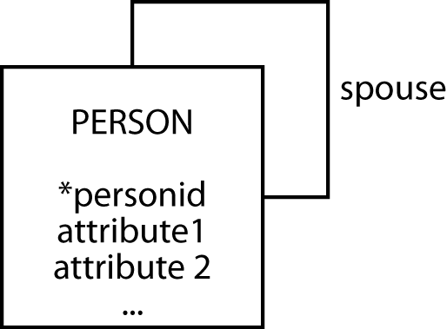
One entity
A 1:1 recursive relationship
person
*personid | attribute1 | attribute2 | … | spouse

Slide 5
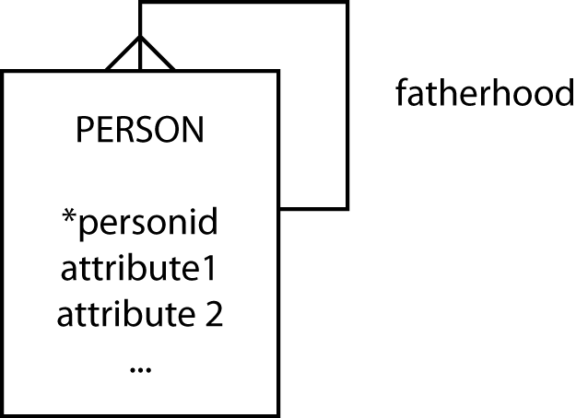
One entity
A recursive 1:m relationship
person
*personid | attribute1 | attribute2 | … | father

Slide 6
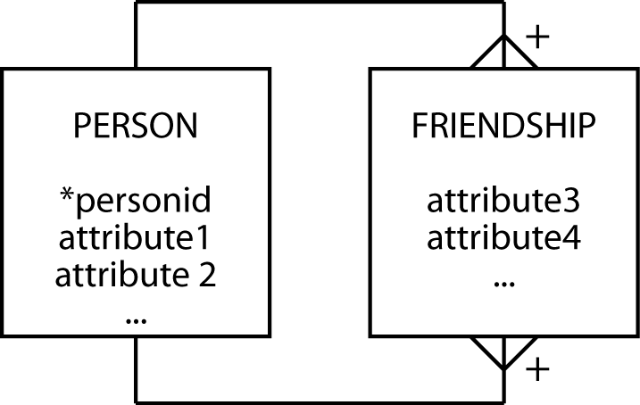
One entity
A recursive m:m relationship
person
*personid | attribute1 | attribute2 | …
friendship
*personid1 | *personid2 | attribute3 | attribute4 | …

Slide 7
Two entities
A 1:1 relationship
department
*deptid | deptattrib1 | deptattrib2 | … | bossno
employee
*empid | empattrib1 | empattrib2 | …

Slide 8
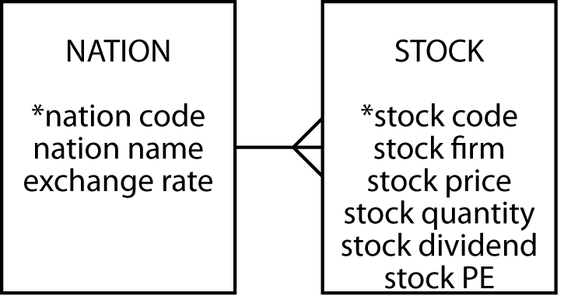
Two entities
A 1:m relationship
nation
*natcode | natname | exchrate
stock
*stkcode | stkfirm | stkprice | stkqty | stkdiv | stkpe | natcode

Slide 9
Two entities
An m:m relationship
book
*callno | isbn | booktitle | …
borrower
*borrowerid | …
copy
*bookno | duedate | … | callno | borrowerid

Slide 10
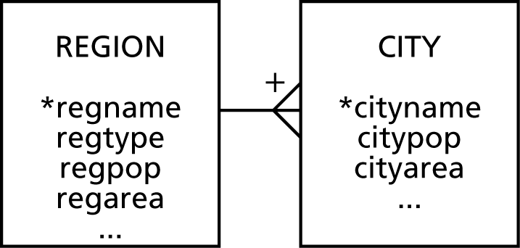
Relationship descriptors as identifiers
A dependent entity
region
regname | regtype | regpop | regarea | …
city
*cityname | citypop | cityarea | … | *regname

Slide 11
Relationship descriptors as identifiers
An associative entity
city
*cityname | …
store
*storestreet | storezip | … | *cityname | *firmname
firm
*firmname | firmstreet | firmzip | …

Slide 12
A tree structure
firm
*firmname | …
division
*divname | … | *firmname
department
*deptname | … | *divname | *firmname
section
*sectionid | … | *deptname | *divname | *firmname

Slide 13
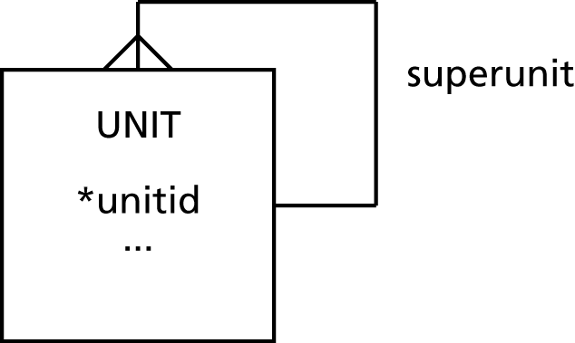
Recursive tree
unit
*unitid | attribute1 | … | superunitid

Slide 14
Key points
There are a few basic structures
All data models are constructed from these basic structures

