Slide 1
Data Structure and Storage
The modern world has a false sense of superiority because it relies on the mass of knowledge that it can use, but what is important is the extent to which knowledge is organized and mastered
Goethe, 1810

Slide 2
Bytes
Abbreviation | Prefix | Factor
k | kilo | 10³
M | mega | 10⁶
G | giga | 10⁹
T | tera | 10¹²
P | peta | 10¹⁵
E | exa | 10¹⁸
Z | zetta | 10²¹
Y | yotta | 10²⁴
R | ronna | 10²⁷
Q | quetta | 10³⁰

Slide 3
Market
2012
  Digital universe estimated at 2.8 YB
  Doubling every two years
2020
  5.2 TB per person
Notes:
http://www.zdnet.com/storage-in-2014-an-overview-7000024712/

Slide 4
Data Structures
The goal is to minimize disk accesses
Disks are relatively slow compared to main memory
  Writing a letter compared to a telephone call
Disks are a bottleneck
Appropriate data structures can reduce disk accesses

Slide 5
Database access

Slide 6
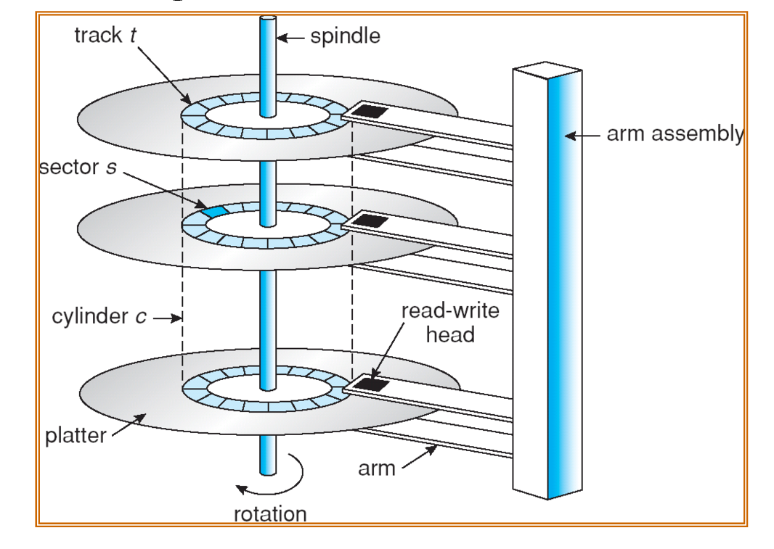
Disks
Data stored on tracks on a surface
A disk drive can have multiple surfaces
Rotational delay
  Waiting for the physical storage location of the data to appear under the read/write head
  Around 4 msec for a magnetic disk
  Set by the manufacturer
Access arm delay
  Moving the read/write head to the track on which the storage location can be found
  Around 9 msec for a magnetic disk

Slide 7
Minimizing data access times
Rotational delay is fixed by the manufacturer
Access arm delay can be reduced by storing files on
  The same track
  The same track on each surface
    A cylinder

Slide 8
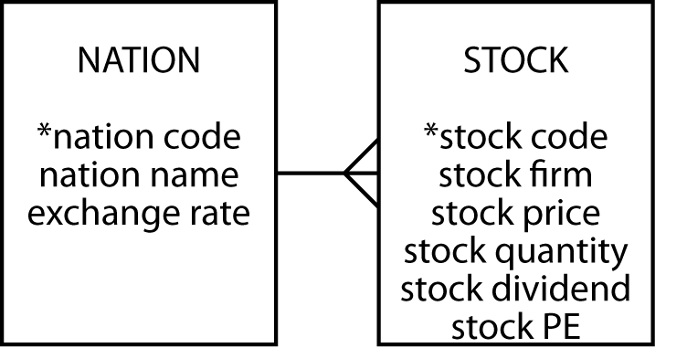
Clustering
Records that are often retrieved together should be stored together
Intra-file clustering
  Records within the one file
    A sequential file
Inter-file clustering
  Records in different files
    A nation and its stocks

Slide 9

Disk manager
Manages physical I/O
Sees the disk as a collection of pages
Has a directory of each page on a disk
Retrieves, replaces, and manages free pages

Slide 10
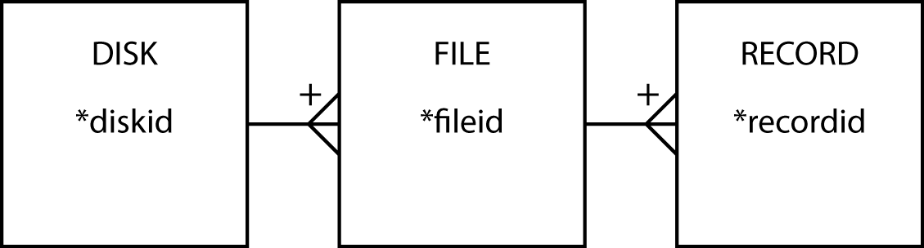
File manager
Manages the storage of files
Sees the disk as a collection of stored files
Each file has a unique identifier
Each record within a file has a unique record identifier

Slide 11
File manager's tasks
Create a file
Delete a file
Retrieve a record from a file
Update a record in a file
Add a new record to a file
Delete a record from a file

Slide 12
Sequential retrieval
Consider a file of 10,000 records each occupying 1 page
Queries that require processing all records will require 10,000 accesses
  e.g., Find all items of type 'E'
Many disk accesses are wasted if few records meet the condition

Slide 13
Indexing
An index is a small file that has data for one field of a file
Indexes reduce disk accesses

Slide 14
Querying with an index
Read the index into memory
Search the index to find records meeting the condition
Access only those records containing required data
Disk accesses are substantially reduced when the query involves few records

Slide 15
Maintaining an index
Adding a record requires at least two disk accesses
  Update the file
  Update the index
Trade-off
  Faster queries
  Slower maintenance

Slide 16
Using indexes
Sequential processing of a portion of a file
  Find all items with a type code in the range 'E' to 'K'
Direct processing
  Find all items with a type code of 'E' or 'N'
Existence testing
  Determining whether a record meeting the criteria exists without having to retrieve it

Slide 17
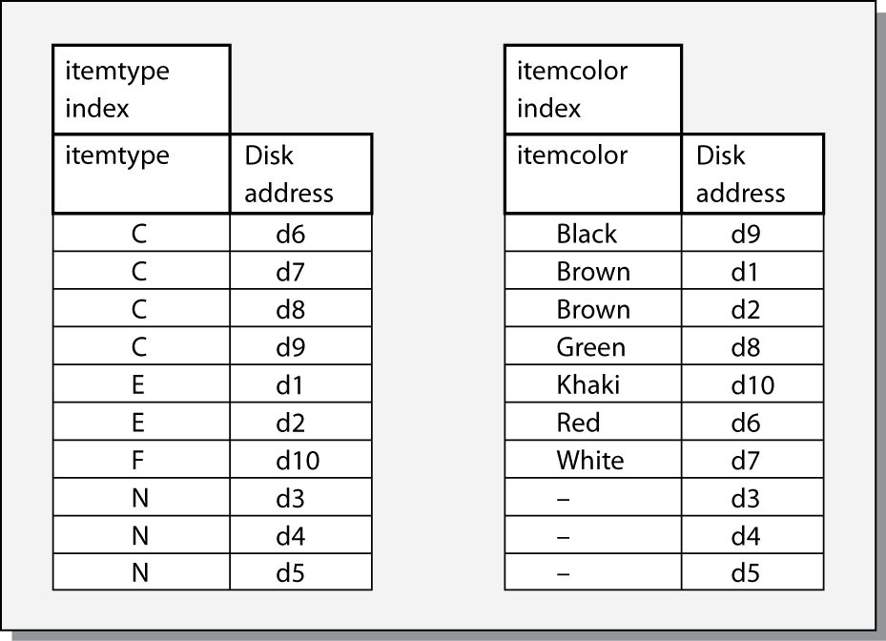
Multiple indexes
Find red items of type 'C'
  Both indexes can be searched to identify records to retrieve

Slide 18
Multiple indexes
Indexes are also called inverted lists
  A file of record locations rather than data
Trade-off
  Faster retrieval
  Slower maintenance

Slide 19
B-tree
A form of inverted list
Frequently used for relational systems
Basis of IBM’s VSAM underlying DB2
Supports sequential and direct accessing
Has two parts
  Sequence set
  Index set

Slide 20
B-tree
Sequence set is a single level index with pointers to records
Index set is a tree-structured index to the sequence set

Slide 21
B+ tree
The combination of index set (the B-tree) and the sequence set is called a B+ tree
The number of data values and pointers for any given node are not restricted
Free space is set aside to permit rapid expansion of a file
Tradeoffs
  Fast retrieval when pages are packed with data values and pointers
  Slow updates when pages are packed with data values and pointers

Slide 22
Hash for internal memory
Hash maps are available in most programing languages
  Also known as lookup tables
  A key-value pair
International dialing codes
Key | Value
Afghanistan | 93
Albania | 355
Algeria | 213
American Samoa | 1684
… | …

Slide 23
Hashing for external memory
A technique for reducing disk accesses for direct access
Avoids an index
Number of accesses per record can be close to one
The hash field is converted to a hash address by a hash function
Hash maps functions are available for internal programming in Java
Notes:
What is the likely choice of the hash field?
The primary key

Slide 24
Shortcomings of hashing
Different hash fields convert to the same hash address
  Synonyms
  Store the colliding record in an overflow area
Long synonym chains degrade performance
There can be only one hash field
The file can no longer be processed sequentially

Slide 25
Hashing
hash address = remainder after dividing SSN by 10000

Slide 26
Linked list
A structure for inter-file clustering
An example of a parent/child structure

Slide 27
Linked lists
There can be two-way pointers, forward and backward, to speed up deletion
Each child can have a pointer to its parent

Slide 28
Bit map indexes
Uses a single bit, rather than multiple bytes, to indicate the specific value of a field
  Color can have only three values, so use three bits
Itemcode | Color |  |  | Code |  | Disk address
 | Red | Green | Blue | A | N
1001 | 0 | 0 | 1 | 0 | 1 | d1
1002 | 1 | 0 | 0 | 1 | 0 | d2
1003 | 1 | 0 | 0 | 1 | 0 | d3
1004 | 0 | 1 | 0 | 1 | 0 | d4

Slide 29
Bit map indexes
A bit map index saves space and time compared to a standard index
Itemcode | Color CHAR(8) | Code CHAR(1) | Disk address
1001 | Blue | N | d1
1002 | Red | A | d2
1003 | Red | A | d3
1004 | Green | A | d4

Slide 30
Join indexes
Speed up joins by creating an index for the primary key and foreign key pair
nation index |  |  | stock index
natcode | Disk address |  | natcode | Disk address
UK | d1 |  | UK | d101
USA | d2 |  | UK | d102
 |  |  | UK | d103
 |  |  | USA | d104
 |  |  | USA | d105
join index
nation disk address | stock disk address
d1 | d101
d1 | d102
d1 | d103
d2 | d104
d2 | d105

Slide 31
Data coding standards
ASCII
UNICODE

Slide 32
ASCII
Each alphabetic, numeric, or special character is represented by a 7-bit code
128 possible characters
ASCII code usually occupies one byte

Slide 33
UNICODE
A unique binary code for every character, no matter what the platform, program, or language
Currently contains 34,168 distinct characters derived from 24 supported language scripts
Covers the principal written languages

Slide 34
UNICODE
Two encoding forms
  A default 16-bit form
  An 8-bit form called UTF-8 for ease of use with existing ASCII-based systems
The default encoding of HTML and XML
The basis of global software

Slide 35
Comma-separated values (CSV)
A text file
Records separated by line breaks
  Typically, all records have the same set of fields in the same sequence
  First record can be a header
Each record consists of fields separated by some other character or string
  Usually, a comma or tab
  Strings are enclosed in quotes
Can import into and export from MySQL

Slide 36
CSV
"shrcode","shrfirm","shrprice","shrqty","shrdiv","shrpe"
"AR","Abyssinian Ruby",31.82,22010,1.32,13
"BE","Burmese Elephant",0.07,154713,0.01,3
"BS","Bolivian Sheep",12.75,231678,1.78,11
"CS","Canadian Sugar",52.78,4716,2.50,15
"FC","Freedonia Copper",27.50,10529,1.84,16
"ILZ","Indian Lead & Zinc",37.75,6390,3.00,12
"NG","Nigerian Geese",35.00,12323,1.68,10
"PT","Patagonian Tea",55.25,12635,2.50,10
"ROF","Royal Ostrich Farms",33.75,1234923,3.00,6
"SLG","Sri Lankan Gold",50.37,32868,2.68,16
Header
Data

Slide 37
JavaScript object notation (JSON)
A language independent data exchange format
A collection of name/value pairs
An ordered list of values
Parsers available for most common languages
Extensions available to import to and export from MySQL

Slide 38
JSON data types
Number
  Double precision floating-point
String
  A sequence of zero or more Unicode characters in double quotes, with backslash escaping of special characters
Object
Array
Null
  Empty

Slide 39
JSON object
An unordered set of name/value pairs
  Separated by :
  Enclosed in curly braces

Slide 40
JSON array
An ordered collection of values
  Enclosed in square brackets

Slide 41
JSON
{
"shares": [
{
"shrcode": "FC",
"shrdiv": 1.84,
"shrfirm": "Freedonia Copper",
"shrpe": 16,
"shrprice": 27.5,
"shrqty": 10529
},
{
"shrcode": "PT",
"shrdiv": 2.5,
"shrfirm": "Freedonia Copper",
"shrpe": 10,
"shrprice": 55.25,
"shrqty": 12635
}
]
}
Array
Object
Value

Slide 42
The evolution of hard drives
A history of the hard drive in pictures

Slide 43
Data storage devices
Data storage device can be used for
  On-line data
    Access speed
    Capacity
  Back-up files
    Security against data loss
  Archival data
    Long-term storage

Slide 44
Key variables
Data volume
Data volatility
Access speed
Storage cost
Medium reliability
Legal standing of stored data

Slide 45
Magnetic technology
The major form of data storage
A mature and widely used technology
Strong magnetic fields can erase data
Magnetization decays with time

Slide 46
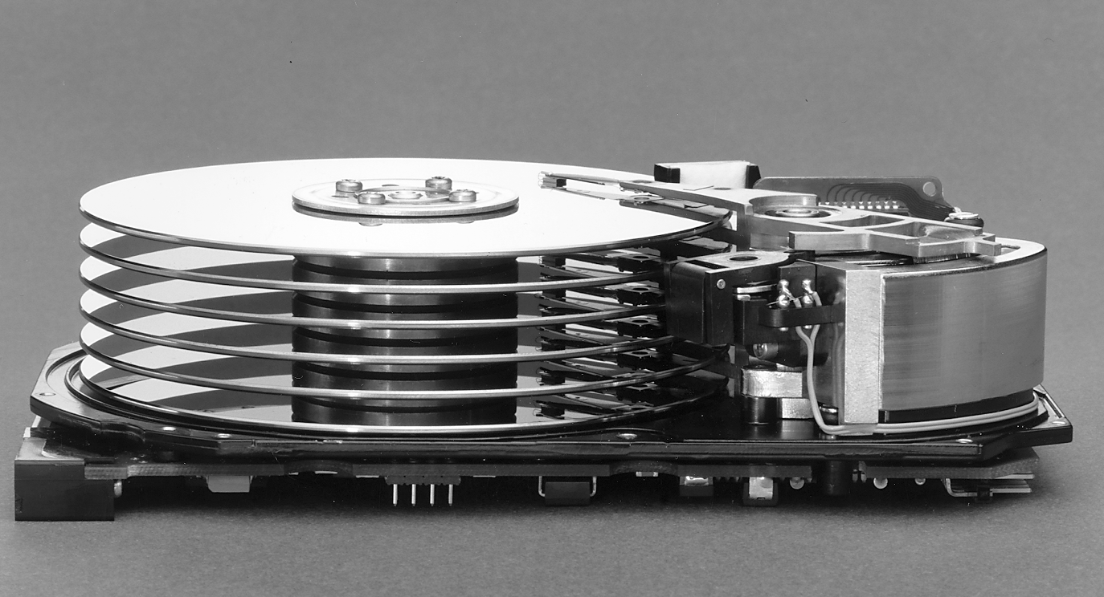
Hard disk drive (HDD)
Sealed, permanently mounted
Highly reliable
Access times of 4-10 msec
Transfer rates as high as 1,300 Mbytes per second
Capacities in Tbytes
HDD unit shipments and sales revenues are declining, though production (exabytes per year) is growing

Slide 47
RAID
Redundant arrays of inexpensive or independent drives
Exploits economies of scale of disk manufacturing for the personal computer market
Can also give greater security
Increases a system's fault tolerance
Not a replacement for regular backup

Slide 48
Parity
A bit added to the end of a binary code that indicates whether the number of bits in the string with the value one is even or odd
Parity is used for detecting and correcting errors
Data | Number of one bits | Even parity | Odd parity
0001100 | 2 | 00011000 | 00011001

Slide 49
Mirroring

Slide 50
Mirroring
Write
  Identical copies of a file are written to each drive in an array
Read
  Alternate pages are read simultaneously from each drive
  Pages put together in memory
  Access time is reduced by approximately the number of disks in the array
Read error
  Read required page from another drive
Tradeoffs
  Reduced access time
  Greater security
  More disk space

Slide 51
Striping

Slide 52
Striping
Three drive model
Write
  Half of file to first drive
  Half of file to second drive
  Parity bit to third drive
Read
  Portions from each drive are put together in memory
Read error
  Lost bits are reconstructed from third drive’s parity data
Tradeoffs
  Increased data security
  Less storage capacity than mirroring
  Not as fast as mirroring

Slide 53
RAID levels
All levels, except 0, have common features
The operating system sees a set of physical drives as one logical drive
Data are distributed across physical drives
Parity is used for data recovery

Slide 54
RAID levels
Level 0
  Data spread across multiple drives
  No data recovery when a drive fails
Level 1
  Mirroring
  Critical non-stop applications
Level 3
  Striping
Level 5
  A variation of striping
  Parity data is spread across drives
  Less capacity than level 1
  Higher I/O rates than level 3

Slide 55
RAID 5

Slide 56
Magnetic technology
Removable magnetic disk
Magnetic tape
Magnetic tape cartridge

Slide 57
Solid State
Arrays of memory chips
  ~35 cents per Gbyte
  Magnetic disk is ~ 5 cents per Gbyte
Prices for SSD are decreasing faster than HDD prices
Faster
Less energy
More reliable
Handhelds and laptops
Notes:
http://darrenyates.com.au/?p=1202 (HDD price)
http://www.computerworld.com/s/article/9192359/Macbook_Air_could_foretell_death_of_hard_drives?taxonom n yId=19&pageNumber=2

Slide 58
Flash drive
Small
Removable
Solid state
USB connector
Up to 1 Tbytes capacity
Around 25 cents per Gbyte for smaller capacity drives
About 50 cents per Gbyte for larger capacity drivers

Slide 59
Optical technology
A more recent development than magnetic
Use a laser for reading and writing data
High storage densities
Low cost
Direct access
Long storage life
Not susceptible to head crashes

Slide 60
Blu-ray Disc
Capacity of 25 to 50 Gbytes
20-layer version can store 500 Gbytes
Versions for BD-ROM, BD-R, BD-RE

Slide 61
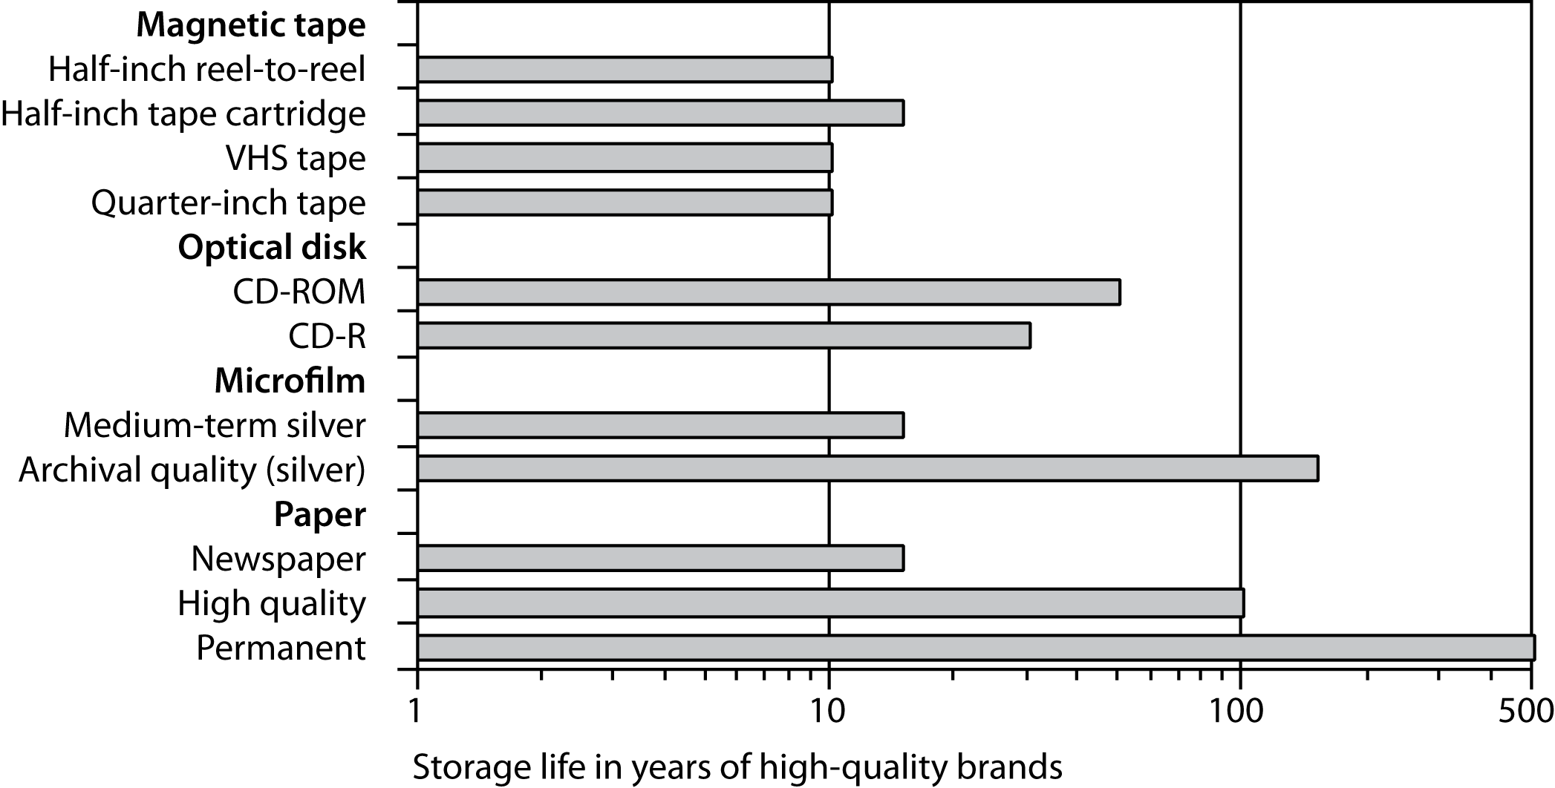
Storage life

Slide 62
Merit of data storage devices
Device | Access speed | Volume | Volatility | Cost per megabyte | Reliability | Legal standing
Solid state | *** | * | *** | * | ** | *
Fixed disk | *** | *** | *** | ** | ** | *
RAID | *** | *** | *** | ** | *** | *
Removable disk | ** | ** | *** | ** | ** | *
Tape | * | ** | * | *** | ** | *
Cartridge | ** | *** | * | *** | ** | *
Mass storage | ** | *** | * | *** | ** | *
SAN | *** | *** | *** | ** | *** | *
Optical-ROM | * | *** | * | *** | *** | ***
Optical-R | * | *** | * | *** | *** | **
Optical-RW | * | *** | ** | *** | *** | *

Slide 63
Data compression
Encoding digital data so it requires less storage space and thus less network bandwidth
Lossless
  File can be restored to original state
Lossy
  File cannot be restored to original state
  Used for graphics, video, and audio files

Slide 64
Recent developments
Declining cost of main-memory
Multicore processors
Can get massive performance improvements for business analytics
SAP HANA is a product of these recent developments
  Overcomes the disk bottleneck
Notes:
This section draws on SAP HANA Essentials by Jeffrey Word.

Slide 65
Rethinking metrics
Traditional
  Cost per TB
New
  Cost per TB per second
Main memory is roughly 10 times more expensive but 1000 times faster
Total cost of ownership lower as well

Slide 66
Eliminating disk-based database
Faster and cheaper architecture
Some firms will have a need for magnetic disks for some years because of database sizes
Transition as main memory becomes cheaper
SAP's Hana is an example

Slide 67
Columnar and row-based data storage
A table can be stored as a series of rows or columns
Row-storage typically good for transactions
Column-storage typically good for business analytics
In-memory facilitates either approach
  And so can disk

Slide 68
In-memory systems
In-memory can achieve 5-10 compression ratios
  Helps reduce cost of the transition
SQL with some extensions

Slide 69
Key points
Disk drives are relatively slow compared to main memory
Storage devices vary on several parameters
SSD gradually replacing HDD
Select a storage device based on storage and retrieval goals
In-memory database is a recent and growing development

