Slide 1
Cluster Computing
Let us change our traditional attitude to the construction of programs: Instead of imagining that our main task is to instruct a computer what to do, let us concentrate rather on explaining to humans what we want the computer to do
Donald E. Knuth, Literate Programming, 1984
Notes:
http://www.manamplified.org/archives/2008/06/hadoop-quotes.html

Slide 2
Drivers

Slide 3
Central activity

Slide 4
Dominant logics
Economy | Subsistence | Agricultural | Industrial | Service | Sustainable
Question | How to survive? | How to farm? | How to manage resources? | How to create customers? | How to reduce impact?
Dominant issue | Survival
 |  | Production
 |  |  |  | Customer service
 |  |  |  |  | Sustainability
Key information systems | Gesture Speech | Writing Calendar | Accounting ERP Project management | CRM Analytics | Simulation Optimization Design Digital twin

Slide 5
Data sources

Slide 6
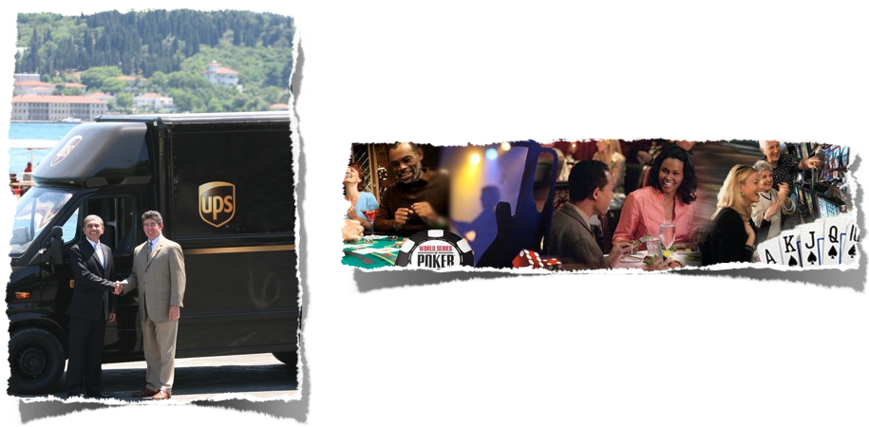
Operational

Slide 7
Social
Notes:
http://lunartheme.com/understanding-wordpress-build-social-network/

Slide 8
Environmental

Slide 9
Digital transformation

Slide 10
Data
Data are the raw material for information
Ideally, the lower the level of detail the better
  Summarize up but not detail down
Immutability means no updating
  Append plus a time stamp
Maintain history

Slide 11
Data types
Structured
Unstructured
  Can structure with some effort

Slide 12
Requirements for Big Data
Robust and fault-tolerant
Low latency reads and updates
Scalable
Support a wide variety of applications
Extensible
Ad hoc queries
Minimal maintenance
Debuggable

Slide 13
Bottlenecks

Slide 14
Solving the speed problem

Slide 15
Lambda architecture
Speed layer
Serving layer
Batch layer

Slide 16
Batch layer
Addresses the cost problem
  The batch layer stores the master copy of the dataset
    A very large set of records
    An immutable growing dataset
Continually pre-computes batch views on that master dataset so they are available when requested
  Might take several hours to run

Slide 17
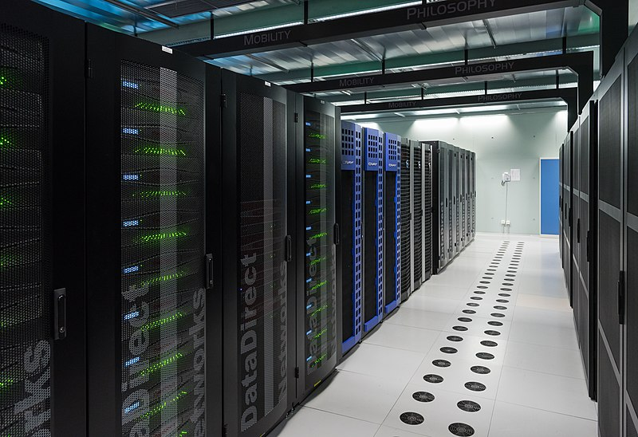
Batch programming
Automatically parallelized across a cluster of machines
  Supports scalability to any size dataset
If you have an x nodes cluster, the computation will be about x times faster compared to a single machine
Notes:
https://upload.wikimedia.org/wikipedia/commons/e/e5/High_Performance_Computing_Center_Stuttgart_HLRS_2015_07_Cray_XC40_Hazel_Hen_IO.jpg

Slide 18
Serving layer
A specialized distributed database
Indexes pre-computed batch views and loads them so they can be efficiently queried
Continuously swaps in newer pre-computed versions of batch views

Slide 19
Speed layer
The only data not represented in a batch view are those data collected while the pre-computation was running
The speed layer is a real-time system to top-up the analysis with the latest data
  Does incremental updates based on recent data
  Modifies the view as data are collected
  Merges the two views as required by queries

Slide 20
Lambda architecture

Slide 21
Speed layer
Intermediate results are discarded every time a new batch view is received
The complexity of the speed layer is “isolated”
  If anything goes wrong, the results are only a few hours out-of-date and fixed when the next batch update is received

Slide 22
Lambda architecture

Slide 23
Lambda architecture
New data are sent to the batch and speed layers
  New data are appended to the master dataset to preserve immutability
Speed layer does an incremental update

Slide 24
Lambda architecture
Batch layer pre-computes using all data
Serving layer indexes batch created views
  Prepares for rapid response to queries

Slide 25
Lambda architecture
Queries are handled by merging data from the serving and speed layers

Slide 26
Master dataset
Goal is to preserve integrity
Other elements can be recomputed
  Replication across nodes
  Redundancy is integrity

Slide 27
CRUD to CR
Create
Read
Update
Delete
Create
Read

Slide 28
Immutability exceptions
Garbage collection
  Delete elements of low potential value
    Don’t keep some histories
Regulations and privacy
  Delete elements that are not permitted
    History of books borrowed

Slide 29
Fact-based data model
Each fact is a single piece of data
  Clare is female
  Clare works at Bloomingdales
  Clare lives in New York
Multi-valued facts need to be decomposed
  Clare is a female working at Bloomingdales in New York
A fact is data about an entity or a relationship between two entities

Slide 30
Fact-based data model
Each fact has an associated timestamp recording the earliest time that the fact is believed to be true
  For convenience, usually the time the fact is captured
  Create a new data type of time series or attributes become entities
More recent facts override older facts
All facts need to be uniquely identified
  Often a timestamp plus other attributes
  Use a 64-bit nonce (number used once) field, which is a a random number, if timestamp plus attribute combination could be identical
  UUID

Slide 31
Fact-based versus relational
Decision-making effectiveness versus operational efficiency
  Days versus seconds
Access many records versus access a few
Immutable versus mutable
  History versus current view

Slide 32
Schemas
Schemas increase data quality by defining structure
Catch errors at creation time when they are easier and cheaper to correct

Slide 33
Fact-based data model
Graphs can represent facts-based data models
  Nodes are entities
  Properties are attributes of entities
  Edges are relationships between entities

Slide 34
Graph versus relational
Keep a full history
Append only
Scalable?

Slide 35
Solving the speed and cost problems

Slide 36
Hadoop
Distributed file system
  Hadoop distributed file system (HDFS)
  A storage structure for large data sets
Commodity hardware
  A cluster of nodes
Companies uses Hadoop for data analytics, machine learning, search ranking, email spam filtering, ad optimization, ETL, and more

Slide 37
Hadoop
Lower cost
  Commodity hardware
Speed
  Multiple processors

Slide 38
HDFS
Files are broken into fixed sized blocks of at least 64MB
Blocks are replicated across nodes
  Parallel processing
  Fault tolerance

Slide 39
HDFS
Node storage
  Store blocks sequentially to minimize disk head movement
  Blocks are grouped into files
  All files for a dataset are grouped into a single folder
  No random access to records
  New data are added as a new file

Slide 40
HDFS
Scalable storage
  Add nodes
  Append new data as files
Scalable computation
  Support of MapReduce
Partitioning
  Group data into folders for processing at the folder level

Slide 41
Apache Spark
An Apache project for cluster computing
Based on resilient distributed dataset (RDD)
  Similar characteristics to HDFS
Can interface with Hadoop

Slide 42
Apache Spark components
Spark SQL
Spark streaming
  Real-time event analysis
Machine learning library
GraphX for graph processing
Applications can be written in Java, Scala, Python, and R

Slide 43
R & Spark
sparklyr package
Enables dplyr for processing Spark files
Local mode for development and testing
Access to Machine Learning library

Slide 44
R & Spark
Need the latest version of Java
Install a local version of Spark
library(sparklyr)
spark_install(version='2.0.2')

Slide 45
R & Spark
Create a local Spark connection
library(sparklyr)
sc <- spark_connect(master = "local")

Slide 46
R & Spark
Tabulate

Slide 47
R
library(tidyverse)
url <- "http://people.terry.uga.edu/rwatson/data/centralparktemps.txt"
t <- read_delim(url, delim=',')
# tabulate frequencies for temperature
t %>%
mutate(Fahrenheit = round(temperature,digits=0)) %>%
group_by(Fahrenheit) %>%
summarize(Frequency = n())

Slide 48
Spark
library(sparklyr)
library(tidyverse)
spark_install(version='2.0.2')
sc <- spark_connect(master = "local", spark_home=spark_home_dir(version = "2.0.2"))
t_tbl <- copy_to(sc,t)
t_tbl %>%
mutate(Fahrenheit = round(temperature,0)) %>%
group_by(Fahrenheit) %>%
summarize(Frequency = n()) %>%
arrange(Fahrenheit)

Slide 49
R & Spark
Basic statistics

Slide 50
R
library(tidyverse)
url <- "http://people.terry.uga.edu/rwatson/data/centralparktemps.txt"
t <- read_delim(url, delim=',')
# report minimum, mean, and maximum by year
t %>%
group_by(year) %>%
summarize(Min=min(temperature),
Mean = round(mean(temperature),1),
Max = max(temperature))

Slide 51
Spark
library(sparklyr)
library(tidyverse)
spark_install(version='2.0.2')
sc <- spark_connect(master = "local", spark_home=spark_home_dir(version = "2.0.2"))
t_tbl <- copy_to(sc,t)
# report minimum, mean, and maximum by year
t_tbl %>%
group_by(year) %>%
summarize(Min=min(temperature),
Mean = round(mean(temperature),1),
Max = max(temperature)) %>%
arrange(year)

Slide 52
HBase
A distributed database
Does not enforce relationships
Does not enforce strict column data typing
Part of the Hadoop ecosytem

Slide 53
Applications
Facebook
Twitter
StumbleUpon

Slide 54
Hiring: learning from big data
People with a criminal background perform a bit better in customer-support call centers
Customer-service employees who live nearby are less likely to leave
Honest people tend to perform better and stay on the job longer
but make less effective salespeople

Slide 55
Outcomes
Scientific discovery
  Quasars
  Higgs Boson
Discovering linkages among humans, products, and services
An ecological sustainable society
  Energy Informatics

Slide 56
Critical questions
What’s the business problem?
What information is needed to make a high-quality decision?
What data can be converted into information?

Slide 57
Conclusions
Faster and lower cost solutions for data-driven decision making
HDFS
  Reduces the cost of storing large data sets
  Becoming the new standard for data storage
Cluster computing changed the way data are processed
  Cheaper
  Faster

