Slide 1
Text mining & natural language processing
From now on I will consider a language to be a set (finite or infinite) of sentences, each finite in length and constructed out of a finite set of elements. All natural languages in their spoken or written form are languages in this sense.
Noam Chomsky

Slide 2
Levels of processing
Semantics
  Focuses on the study of the meaning of words and the interactions between words to form larger units of meaning (such as sentences)
Discourse
  Building on the semantic level, discourse analysis aims to determine the relationships between sentences
Pragmatics
  Studies how context, world knowledge, language conventions and other abstract properties contribute to the meaning of text

Slide 3
Evolution of translation
Word substitution
Linguistic analysis
Machine learning

Slide 4
NLP
Text is more difficult to process than numbers
Language has many irregularities
Typical speech and written text are not perfect
Don’t expect perfection from text analysis

Slide 5
Sentiment analysis
A popular and simple method of measuring aggregate feeling
Give a score of +1 to each “positive” word and -1 to each “negative” word
Sum the total to get a sentiment score for the unit of analysis (e.g., tweet)

Slide 6
Shortcomings
Irony
  The name of Britain’s biggest dog (until it died) was Tiny
Sarcasm
  I started out with nothing and still have most of it left
Word analysis
  “Not happy” scores +1

Slide 7
Tokenization
Breaking a document into chunks
  Tokens
  Typically words
  Break at whitespace
Create a “bag of words”
Many operations are at the word level

Slide 8
Terminology
N
  Corpus size
  Number of tokens
V
  Vocabulary
  Number of distinct tokens in the corpus

Slide 9
Count the number of words
require(stringr)
# split a string into words into a list of words
y <- str_split("The dead batteries were given out free of charge", " ")
# report length of the vector
length(y[[1]]) # double square bracket "[[]]" to reference a list member

Slide 10
R function for sentiment analysis

Slide 11
score.sentiment = function(sentences, pos.words, neg.words, .progress='none')
{
require(plyr)
require(stringr)
# split sentence into words
scores = laply(sentences, function(sentence, pos.words, neg.words) {
# clean up sentences with R's regex-driven global substitute, gsub():
sentence = gsub('[[:punct:]]', '', sentence)
sentence = gsub('[[:cntrl:]]', '', sentence)
sentence = gsub('\\d+', '', sentence)
# and convert to lower case:
sentence = tolower(sentence)
# split into words. str_split is in the stringr package
word.list = str_split(sentence, '\\s+')
# sometimes a list() is one level of hierarchy too much
words = unlist(word.list)
# compare words to the list of positive & negative terms
pos.matches = match(words, pos.words)
neg.matches = match(words, neg.words)
# match() returns the position of the matched term or NA
# we just want a TRUE/FALSE:
pos.matches = !is.na(pos.matches)
neg.matches = !is.na(neg.matches)
# and conveniently, TRUE/FALSE will be treated as 1/0 by sum():
score = sum(pos.matches) - sum(neg.matches)
return(score)
}, pos.words, neg.words, .progress=.progress )
scores.df = data.frame(score=scores, text=sentences)
return(scores.df)
}

Slide 12
Sentiment analysis
Create an R script containing the score.sentiment function
Save the script
Run the script
  Compiles the function for use in other R scripts
  Lists under Functions in Environment

Slide 13
Sentiment analysis
sample = c("You're awesome and I love you", "I hate and hate and hate. So angry. Die!", "Impressed and amazed: you are peerless in your achievement of unparalleled mediocrity.")
hu.liu.pos = scan('http://dl.dropbox.com/u/6960256/data/positive-words.txt', what='character', comment.char=';')
hu.liu.neg = scan('http://dl.dropbox.com/u/6960256/data/negative-words.txt', what='character', comment.char=';')
pos.words = c(hu.liu.pos)
neg.words = c(hu.liu.neg)
result = score.sentiment(sample, pos.words, neg.words)
# reports score by sentence
result$score
sum(result$score)
mean(result$score)
result$score

Slide 14
Text mining with tm

Slide 15
Creating a corpus
A corpus is a collection of written texts
Load Warren Buffet’s letters
require(stringr)
require(tm)
#set up a data frame to hold up to 100 letters
df <- data.frame(num=100)
begin <- 1998 # date of first letter in corpus
i <- begin
# read the letters
while (i < 2013) {
y <- as.character(i)
# create the file name
f <- str_c('http://www.richardtwatson.com/BuffettLetters/',y, 'ltr.txt',sep='')
# read the letter as on large string
d <- readChar(f,nchars=1e6)
# add letter to the data frame
df[i-begin+1,] <- d
i <- i + 1
}
# create the corpus
letters <- Corpus(DataframeSource(as.data.frame(df), encoding = "UTF-8"))

Slide 16
Exercise
Create a corpus of Warren Buffet’s letters for 2008-2012

Slide 17
Readability
Flesch-Kincaid
  An estimate of the grade-level or years of education required of the reader
    13-16 Undergrad
    16-18 Masters
    19 - PhD
  (11.8 * syllables_per_word) + (0.39 * words_per_sentence) - 15.59

Slide 18
koRpus
require(koRpus)
#tokenize the first letter in the corpus
tagged.text <- tokenize(letters[[1]], format="obj",lang="en")
# score
readability(tagged.text, "Flesch.Kincaid", hyphen=NULL,force.lang="en")

Slide 19
Exercise
What is the Flesch-Kincaid score for the 2010 letter?

Slide 20
Preprocessing
Case conversion
  Typically to all lower case
  clean.letters <- tm_map(letters,tolower)
Punctuation removal
  Remove all punctuation
  clean.letters <- tm_map(clean.letters,removePunctuation)
Number filter
  Remove all numbers
  clean.letters <- tm_map(clean.letters,removeNumbers)

Slide 21
Preprocessing
Convert to lowercase before removing stop words
Strip extra white space
  clean.letters <- tm_map(clean.letters,stripWhitespace)
Stop word filter
  clean.letters <- tm_map(clean.letters,removeWords,stopwords('SMART'))
Specific word removal
  dictionary <- c("berkshire","hathaway", "charlie", "million", "billion", "dollar")
  clean.letters <- tm_map(clean.letters,removeWords,dictionary)

Slide 22
Preprocessing
Word filter
  Remove all words less than or greater than specified lengths
POS (parts of speech) filter
Regex filter
Replacer
  Pattern replacer

Slide 23
Preprocessing
Sys.setenv(NOAWT = TRUE) # for Mac OS X
require(Snowball)
require(SnowballC)
require(RWeka)
require(rJava)
require(RWekajars)
# convert to lower
clean.letters <- tm_map(letters,tolower)
# remove punctuation
clean.letters <- tm_map(clean.letters,removePunctuation)
# remove numbers
clean.letters <- tm_map(clean.letters,removeNumbers)
# remove stop words
clean.letters <- tm_map(clean.letters,removeWords,stopwords('SMART'))
# strip extra white space
clean.letters <- tm_map(clean.letters,stripWhitespace)

Slide 24
Stemming
Can take a while to run
Reducing inflected (or sometimes derived) words to their stem, base, or root form
  Banking to bank
  Banks to bank
stem.letters <- tm_map(clean.letters,stemDocument, language = "english")

Slide 25
Frequency of words
A simple analysis is to count the number of terms
Extract all the terms and place into a term-document matrix
  One row for each term and one column for each document
tdm <- TermDocumentMatrix(stem.letters,control = list(minWordLength=3))
dim(tdm)

Slide 26
Stem completion
Will take minutes to run
Returns stems to an original form to make text more readable
Uses original document as the dictionary
Several options for selecting the matching word
  prevalent, first, longest, shortest
Time consuming so don't apply to the corpus but the term-document matrix
tdm.stem <- stemCompletion(rownames(tdm), dictionary=clean.letters, type=c("prevalent"))
# change to stem completed row names
rownames(tdm) <- as.vector(tdm.stem)

Slide 27
Frequency of words
Report the frequency
  findFreqTerms(tdm, lowfreq = 100, highfreq = Inf)

Slide 28
Frequency of words (alternative)
Extract all the terms and place into a document-term matrix
  One row for each document and one column for each term
  dtm <- DocumentTermMatrix(stem.letters,control = list(minWordLength=3))
  dtm.stem <- stemCompletion(rownames(dtm), dictionary=clean.letters, type=c("prevalent"))
  rownames(dtm) <- as.vector(dtm.stem)
Report the frequency
  findFreqTerms(dtm, lowfreq = 100, highfreq = Inf)

Slide 29
Exercise
Create a term-document matrix and find the words occurring more than 100 times in the letters for 2008-2102
  Do appropriate preprocessing

Slide 30
Frequency
Term frequency (tf)
  Words that occur frequently in a document represent its meaning well
Inverse document frequency (idf)
  Words that occur frequently in many documents aren’t good at discriminating among documents

Slide 31
Frequency of words
# convert term document matrix to a regular matrix to get frequencies of words
m <- as.matrix(tdm)
# sort on frequency of terms to get frequencies of words
v <- sort(rowSums(m), decreasing=TRUE)
# display the ten most frequent words
v[1:10]

Slide 32
Exercise
Report the frequency of the 20 most frequent words
  Do several runs to identify words that should be removed from the top 20 and remove them

Slide 33
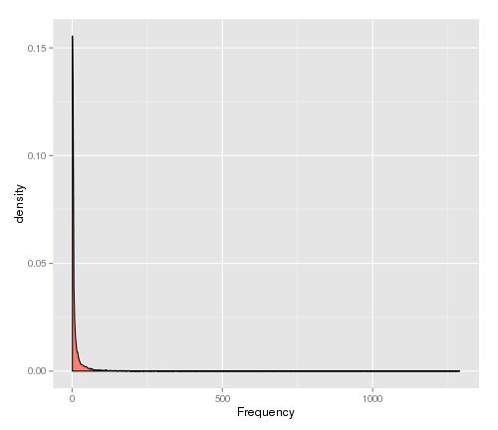
Probability density
Require(ggplot2)
# get the names corresponding to the words
names <- names(v)
# create a data frame for plotting
d <- data.frame(word=names, freq=v)
ggplot(d,aes(freq)) + geom_density(fill="salmon") + xlab("Frequency")

Slide 34
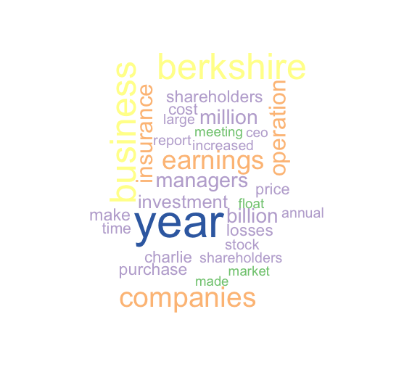
Word cloud
require(wordcloud)
# select the color palette
pal = brewer.pal(5,"Accent")
# generate the cloud based on the 30 most frequent words
wordcloud(d$word, d$freq, min.freq=d$freq[30],colors=pal)

Slide 35
Exercise
Produce a word cloud for the words identified in the prior exercise

Slide 36
Co-occurrence
Co-occurrence measures the frequency with which two words appear together
If two words both appear or neither appears in same document
  Correlation = 1
If two words never appear together in the same document
  Correlation = -1

Slide 37
Co-occurrence
data <- c("word1", "word1 word2","word1 word2 word3","word1 word2 word3 word4","word1 word2 word3 word4 word5")
frame <- data.frame(data)
frame
test <- Corpus(DataframeSource(frame, encoding = "UTF-8"))
tdmTest <- TermDocumentMatrix(test)
findFreqTerms(tdmTest)

Slide 38
Co-occurrence matrix
Note that co-occurrence is at the document level
Document
 | 1 | 2 | 3 | 4 | 5
word1 | 1 | 1 | 1 | 1 | 1
word2 | 0 | 1 | 1 | 1 | 1
word3 | 0 | 0 | 1 | 1 | 1
word4 | 0 | 0 | 0 | 1 | 1
word5 | 0 | 0 | 0 | 0 | 1
> # Correlation between word2 and word3, word4, and word5
> cor(c(0,1,1,1,1),c(0,0,1,1,1))
[1] 0.6123724
> cor(c(0,1,1,1,1),c(0,0,0,1,1))
[1] 0.4082483
> cor(c(0,1,1,1,1),c(0,0,0,0,1))
[1] 0.25

Slide 39
Association
Measuring the association between a corpus and a given term
Compute all correlations between the given term and all terms in the term-document matrix and report those higher than the correlation threshold

Slide 40
Find Association
Computes correlation of columns to get association
# find associations greater than 0.1
findAssocs(tdmTest,"word2",0.1)

Slide 41
Find Association
# compute the associations
findAssocs(tdm, "investment",0.90)
shooting cigarettes eyesight feed moneymarket pinpoint
0.83 0.82 0.82 0.82 0.82 0.82
ringmaster suffice tunnels unnoted
0.82 0.82 0.82 0.82

Slide 42
Exercise
Select a word and compute its association with other words in the Buffett letters corpus
  Adjust the correlation coefficient to get about 10 words

Slide 43
Cluster analysis
Assigning documents to groups based on their similarity
  Google uses clustering for its news site
Map frequent words into a multi-dimensional space
Multiple methods of clustering
How many clusters?

Slide 44
Clustering
The terms in a document are mapped into n-dimensional space
  Frequency is used as a weight
Similar documents are close together
  Several methods of measuring distance

Slide 45
Cluster analysis
require(ggplot2)
require(ggdendro)
# name the columns for the letter's year
colnames(tdm) <- 1998:2012
# Remove sparse terms
tdm1 <- removeSparseTerms(tdm, 0.5)
# transpose the matrix
tdmtranspose <- t(tdm1)
cluster = hclust(dist(tdmtranspose),method='centroid')
# get the clustering data
dend <- as.dendrogram(cluster)
# plot the tree
ggdendrogram(dend,rotate=T)

Slide 46
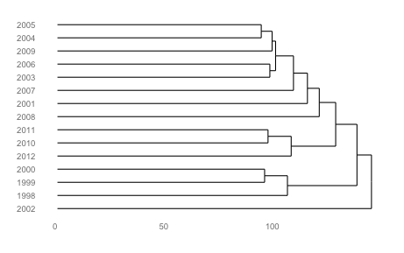
Cluster analysis

Slide 47
Exercise
Review the documentation of the hclust function in the stats package and try one or two other clustering techniques

Slide 48
Topic modeling
Goes beyond the independent bag-of-words approach to consider the order of words
Topics are latent (hidden)
The number of topics is fixed in advance
Input is a document term matrix

Slide 49
Topic modeling
Some methods
  Latent Dirichlet allocation (LDA)
  Correlated topics model (CTM)

Slide 50
Identifying topics
Words that occur frequently in many documents are not good differentiators
The weighted term frequency inverse document frequency (tf-idf) determines discriminators
Based on
  term frequency (tf)
  inverse document frequency (idf)

Slide 51
Inverse document frequency (idf)
idf measures the frequency of a term across documents
If a term occurs in every document
  idf = 0
If a term occurs in only one document out of 15
  idf = 3.91
m = number of documents
df_{t} = number of documents with term t

Slide 52
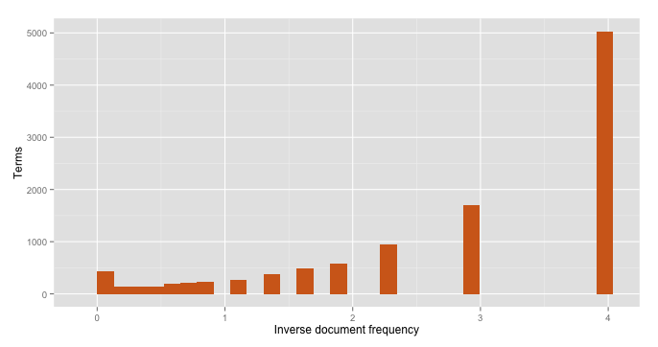
Inverse document frequency (idf)
More than 5,000 terms in only in one document
Less than 500 terms in all documents

Slide 53
Term frequency inverse document frequency (tf-idf)
Multiply a term’s frequency (tf) by its inverse document frequency (idf)
tf_{td} = frequency of term t in document d

Slide 54
Topic modeling
Pre-process in the usual fashion to create a document-term matrix
Reduce the document-term matrix to include terms occurring in a minimum number of documents

Slide 55
Topic modeling
Compute tf-idf
Use median of td-idf
require(topicmodels)
require(slam)
dim(tdm)
# calculate tf-idf for each term
tfidf <- tapply(dtm$v/row_sums(dtm)[dtm$i], dtm$j, mean) * log2(nDocs(dtm)/col_sums(dtm > 0))
# report dimensions (terms)
dim(tfidf)
# report median to use as cut-off point
median(tfidf)

Slide 56
Topic modeling
Omit terms with a low frequency and those occurring in many documents
# select columns with tfidf > median
dtm <- dtm[, tfidf >= median(tfidf)]
#select rows with rowsum > 0
dtm <- dtm[row_sums(dtm) > 0,]
# report reduced dimension
dim(dtm)

Slide 57
Topic modeling
Because the number of topics is in general not known, models with several different numbers of topics are fitted and the optimal number is determined in a data-driven way
Need to estimate some parameters
  alpha = 50/k where k is number of topics
  delta = 0.1

Slide 58
Topic modeling
# set number of topics to extract
k <- 5
SEED <- 2010
# try multiple methods – takes a while for a big corpus
TM <- list(VEM = LDA(dtm, k = k, control = list(seed = SEED)),
VEM_fixed = LDA(dtm, k = k, control = list(estimate.alpha = FALSE, seed = SEED)),
Gibbs = LDA(dtm, k = k, method = "Gibbs", control = list(seed = SEED, burnin = 1000, thin = 100, iter = 1000)), CTM = CTM(dtm, k = k,control = list(seed = SEED, var = list(tol = 10^-3), em = list(tol = 10^-3))))

Slide 59
Examine results for meaningfulness
> topics(TM[["VEM"]], 1)
1 2 3 4 5 6 7 8 9 10 11 12 13 14 15
4 4 4 2 2 5 4 4 4 3 3 5 1 5 5
> terms(TM[["VEM"]], 5)
Topic 1 Topic 2 Topic 3 Topic 4 Topic 5
[1,] "thats" "independent" "borrowers" "clayton" "clayton"
[2,] "bnsf" "audit" "clayton" "eja" "bnsf"
[3,] "cant" "contributions" "housing" "contributions" "housing"
[4,] "blackscholes" "reserves" "bhac" "merger" "papers"
[5,] "railroad" "committee" "derivative" "reserves" "marmon"

Slide 60
Named Entity Recognition (NER)
Identifying some or all mentions of people, places, organizations, time and numbers
Organization
Date
The Olympics were in London in 2012.
Place
The <organization>Olympics</organization> were in <place>London</place> in <date>2012</date>.

Slide 61
Rules-based approach
Appropriate for well-understood domains
Requires maintenance
Language dependent

Slide 62
Statistical classifiers
Look at each word in a sentence and decide
  Start of a named-entity
  Continuation of an already identified named-entity
  Not part of a named-entity
Identify type of named-entity
Need to train on a collection of human-annotated text

Slide 63
Machine learning
Annotation is time-consuming but does not require a high-level of skill
The classifier needs to be trained on approximately 30,000 words
A well-trained system is usually capable of correctly recognizing entities with 90% accuracy

Slide 64
OpenNLP
Comes with an NER tool
Recognizes
  People
  Locations
  Organizations
  Dates
  Times
  Percentages
  Money

Slide 65
OpenNLP
The quality of an NER system is dependent on the corpus used for training
For some domains, you might need to train a model
OpenNLP uses
http://www-nlpir.nist.gov/related_projects/muc/proceedings/muc_7_toc.html

Slide 66
NER
Mostly implemented with Java code
R implementation is not cross platform
KNIME offers a GUI “Lego” kit
  Output is limited
  Documentation is limited

Slide 67
KNIME
KNIME (Konstanz Information Miner)
General purpose data management and analysis package

Slide 68
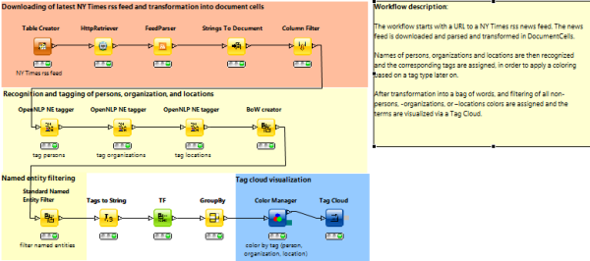
KNIME NER
http://tech.knime.org/files/009004_nytimesrssfeedtagcloud.zip

Slide 69
Further developments
Document summarization
Relationship extraction
  Linkage to other documents
Sentiment analysis
  Beyond the naïve
Cross-language information retrieval
  Chinese speaker querying English documents and getting a translation of the search and selected documents

Slide 70
Conclusion
Text mining is a mix of science and art because natural text is often imprecise and ambiguous
Manage your clients’ expectations
Text mining is a work in progress so continually scan for new developments

