Slide 1
SQL
The questing beast
Sir Thomas Mallory

Slide 2
SQL
A standard
  ANSI
  ISO
SQL skills are in demand
Developed by IBM
Most data management systems have adopted an SQL style language to query data.

Slide 3
SQL
A complete database language
Data definition
  Definition of tables and views
Data manipulation
  Specifying queries
    SELECT
  Maintaining a database
    INSERT
    UPDATE
    DELETE

Slide 4
SQL
Not a complete programming language
Use in conjunction with a complete programming language
  e.g., Java, C#, Python, R
  Embedded SQL

Slide 5
Data definition
Table, views, and indexes can be defined while the system is operational
Base table
  An autonomous, named table
CREATE TABLE

Slide 6
Constraints
Primary key
CONSTRAINT pk_stock PRIMARY KEY(stkcode);
Foreign key
CONSTRAINT fk_stock_nation
FOREIGN KEY(natcode) REFERENCES nation(natcode);
Unique
CONSTRAINT unq_stock_stkname UNIQUE(stkname);

Slide 7
Check constraint – table & column
Table
CREATE TABLE item (
costPrice DECIMAL(9,2),
sellPrice DECIMAL(9,2),
CONSTRAINT profit_check CHECK (sellPrice > costPrice));
Column
CREATE TABLE item (
category CHAR(1) CONSTRAINT category_constraint
CHECK (category IN ('B', 'L', 'S')));

Slide 8
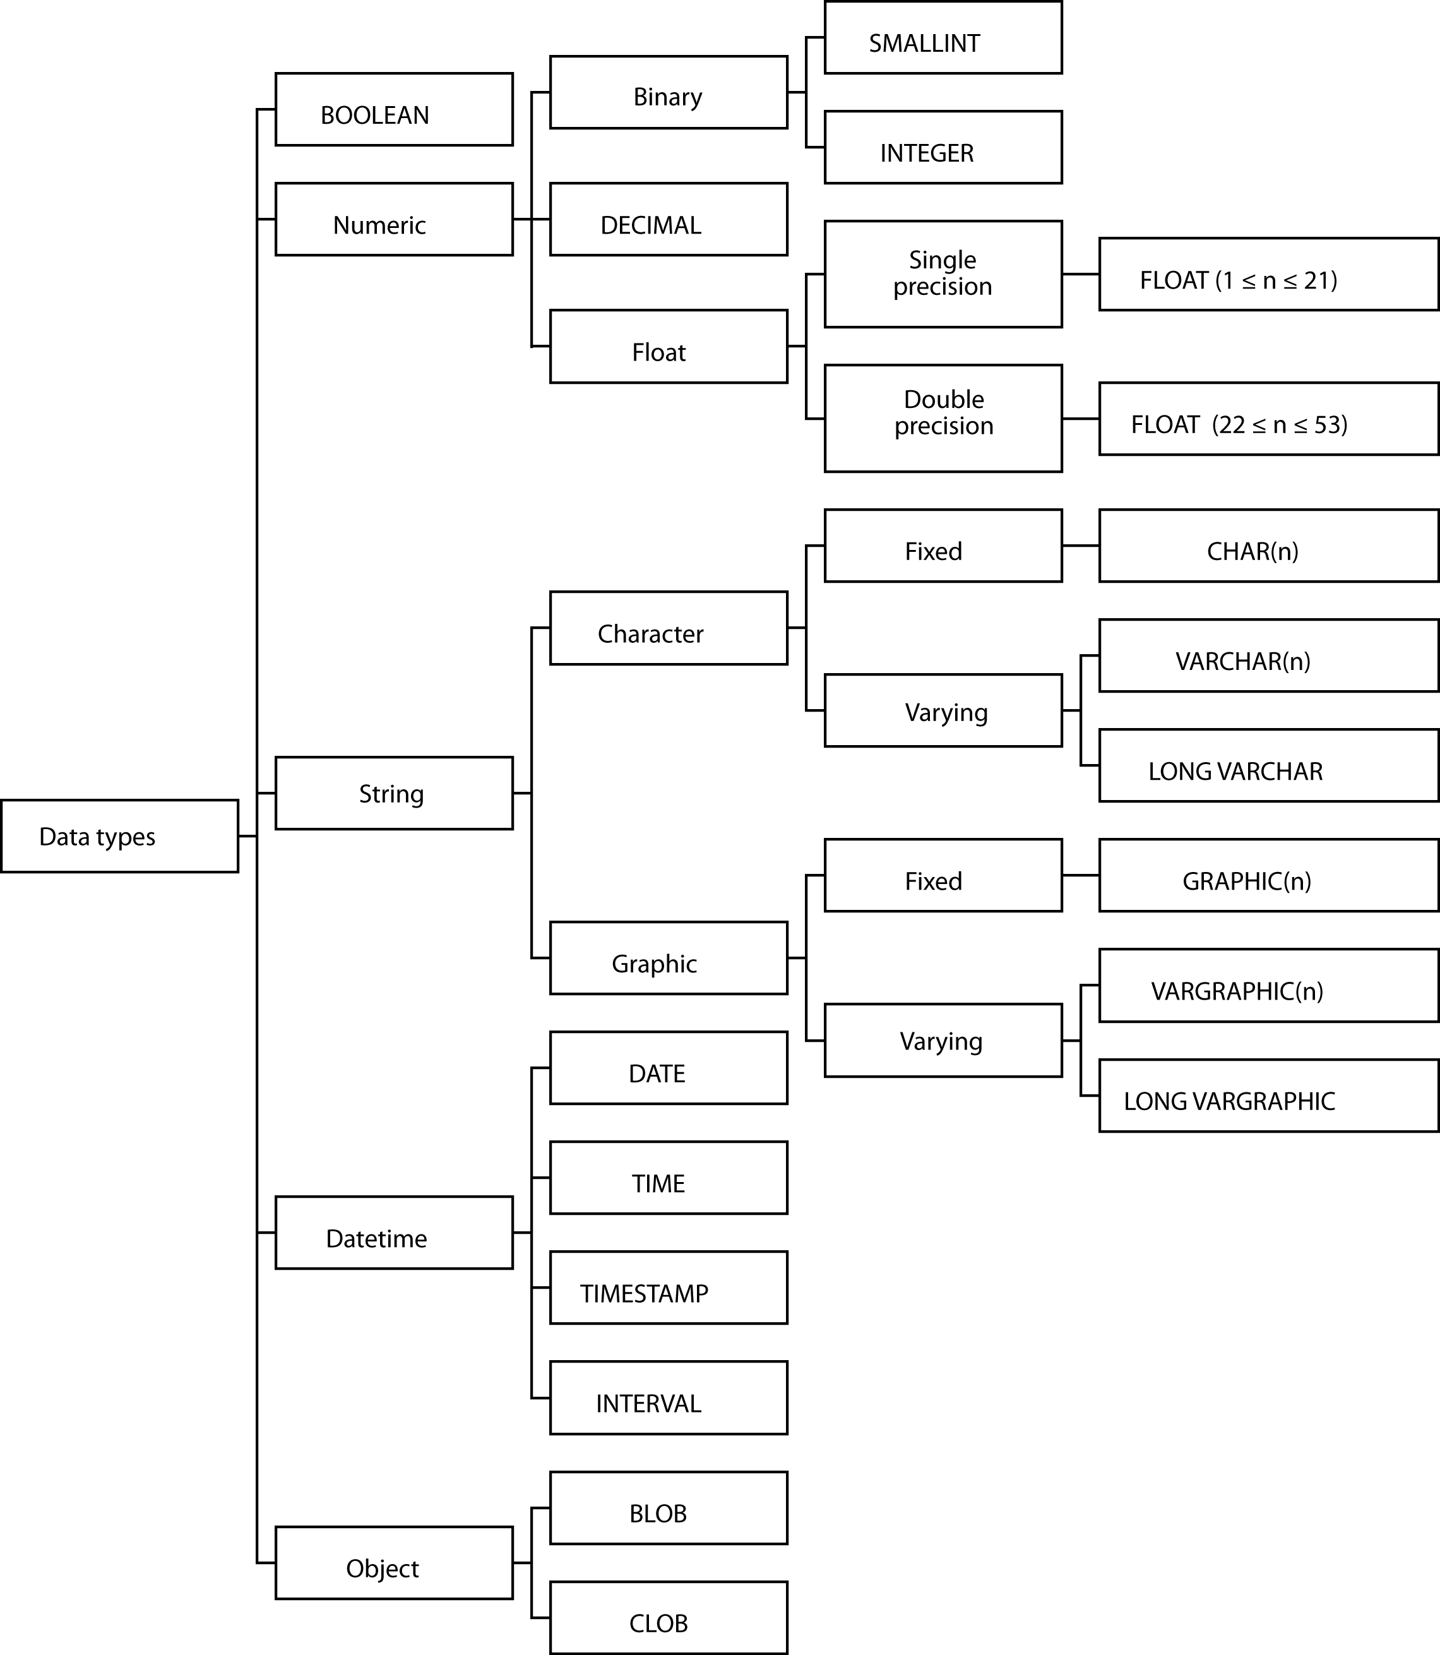
Data types

Slide 9
Data types
BOOLEAN
INTEGER
  31 binary digits
SMALLINT
  15 binary digits
FLOAT
  Scientific work
DECIMAL
  Commercial applications
CHAR and VARCHAR
  Character strings
DATE, TIME, TIMESTAMP, and INTERVAL
BLOB and CLOB
Check the manual for full details

Slide 10
Formatting
Number
  FORMAT(x,d) formats the number x with d decimal places with commas
  SELECT FORMAT(amount,2) FROM Payments;
Date
  DATE_FORMAT (date, format) provides a flexible way of reporting dates
  SELECT DATE_FORMAT(orderDate, '%W, %M %Y') from Orders;
  SELECT DATE_FORMAT(orderDate, '%Y-%m-%d') from Orders;
Check the manual for full details

Slide 11
Exercise
Using the ClassicModels database, report the total value of payments for each customer to the nearest dollar and list in descending value
When you use format you create a string, but you often want to sort on the numeric value of the formatted field. How do you handle this?

Slide 12
Collation sequence
Defines how to sort individual characters in a particular language
English
  A B C … X Y Z
Norwegian
  A B C … X Y Z Æ Ø Å

Slide 13
Collation sequence
Can specify a collation sequence at the database, table, and, column level
Good practice to specify at the database level
CREATE DATABASE ClassicModels
COLLATE latin1_general_cs;
cs indicates case sensitivity

Slide 14
Changing a table
ALTER TABLE
  Adding one new column at a time
  Cannot be used to
    Change a column’s storage format
    Delete an unwanted column
DROP TABLE
  Deletes a table

Slide 15
A view
CREATE VIEW
DROP VIEW

Slide 16
An index
CREATE INDEX
DROP INDEX

Slide 17
Data manipulation statements
INSERT
UPDATE
DELETE
SELECT

Slide 18
INSERT
One row
Multiple rows
With a subquery
  INSERT INTO STOCK
  (stkcode, stkfirm, stkprice, stkdiv, stkpe)
  SELECT code, firm, price, div, pe
  FROM download WHERE code IN
  ('FC','PT','AR','SLG','ILZ','BE','BS','NG',
  'CS','ROF');
The SQL way to copy a table

Slide 19
UPDATE
One row
Multiple rows
All rows

Slide 20
UPDATE: Copy a column
UPDATE table1
SET column1 =
(SELECT column2 FROM table2
WHERE table2.id = table1.id );

Slide 21
DELETE
One row
Multiple rows
All rows
  Not the same as DROP TABLE

Slide 22
Product
All rows of the first table concatenated with all possible rows of the second table
Form the product of stock and nation
  SELECT * FROM stock, nation;

Slide 23
Product
Find the percentage of Australian stocks in the portfolio.
CREATE VIEW austotal (auscount) AS
SELECT COUNT(*) FROM nation JOIN stock
ON nation.natcode = stock.natcode
WHERE natname = 'Australia';
CREATE VIEW total (totalcount) AS
SELECT COUNT(*) FROM stock;
SELECT auscount/totalcount*100
AS percentage FROM austotal, total;
Some implementations might give a result of zero due to use of integer arithmetic. Investigate use of the FLOAT function.
18.75

Slide 24
PRODUCT (alternative)
Find the percentage of Australian stocks in the portfolio.
SELECT FORMAT((SELECT COUNT(*)
FROM nation JOIN stock
ON nation.natcode = stock.natcode
WHERE natname = 'Australia')*100/(SELECT COUNT(*)
FROM stock),2) AS Percentage;
18.75

Slide 25
Join
Join creates a new table from two existing tables by matching on a column common to both tables
Equijoin
  The new table contains two identical columns
  SELECT * FROM stock JOIN nation
  ON stock.natcode = nation.natcode;

Slide 26
Join variations

Slide 27
Inner join
SELECT * FROM stock JOIN nation ON stock.natcode = nation.natcode;
SELECT * FROM stock INNER JOIN nation USING (natcode);
SELECT * FROM stock JOIN nation USING (natcode);
SELECT * FROM stock NATURAL JOIN nation;
  Primary key and foreign key have the same name

Slide 28
Left outer join
An inner join plus those rows from t1 not included in the inner join
  SELECT id, col1, col2 FROM t1 LEFT JOIN t2 USING (id);
t1 |  |  | t2
id | col1 |  | id | col2
1 | a |  | 1 | x
2 | b |  | 3 | y
3 | c |  | 5 | z
id | col1 | col2
1 | a | x
2 | b | null
3 | c | y

Slide 29
Right outer join
An inner join plus those rows from t2 not included in the inner join
SELECT id, col1, col2 FROM t1 RIGHT JOIN t2 USING (id);
t1 |  |  | t2
id | col1 |  | id | col2
1 | a |  | 1 | x
2 | b |  | 3 | y
3 | c |  | 5 | z
id | col1 | col2
1 | a | x
3 | c | y
5 | null | z

Slide 30
Full outer join
An inner join plus those rows from t1 and t2 not included in the inner join
  SELECT id, col1, col2 FROM t1 FULL JOIN t2 USING (id);
t1 |  |  | t2
id | col1 |  | id | col2
1 | a |  | 1 | x
2 | b |  | 3 | y
3 | c |  | 5 | z
id | col1 | col2
1 | a | x
2 | b | null
3 | c | y
5 | null | z
MySQL does not support FULL JOIN.

Slide 31
MySQL: Full outer join
SELECT id, col1, col2 FROM t1 LEFT JOIN t2 USING (id)
UNION
SELECT id, col1, col2 FROM t1 RIGHT JOIN t2 USING (id);

Slide 32
Outer join
Left join example
  List names of all items with details of delivery quantities if any deliveries have been made
  SELECT itemname, delqty FROM qitem
  LEFT JOIN qdel USING (itemname);
Right join example
  List item and quantity sold by department for each sale, including those departments that have not made sales.
  SELECT deptname, itemname, saleqty FROM qsale
  RIGHT JOIN qdept USING (deptname);

Slide 33
Theta join
Join is a product with a condition clause
The condition is not restricted to equality.
A theta join is the general version
Theta is a variable that can take any value from the set [=, <>, >, ≥, <, ≤]

Slide 34
Theta join
Find the names of employees who earn more than their boss
WITH wrk AS (SELECT * FROM emp),
boss AS (SELECT * FROM emp)
SELECT wrk.empfname as Worker, boss.empfname as Boss
FROM wrk JOIN boss
ON wrk.bossno = boss.empno
WHERE wrk.empsalary > boss.empsalary;

Slide 35
Theta join
In an alphabetical list of employees, how many appear before Clare?
WITH A AS (SELECT * FROM emp),
B AS (SELECT * FROM emp)
SELECT count(*)
FROM A JOIN B
ON A.empfname > B.empfname
WHERE A.empfname = "Clare"
This query does not match a foreign key and primary key, but it demonstrates the principle of a theta join
How many after Clare?

Slide 36
Correlated subquery
The inner query is evaluated many times rather than once
  Find those stocks where the quantity is greater than the average for that country.
  SELECT natname, stkfirm, stkqty FROM stock JOIN nation
  ON stock.natcode = nation.natcode
  WHERE stkqty >
  (SELECT AVG(stkqty) FROM stock
  WHERE stock.natcode = nation.natcode);

Slide 37
Correlated subquery
SELECT natname, stkfirm, stkqty FROM stock JOIN nation
ON stock.natcode = nation.natcode
WHERE stkqty >
(SELECT AVG(stkqty) FROM stock
WHERE stock.natcode = nation.natcode);
JOIN
*natname | stkfirm | stkqty
Australia | Indooroopilly Ruby | 56147
Australia | Narembeen Emu | 45619
Australia | Queensland Diamond | 89251
India | Bombay Duck | 167382
United Kingdom | Abyssinian Ruby | 22010
United Kingdom | Burmese Elephant | 154713
United Kingdom | Bolivian Sheep | 231678
United Kingdom | Canadian Sugar | 4716
United Kingdom | Freedonia Copper | 10529
United Kingdom | Indian Lead & Zinc | 6390
United Kingdom | Nigerian Geese | 12323
United Kingdom | Patagonian Tea | 12635
United Kingdom | Royal Ostrich Farms | 1234923
United Kingdom | Sri Lankan Gold | 32868
United States | Georgia Peach | 387333
United States | Minnesota Gold | 816122
Stock
*stkcode | stkfirm | stkprice | stkqty | stkdiv | stkpe | natcode
NE | Narembeen Emu | 12.34 | 45619 | 1.00 | 8 | AUS
IR | Indooroopilly Ruby | 15.92 | 56147 | 0.50 | 20 | AUS
QD | Queensland Diamond | 6.73 | 89251 | 0.50 | 7 | AUS
BD | Bombay Duck | 25.55 | 167382 | 1.00 | 12 | IND
ROF | Royal Ostrich Farms | 33.75 | 1234923 | 3.00 | 6 | UK
CS | Canadian Sugar | 52.78 | 4716 | 2.50 | 15 | UK
FC | Freedonia Copper | 27.50 | 10529 | 1.84 | 16 | UK
BS | Bolivian Sheep | 12.75 | 231678 | 1.78 | 11 | UK
BE | Burmese Elephant | 0.07 | 154713 | 0.01 | 3 | UK
ILZ | Indian Lead & Zinc | 37.75 | 6390 | 3.00 | 12 | UK
SLG | Sri Lankan Gold | 50.37 | 32868 | 2.68 | 16 | UK
AR | Abyssinian Ruby | 31.82 | 22010 | 1.32 | 13 | UK
PT | Patagonian Tea | 55.25 | 12635 | 2.50 | 10 | UK
NG | Nigerian Geese | 35.00 | 12323 | 1.68 | 10 | UK
MG | Minnesota Gold | 53.87 | 816122 | 1.00 | 25 | US
GP | Georgia Peach | 2.35 | 387333 | 0.20 | 5 | US

Slide 38
Correlated subquery
Clue
  The need to compare each row of a table against a function (e.g., average or count) for some rows of a column
Must be used with EXISTS and NOT EXISTS

Slide 39
Exercise
Using the ClassicModels database, write a correlated subquery to determine which employees work in the Paris office

Slide 40
CASE statement
The CASE statement is used to implement a series of conditional clauses
WITH temp AS
(SELECT customerName, COUNT(*) AS orderCount
FROM Orders JOIN Customers
ON Customers.customerNumber = Orders.customerNumber
GROUP BY customerName)
Select customerName, orderCount,
CASE orderCount
WHEN 1 THEN 'One-time customer'
WHEN 2 THEN 'Repeated customer'
WHEN 3 THEN 'Frequent customer'
ELSE 'Loyal customer'
end customerType
FROM temp
ORDER BY customerName;
How would you sort by customer value (e.g., Loyal customer first)

Slide 41
Aggregate functions
COUNT
SUM
AVG
MAX
MIN

Slide 42
SQL Routines
Function
Procedure
Trigger
Improve flexibility, productivity, and enforcement of business rules

Slide 43
SQL function
Similar purpose to built-in functions
CREATE FUNCTION km_to_miles(km REAL)
RETURNS REAL
DETERMINISTIC
RETURN 0.6213712*km;
Use in SQL
SELECT FORMAT(km_to_miles(100),0);
SELECT km_to_miles(distance)from flight;
MySQL defines a deterministic function as one that always produces the same result for the same input parameters

Slide 44
Exercise
Write an SQL function to convert Fahrenheit to Celsius.

Slide 45
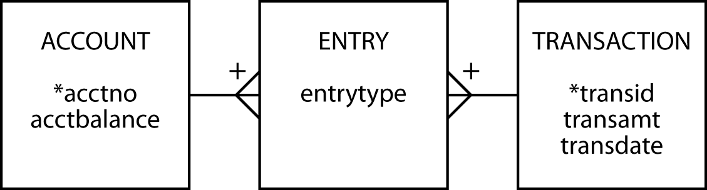
SQL procedure
A stored procedure is SQL code that is dynamically loaded and executed by a CALL statement
Accounting example

Slide 46
SQL procedure
CREATE TABLE account (
acctno INTEGER,
acctbalance DECIMAL(9,2),
primary key (acctno));
CREATE TABLE transaction (
transid INTEGER,
transamt DECIMAL(9,2),
transdate DATE,
PRIMARY KEY(transid));
CREATE TABLE entry (
transid INTEGER,
acctno INTEGER,
entrytype CHAR(2),
PRIMARY KEY(acctno, transid),
CONSTRAINT fk_account FOREIGN KEY(acctno) REFERENCES account(acctno),
CONSTRAINT fk_transaction FOREIGN KEY(transid) REFERENCES transaction(transid));
First create a schema: AccSystem

Slide 47
SQL procedure
DELIMITER //
-- Define the input values
CREATE PROCEDURE transfer (
IN `Credit account` INTEGER,
IN `Debit account` INTEGER,
IN Amount DECIMAL(9,2),
IN `Transaction ID` INTEGER)
LANGUAGE SQL
DETERMINISTIC
BEGIN
-- Save the transaction details
INSERT INTO transaction VALUES (`Transaction ID`, Amount, CURRENT_DATE);
UPDATE account
-- Increase the credit account
SET acctbalance = acctbalance + Amount
WHERE acctno = `Credit account`;
INSERT INTO entry VALUES (`Transaction ID`, `Credit account`, 'cr');
UPDATE account
-- Decrease the debit account
SET acctbalance = acctbalance - Amount
WHERE acctno = `Debit account`;
INSERT INTO entry VALUES (`Transaction ID`, `Debit account`, 'db');
END //
Need to delimit the procedure and SQL commands

Slide 48
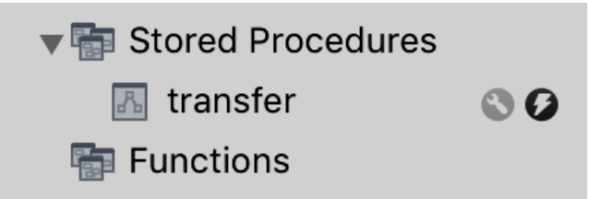
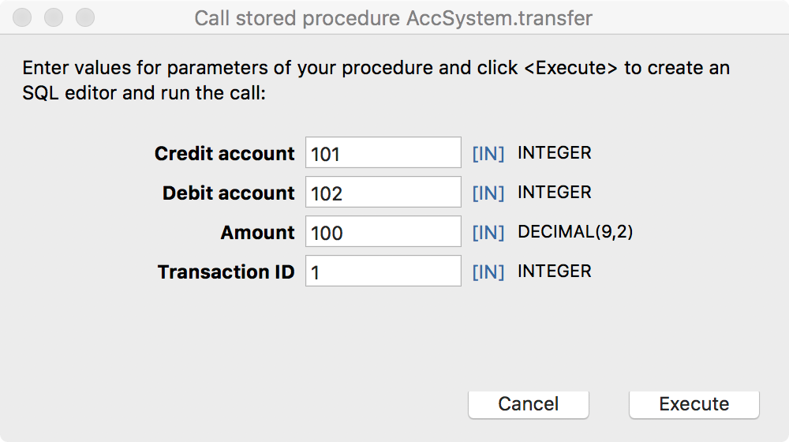
SQL procedure
Click on the stored procedure’s rightmost icon for pop-up entry window

Slide 49
SQL procedure
Example
  Transaction 1 transfers $100 to account 101 (the credit account) from account 102 (the debit account)
  CALL transfer(101,102,100,1);

Slide 50
Trigger
A set of actions set off by an SQL statement that changes the state of the database
  UPDATE
  INSERT
  DELETE

Slide 51
Trigger
Automatically log all updates to a log file
  Create a table for storing log rows
  Create a trigger
CREATE TABLE stock_log (
stkcode CHAR(3),
old_stkprice DECIMAL(6,2),
new_stkprice DECIMAL(6,2),
old_stkqty DECIMAL(8),
new_stkqty DECIMAL(8),
update_stktime TIMESTAMP NOT NULL,
PRIMARY KEY(update_stktime));

Slide 52
Trigger
DELIMITER //
CREATE TRIGGER stock_update
AFTER UPDATE ON stock
FOR EACH ROW BEGIN
INSERT INTO stock_log VALUES
(OLD.stkcode, OLD.stkprice, NEW.stkprice, OLD.stkqty, NEW.stkqty, CURRENT_TIMESTAMP);
END //

Slide 53
Universal Unique Identifier (UUID)
A Universally Unique Identifier (UUID) is a generated number that is globally unique even if generated by two independent programs on different computers
  The probability that a UUID is not unique is close enough to zero to be negligible
Generated from a timestamp (temporal difference) and computer node id (spatial difference)
A UUID value is a 128-bit number
Can be used to create a primary key in a distributed environment
SELECT UUID() AS UUID_Value

Slide 54
Nulls
Don’t confuse null with blank or zero
Multiple meanings
  Unknown data
  Inapplicable data
  No value supplied
  Value undefined
Creates confusion because the user must make an inference
One expert advises that NOT NULL be used for all columns to avoid confusion
Notes:
How might you indicate a column is NULL?
DB2 has a hidden one-character column preceding each column that is used to indicate whether a column is NULL.

Slide 55
Security
Data are a valuable resource
Access should be controlled
SQL security procedures
  CREATE VIEW
  Authorization commands

Slide 56
Authorization
Based on privilege concept
You cannot execute an operation without the appropriate privilege
DBA has all privileges

Slide 57
GRANT
Defines a user’s privileges
Format
  GRANT privileges ON object TO users
  [WITH GRANT OPTION];
An object is a base table or view
The keyword privilege can be ALL PRIVILEGES or chosen from
  SELECT
  UPDATE
  DELETE
  INSERT
Privileges can be granted to everybody using the keyword PUBLIC or to selected users by specifying their user identifier

Slide 58
GRANT
The UPDATE privilege can specify particular columns in a base table or view
Some privileges apply only to base tables
  ALTER
  INDEX
WITH GRANT OPTION
  Permits a user to pass privileges to another user

Slide 59
Using GRANT
Give Alice all rights to the STOCK table.
GRANT ALL PRIVILEGES ON stock TO alice;
Permit the accounting staff, Todd and Nancy, to update the price of a stock.
GRANT UPDATE (stkprice) ON stock TO todd, nancy;
Give all staff the privilege to select rows from ITEM.
GRANT SELECT ON item TO PUBLIC;
Give Alice all rights to view STK.
GRANT SELECT, UPDATE, DELETE, INSERT ON stk
TO alice;
Notes:
Why wasn’t ALL PRIVILEGES used?
Since STK is a view, ALICE cannot be granted ALL PRIVILEGES since this would include ALTER and INDEX privileges for a view

Slide 60
REVOKE
Removes privileges
Format
  REVOKE privileges ON object FROM users;
Cascading REVOKE
  Reverses use of the WITH GRANT OPTION
  When a user’s privileges are revoked, all users whose privileges were established using WITH GRANT OPTION are also revoked

Slide 61
Using REVOKE
Remove Sophie's ability to select from ITEM.
REVOKE SELECT ON item FROM sophie;
Nancy is no longer permitted to update stock prices.
REVOKE UPDATE ON stock FROM nancy;
Notes:
A revoked UPDATE is not column specific

Slide 62
Injection attack
An injection attack takes advantage of parameterized queries to make unauthorized queries
The attacker creates or alters existing SQL commands
The application takes the attacker’s input and combines it to build an unintended SQL query

Slide 63
Avoidance
Limit the authorization of the connection
  SELECT only
Check the input is of the expected data type
Use parameterized queries

Slide 64
The catalog
A relational database containing definitions of base tables, view, etc.
Can be interrogated using SQL
Called systems tables rather than base tables
MySQL
  Information_schema

Slide 65
Interrogating the catalog
Find the table(s) with the most rows.
SELECT TABLE_NAME, TABLE_ROWS
FROM Information_schema.TABLES
WHERE TABLE_ROWS = (SELECT MAX(TABLE_ROWS)
FROM Information_schema.TABLES);
What columns in what tables store dates?
SELECT TABLE_NAME, COLUMN_NAME
FROM Information_schema.COLUMNS
WHERE DATA_TYPE = 'date'
ORDER BY TABLE_NAME, COLUMN_NAME;
MySQL catalog queries

Slide 66
Natural language processing
English | SQL generated for MS Access
Which movies have won best foreign film sorted by year? | SELECT DISTINCT [Year], [Title] FROM [Awards] INNER JOIN [Movies] ON [Movies].[Movie ID] = [Awards].[Movie ID] WHERE [Categorie] = 'Best Foreign Film' and [Status]='Winner' ORDER BY [Year] ASC

Slide 67
Open Database Connectivity (ODBC)
Application
ODBC API
ODBC driver manager
Service provide API
Driver for DBMS server
DBMS server

Slide 68
Embedded SQL
SQL is not a stand-alone programming language
SQL statements can be embedded in application programs
The incompatibility between the table processing of SQL and record-at-time processing in procedural languages is addressed using a cursor

Slide 69
LibreOffice/MS Access
Strengths
  Interface
  SQL DML
  Referential integrity
  Fast execution
  Views (queries)
  Updateable views
Weaknesses
  No support for GRANT and REVOKE
  Domains
  No support for COMMIT and ROLLBACK
  Limited concurrency control

Slide 70
User-defined data types
May be used in the same way as built-in data types
A UDT is defined by
  Specifying a set of declarations of the stored attributes that represent the value of the UDT
  The operations that define the equality and ordering relationships of the UDT
  The operations and derived attributes that represent the behavior of the UDT

Slide 71
The future of SQL
One of the more successful standardization stories
Highly portable
  Across operating systems
  Across applications and organizations
Mainstay of transaction processing systems for now and the immediate future

Slide 72
Key points
SQL routines
  Function
  Procedure
  Triggers
Security
  GRANT
  REVOKE
Connectivity
Embedded SQL

