Slide 1
The One-to-Many Relationship
Cow of many-well milked and badly fed
Spanish proverb

Slide 2
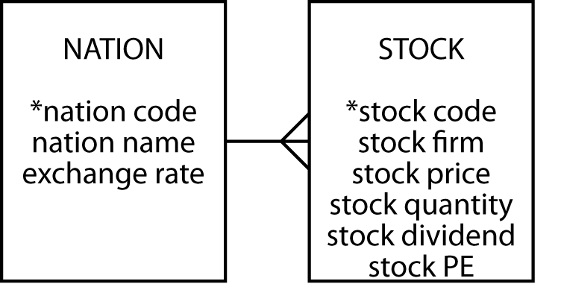
The one-to-many relationship
Entities are related to other entities
A 1:m relationship

Slide 3
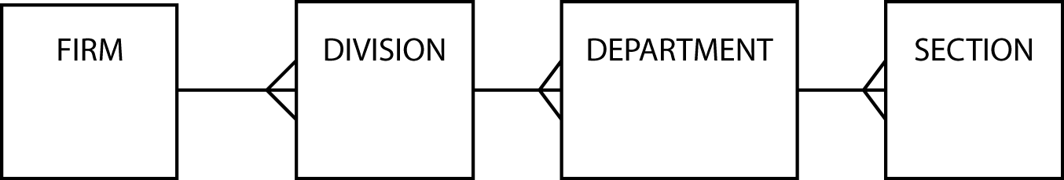
Hierarchical relationships
Occur frequently
Multiple 1:m relationships

Slide 4
STOCK with additional columns
stock
*stkcode | stkfirm | stkprice | stkqty | stkdiv | stkpe | natname | exchrate
FC | Freedonia Copper | 27.50 | 10529 | 1.84 | 16 | United Kingdom | 1.00
PT | Patagonian Tea | 55.25 | 12635 | 2.50 | 10 | United Kingdom | 1.00
AR | Abyssinian Ruby | 31.82 | 22010 | 1.32 | 13 | United Kingdom | 1.00
SLG | Sri Lankan Gold | 50.37 | 32868 | 2.68 | 16 | United Kingdom | 1.00
ILZ | Indian Lead &Zinc | 37.75 | 6390 | 3.00 | 12 | United Kingdom | 1.00
BE | Burmese Elephant | .07 | 154713 | 0.01 | 3 | United Kingdom | 1.00
BS | Bolivian Sheep | 12.75 | 231678 | 1.78 | 11 | United Kingdom | 1.00
NG | Nigerian Geese | 35.00 | 12323 | 1.68 | 10 | United Kingdom | 1.00
CS | Canadian Sugar | 52.78 | 4716 | 2.50 | 15 | United Kingdom | 1.00
ROF | Royal Ostrich Farms | 33.75 | 1234923 | 3.00 | 6 | United Kingdom | 1.00
MG | Minnesota Gold | 53.87 | 816122 | 1.00 | 25 | USA | 0.67
GP | Georgia Peach | 2.35 | 387333 | .20 | 5 | USA | 0.67
NE | Narembeen Emu | 12.34 | 45619 | 1.00 | 8 | Australia | 0.46
QD | Queensland Diamond | 6.73 | 89251 | .50 | 7 | Australia | 0.46
IR | Indooroopilly Ruby | 15.92 | 56147 | .50 | 20 | Australia | 0.46
BD | Bombay Duck | 25.55 | 167382 | 1.00 | 12 | India | 0.0228

Slide 5
Create another entity to avoid update anomalies
Insert
Delete
Update

Slide 6
Mapping to a relational database
Each entity becomes a table
The entity name becomes the table name
Each attribute becomes a column
Add a column to the table at the many end of a 1:m relationship
Put the identifier of the one end in the added column

Slide 7
NATION and STOCK
nation
*natcode | natname | exchrate
UK | United Kingdom | 1.00
USA | United States | 0.67
AUS | Australia | 0.46
IND | India | 0.0228
stock
*stkcode | stkfirm | stkprice | stkqty | stkdiv | stkpe | natcode
FC | Freedonia Copper | 27.50 | 10529 | 1.84 | 16 | UK
PT | Patagonian Tea | 55.25 | 12635 | 2.50 | 10 | UK
AR | Abyssinian Ruby | 31.82 | 22010 | 1.32 | 13 | UK
SLG | Sri Lankan Gold | 50.37 | 32868 | 2.68 | 16 | UK
ILZ | Indian Lead &Zinc | 37.75 | 6390 | 3.00 | 12 | UK
BE | Burmese Elephant | .07 | 154713 | 0.01 | 3 | UK
BS | Bolivian Sheep | 12.75 | 231678 | 1.78 | 11 | UK
NG | Nigerian Geese | 35.00 | 12323 | 1.68 | 10 | UK
CS | Canadian Sugar | 52.78 | 4716 | 2.50 | 15 | UK
ROF | Royal Ostrich Farms | 33.75 | 1234923 | 3.00 | 6 | UK
MG | Minnesota Gold | 53.87 | 816122 | 1.00 | 25 | USA
GP | Georgia Peach | 2.35 | 387333 | .20 | 5 | USA
NE | Narembeen Emu | 12.34 | 45619 | 1.00 | 8 | AUS
QD | Queensland Diamond | 6.73 | 89251 | .50 | 7 | AUS
IR | Indooroopilly Ruby | 15.92 | 56147 | .50 | 20 | AUS
BD | Bombay Duck | 25.55 | 167382 | 1.00 | 12 | IND

Slide 8
Foreign keys
A foreign key is a column that is a primary key of another table
  natcode in stock is a foreign key because natcode is the primary key of nation
Records a 1:m relationship

Slide 9
Referential integrity constraint
For every value of a foreign key there is a primary key with that value
For every value of natcode in stock there is a value of natcode in nation
A primary key must exist before the foreign key can be defined
  Must create the nation before its stocks

Slide 10
Creating the tables
CREATE TABLE nation (
natcode CHAR(3),
natname VARCHAR(20),
exchrate DECIMAL(9,5),
PRIMARY KEY (natcode));
CREATE TABLE stock (
stkcode CHAR(3),
stkfirm VARCHAR(20),
stkprice DECIMAL(6,2),
stkqty DECIMAL(8),
stkdiv DECIMAL(5,2),
stkpe DECIMAL(5),
natcode CHAR(3),
PRIMARY KEY(stkcode),
CONSTRAINT fk_has_nation FOREIGN KEY(natcode)
REFERENCES nation(natcode));

Slide 11
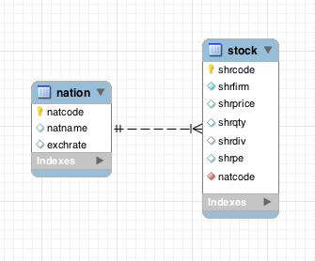
Representing a 1:m relationship in MySQL Workbench
A non-identifying relationship in MySQL Workbench

Slide 12
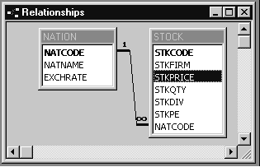
Representing a 1:m relationship in MS Access

Slide 13
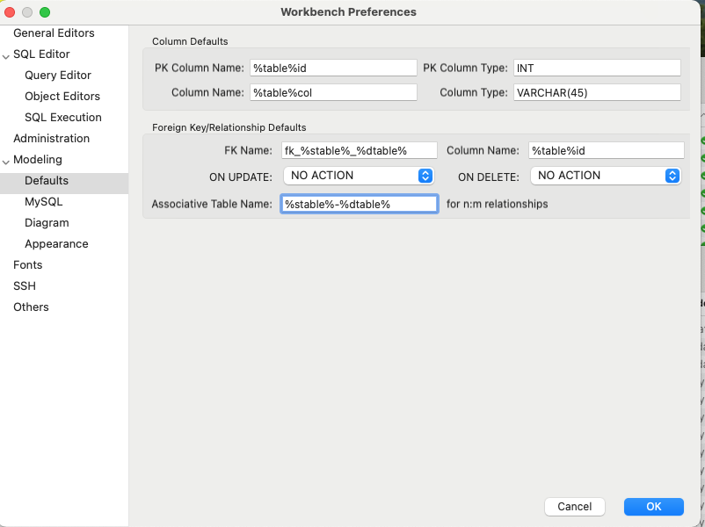
Workbench preferences
Change
Change
Change

Slide 14
Exercise
Develop a data model to keep track of a distance runner’s times over various lengths
Create the database and add 3 rows for each of 2 athletes

Slide 15
Join
Create a new table from two existing tables by matching on a common column
SELECT * FROM stock JOIN nation
ON stock.natcode = nation.natcode;
stkcode | stkfirm | stkprice | stkqty | stkdiv | stkpe | natcode | natcode | natname | exchrate
NE | Narembeen Emu | 12.34 | 45619 | 1.00 | 8 | AUS | AUS | Australia | 0.46000
IR | Indooroopilly Ruby | 15.92 | 56147 | 0.50 | 20 | AUS | AUS | Australia | 0.46000
QD | Queensland Diamond | 6.73 | 89251 | 0.50 | 7 | AUS | AUS | Australia | 0.46000
BD | Bombay Duck | 25.55 | 167382 | 1.00 | 12 | IND | IND | India | 0.02280
ROF | Royal Ostrich Farms | 33.75 | 1234923 | 3.00 | 6 | UK | UK | United Kingdom | 1.00000
CS | Canadian Sugar | 52.78 | 4716 | 2.50 | 15 | UK | UK | United Kingdom | 1.00000
FC | Freedonia Copper | 27.50 | 10529 | 1.84 | 16 | UK | UK | United Kingdom | 1.00000
BS | Bolivian Sheep | 12.75 | 231678 | 1.78 | 11 | UK | UK | United Kingdom | 1.00000
BE | Burmese Elephant | 0.07 | 154713 | 0.01 | 3 | UK | UK | United Kingdom | 1.00000
ILZ | Indian Lead & Zinc | 37.75 | 6390 | 3.00 | 12 | UK | UK | United Kingdom | 1.00000
SLG | Sri Lankan Gold | 50.37 | 32868 | 2.68 | 16 | UK | UK | United Kingdom | 1.00000
AR | Abyssinian Ruby | 31.82 | 22010 | 1.32 | 13 | UK | UK | United Kingdom | 1.00000
PT | Patagonian Tea | 55.25 | 12635 | 2.50 | 10 | UK | UK | United Kingdom | 1.00000
NG | Nigerian Geese | 35.00 | 12323 | 1.68 | 10 | UK | UK | United Kingdom | 1.00000
MG | Minnesota Gold | 53.87 | 816122 | 1.00 | 25 | US | US | United States | 0.67000
GP | Georgia Peach | 2.35 | 387333 | 0.20 | 5 | US | US | United States | 0.67000

Slide 16
Join
Report the value of each stock holding in UK pounds. Sort the report by nation and firm.
SELECT natname, stkfirm, stkprice, stkqty, exchrate,
stkprice*stkqty*exchrate AS stkvalue
FROM stock JOIN nation
ON stock.natcode = nation.natcode
ORDER BY natname, stkfirm;
natname | stkfirm | stkprice | stkqty | exchrate | stkvalue
Australia | Indooroopilly Ruby | 15.92 | 56147 | 0.46000 | 411175.71
Australia | Narembeen Emu | 12.34 | 45619 | 0.46000 | 258951.69
Australia | Queensland Diamond | 6.73 | 89251 | 0.46000 | 276303.25
India | Bombay Duck | 25.55 | 167382 | 0.02280 | 97506.71
United Kingdom | Abyssinian Ruby | 31.82 | 22010 | 1.00000 | 700358.20
United Kingdom | Bolivian Sheep | 12.75 | 231678 | 1.00000 | 2953894.50
United Kingdom | Burmese Elephant | 0.07 | 154713 | 1.00000 | 10829.91
United Kingdom | Canadian Sugar | 52.78 | 4716 | 1.00000 | 248910.48
United Kingdom | Freedonia Copper | 27.50 | 10529 | 1.00000 | 289547.50
United Kingdom | Indian Lead & Zinc | 37.75 | 6390 | 1.00000 | 241222.50
United Kingdom | Nigerian Geese | 35.00 | 12323 | 1.00000 | 431305.00
United Kingdom | Patagonian Tea | 55.25 | 12635 | 1.00000 | 698083.75
United Kingdom | Royal Ostrich Farms | 33.75 | 1234923 | 1.00000 | 41678651.25
United Kingdom | Sri Lankan Gold | 50.37 | 32868 | 1.00000 | 1655561.16
United States | Georgia Peach | 2.35 | 387333 | 0.67000 | 609855.81
United States | Minnesota Gold | 53.87 | 816122 | 0.67000 | 29456209.73

Slide 17
GROUP BY - reporting by groups
Report by nation the total value of stockholdings.
SELECT natname, SUM(stkprice*stkqty*exchrate) AS stkvalue
FROM stock JOIN nation ON stock.natcode = nation.natcode
GROUP BY natname;
natname | stkvalue
Australia | 946430.65
India | 97506.71
United Kingdom | 48908364.25
United States | 30066065.54

Slide 18
HAVING - the WHERE clause of groups
Report the total value of stocks for nations with two or more listed stocks.
SELECT natname, SUM(stkprice*stkqty*exchrate) AS stkvalue
FROM stock JOIN nation ON stock.natcode = nation.natcode
GROUP BY natname
HAVING COUNT(*) >= 2;
natname | stkvalue
Australia | 946430.65
United Kingdom | 48908364.25
United States | 30066065.54

Slide 19
Exercise
Report the total dividend payment for each country that has three or more stocks in the portfolio

Slide 20
Structure of SQL statements

Slide 21
Regular expression
Search for a string not containing specified characters
  [^a-f] means any character not in the set containing a, b, c, d, e, or f
    This means the string 'abcdefg' will be reported because it contains a 'g', which is not in a-f
List the names of nations with non-alphabetic characters in their names
SELECT * FROM nation
WHERE LOWER(natname) REGEXP '[^a-z]'

Slide 22
Regular expression
Search for a string containing a repetition
  {n} means repeat the pattern n times
List the names of firms with a double lower case ‘e’.
SELECT * FROM stock
WHERE stkfirm REGEXP '[e]{2}'

Slide 23
Regular expression
Search for a string containing several different specified strings
  | means alternation (or)
List the names of firms with a double ‘s’ or a double ‘n’.
SELECT * FROM stock
WHERE LOWER(stkfirm)
REGEXP '[s]{2}|[n]{2}'

Slide 24
Regular expression
Search for multiple versions of a string
  [ea] means any character from the set containing e and a
    It will match for ‘e’ or ‘a’
List the names of firms with names that include ‘inia’ or ‘onia’.
SELECT * FROM stock
WHERE LOWER(stkfirm) REGEXP '[io]nia'

Slide 25
Regular expression
Find firms with ‘t’ as the third letter of their name.
SELECT shrfirm FROM share
WHERE LOWER(shrfirm) REGEXP '^(.){2}t';
Find firms not containing an ‘s’ in their name.
SELECT shrfirm FROM share
WHERE LOWER(shrfirm) NOT REGEXP 's';

Slide 26
Regular expression
Search for rows not containing a specified character in any position in given column
  ^[^x]*$ means any character (*) from the first (^) through the last ($) is not x [^x]
List the names of nations without s or S anywhere in their names
SELECT * FROM nation
WHERE LOWER(natname) REGEXP '^[^s]*$'
List the names of nations with s or S somewhere in their names
SELECT * FROM nation
WHERE LOWER(natname) REGEXP '[s]'

Slide 27
regexlib.com
A library of regular expressions
Cheat sheet for creating expressions
Regex Tester

Slide 28
Exercise
Report the names of nations starting with ‘United’

Slide 29
Subqueries
A query nested within another query
Report the names of all Australian stocks.
SELECT stkfirm FROM stock
WHERE natcode IN
(SELECT natcode FROM nation
WHERE natname = 'Australia');
stkfirm
Narembeen Emu
Queensland Diamond
Indooroopilly Ruby

Slide 30
Correlated subquery
Solves the inner query many times
Find those stocks where the quantity is greater than the average for that country.
SELECT natname, stkfirm, stkqty FROM stock JOIN nation
ON stock.natcode = nation.natcode
AND stkqty >
(SELECT AVG(stkqty) FROM stock
WHERE stock.natcode = nation.natcode);
natname | stkfirm | stkqty
Australia | Queensland Diamond | 89251
United Kingdom | Bolivian Sheep | 231678
United Kingdom | Royal Ostrich Farms | 1234923
United States | Minnesota Gold | 816122
Correlated subqueries can be resource intensive

Slide 31
Correlated subquery
SELECT natname, stkfirm, stkqty FROM stock JOIN nation
ON stock.natcode = nation.natcode
WHERE stkqty >
(SELECT AVG(stkqty) FROM stock
WHERE stock.natcode = nation.natcode);
JOIN
*natname | stkfirm | stkqty
Australia | Indooroopilly Ruby | 56147
Australia | Narembeen Emu | 45619
Australia | Queensland Diamond | 89251
India | Bombay Duck | 167382
United Kingdom | Abyssinian Ruby | 22010
United Kingdom | Burmese Elephant | 154713
United Kingdom | Bolivian Sheep | 231678
United Kingdom | Canadian Sugar | 4716
United Kingdom | Freedonia Copper | 10529
United Kingdom | Indian Lead & Zinc | 6390
United Kingdom | Nigerian Geese | 12323
United Kingdom | Patagonian Tea | 12635
United Kingdom | Royal Ostrich Farms | 1234923
United Kingdom | Sri Lankan Gold | 32868
United States | Georgia Peach | 387333
United States | Minnesota Gold | 816122
Stock
*stkcode | stkfirm | stkprice | stkqty | stkdiv | stkpe | natcode
NE | Narembeen Emu | 12.34 | 45619 | 1.00 | 8 | AUS
IR | Indooroopilly Ruby | 15.92 | 56147 | 0.50 | 20 | AUS
QD | Queensland Diamond | 6.73 | 89251 | 0.50 | 7 | AUS
BD | Bombay Duck | 25.55 | 167382 | 1.00 | 12 | IND
ROF | Royal Ostrich Farms | 33.75 | 1234923 | 3.00 | 6 | UK
CS | Canadian Sugar | 52.78 | 4716 | 2.50 | 15 | UK
FC | Freedonia Copper | 27.50 | 10529 | 1.84 | 16 | UK
BS | Bolivian Sheep | 12.75 | 231678 | 1.78 | 11 | UK
BE | Burmese Elephant | 0.07 | 154713 | 0.01 | 3 | UK
ILZ | Indian Lead & Zinc | 37.75 | 6390 | 3.00 | 12 | UK
SLG | Sri Lankan Gold | 50.37 | 32868 | 2.68 | 16 | UK
AR | Abyssinian Ruby | 31.82 | 22010 | 1.32 | 13 | UK
PT | Patagonian Tea | 55.25 | 12635 | 2.50 | 10 | UK
NG | Nigerian Geese | 35.00 | 12323 | 1.68 | 10 | UK
MG | Minnesota Gold | 53.87 | 816122 | 1.00 | 25 | US
GP | Georgia Peach | 2.35 | 387333 | 0.20 | 5 | US

Slide 32
Exercise
Report the country, firm, and stock holding for the maximum quantity of stock held for each country

Slide 33
Views - virtual tables
An imaginary table constructed by the DBMS when required
Only the definition of the view is stored, not the result
CREATE VIEW stkvalue
(nation, firm, price, qty, exchrate, value)
AS SELECT natname, stkfirm, stkprice, stkqty, exchrate,
stkprice*stkqty*exchrate
FROM stock JOIN nation
ON stock.natcode = nation.natcode;
Notes:
Added to MySQL 5.0.1

Slide 34
Views - querying
Query exactly as if a table
SELECT nation, firm, value
FROM stkvalue WHERE value > 100000;
nation | firm | value
United Kingdom | Freedonia Copper | 289547.50
United Kingdom | Patagonian Tea | 698083.75
United Kingdom | Abyssinian Ruby | 700358.20
United Kingdom | Sri Lankan Gold | 1655561.16
United Kingdom | Indian Lead & Zinc | 241222.50
United Kingdom | Bolivian Sheep | 2953894.50
United Kingdom | Nigerian Geese | 431305.00
United Kingdom | Canadian Sugar | 248910.48
United Kingdom | Royal Ostrich Farms | 41678651.25
United States | Minnesota Gold | 29456209.73
United States | Georgia Peach | 609855.80
Australia | Narembeen Emu | 258951.69
Australia | Queensland Diamond | 276303.24
Australia | Indooroopilly Ruby | 411175.71

Slide 35
Why create a view?
Simplify query writing
  Calculated columns
Restrict access to parts of a table

Slide 36
Exercise
Create a view for dividend payment

Slide 37
Summary
New topics
  1:m relationship
  Foreign key
  Correlated subquery
  GROUP BY
  HAVING clause
  View

