Slide 1
Information
Effective information management must begin by thinking about how people use information—not with how people use machines.
Thomas Davenport

Slide 2
Key characteristics of the early 21st century
High-velocity global change
  Changing international relationships
  The emergence of China as an economic power
  Trading blocs
  Globalization and deglobalization of business
  Accelerated digital transformation

Slide 3
Key characteristics of the early 21st century
The emergence of influential information-based organizations
  Apple – iPhone, iPad, App Store, and iTunes
  Google - to organize the world's information and make it universally accessible and useful
  Facebook – social media
  Amazon – online retail and cloud computing
  Alibaba
  Tencent
  Microsoft - Windows and Office
  SAP - enterprise resource planning software

Slide 4
Economies and IS
Economy | Subsistence | Agricultural | Industrial | Service | Sustainable
Question | How to survive? | How to farm? | How to manage resources? | How to create customers? | How to reduce impact?
Dominant issue | Survival
 |  | Production
 |  |  |  | Customer service
 |  |  |  |  | Sustainability
Key information systems | Gesture Speech | Writing Calendar | Accounting ERP Project management | CRM Analytics | Simulation Optimization Design

Slide 5
Exercise
What changes have you observed that indicate a shift in the dominant logic towards sustainability?

Slide 6
Wealth creation
Old wealth | New wealth
Military | Intelligence
Natural resources | Marketing
Population | Global reach
Industry | Education

Slide 7
The information age
Built on sand
  Silicon chips
  Fiber optics
Borderless
  A free flow of:

Slide 8
Eras of information systems
Era | Focus | Period | Technology | Networks
1 | Take information work to the computer | 1950s – mid-1970s | Batch | Few data networks
2 | Take information work to the employee | Mid-1970s – mid-1990s | Host/terminal | Spread of private networks
3 | Take information work to the customer and other stakeholders | Mid-1990s - present | Browser/server | Public networks

Slide 9
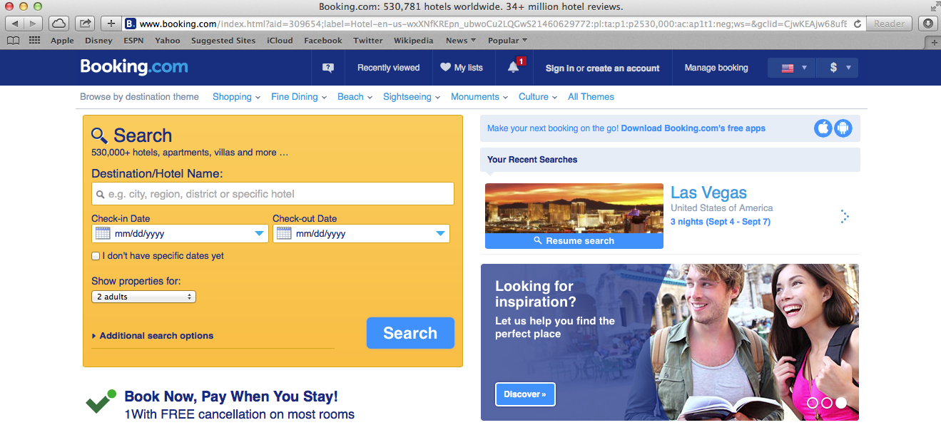
How IS creates value
Who | Every time an organization makes contact with a stakeholder, it has an opportunity to influence, inform, or transfer work to the stakeholder.

Slide 10
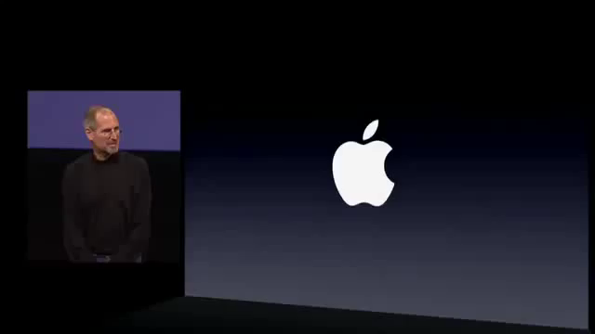
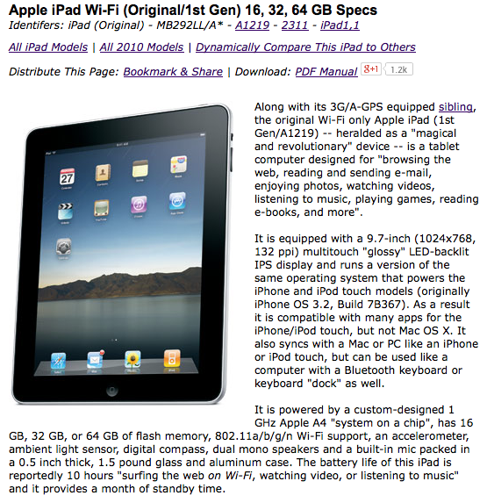
How IS creates value
How | How an organization reaches a stakeholder determines the potential success of the interaction. The higher the bandwidth of the connection, the richer the message, the greater the amount of information that can be conveyed, and the more information work that can be transferred.
Text

Slide 11
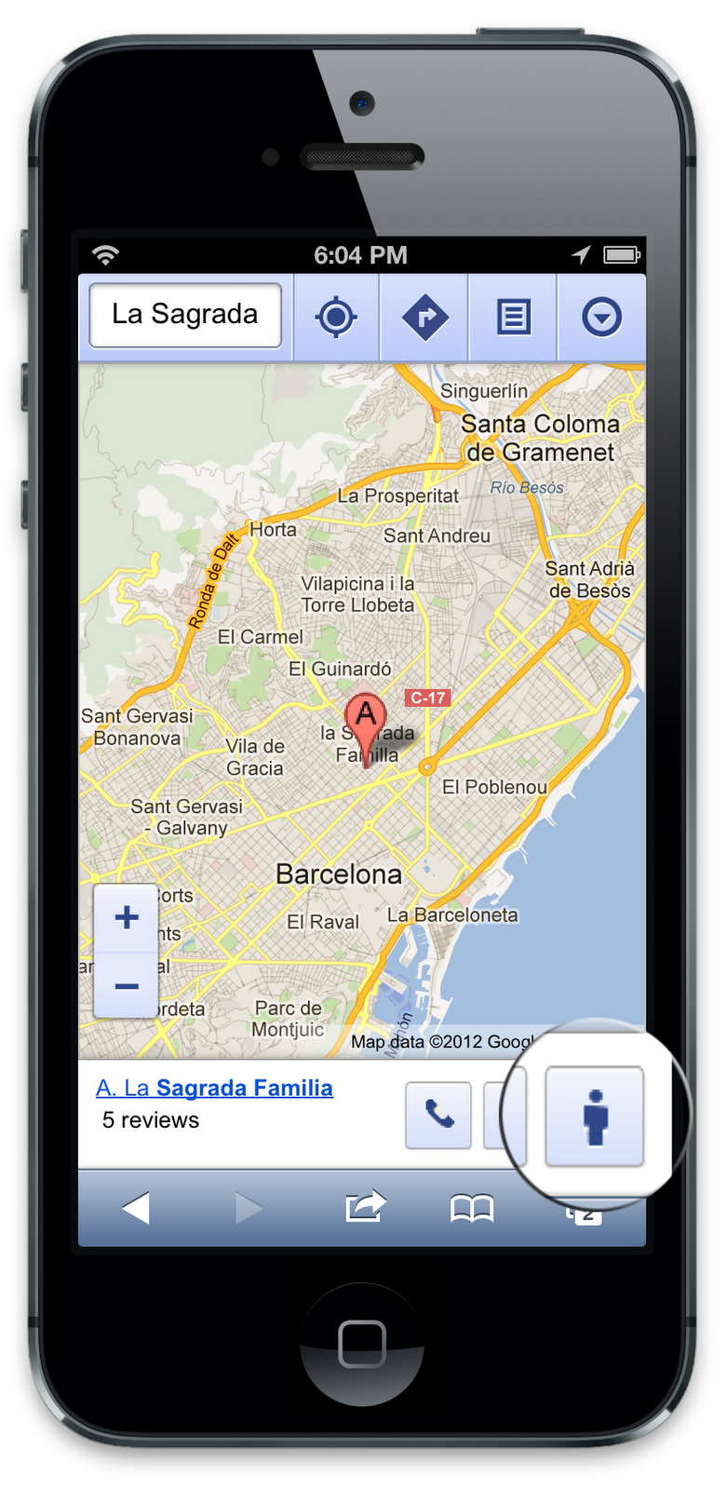
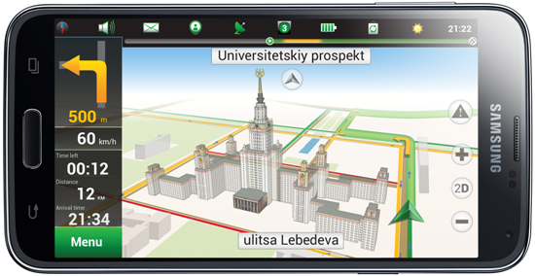
How IS creates value
Where | Value is created when customers get information directly related to their current location and what local services they want to consume.

Slide 12
How IS creates value
When | When a firm delivers a service to a client can greatly determine its value.
Notes:
http://www.copybook.com/airport/simpleway/simpleway-simplevox-airport-announcement-system-gallery/03-simplevox-gate-ui---gate-change_01

Slide 13
Knowledge transfer
Writing and paper enable accumulation and transmission of knowledge
Writing encodes information
Full writing systems are 5,000 years old
Storage medium has progressed from clay to solid state memory
Large scale organizational memory parallels development of large organizations

Slide 14
Information hardness
Minerals | Scale | Data
Talc | 1 | Unidentified source-rumors, gossip, and hearsay
Gypsum | 2 | Identified nonexpert source - opinions, feelings, ideas
Calcite | 3 | Identified expert source - predictions, speculations, forecasts, estimates
Fluorite | 4 | Unsworn testimony - explanations, justifications, assessments, interpretations
Apatite | 5 | Sworn testimony - explanations, justifications, assessments, interpretations
Orthoclase | 6 | Budgets, formal plans
Quartz | 7 | News reports, non-financial data, industry statistics, survey data
Topaz | 8 | Unaudited financial statements, government statistics
Corundum | 9 | Audited financial statements, government statistics
Diamond | 10 | Stock exchange and commodity market data

Slide 15
Information richness
Richest |  |  |  | Leanest
Face-to-face | Telephone | Personal documents (letters and memos) | Impersonal written documents | Numeric documents
Managers seek rich information to resolve equivocality
Information systems typically deliver lean information

Slide 16
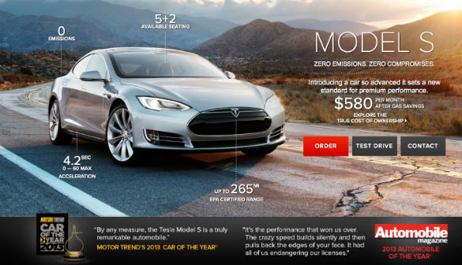
Information classes—content
Class | Description
Content | Quantity, location, and types of items

Slide 17
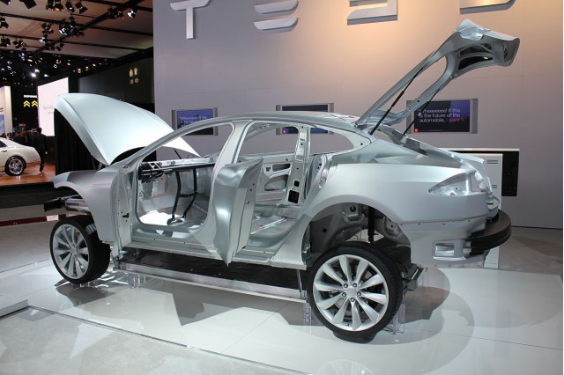
Information classes—form
Class | Description
Form | Shape and composition of an object
What goes into a Tesla?

Slide 18

Information classes—behavior
Class | Description
Behavior | Simulation of a physical object
Computations

Slide 19
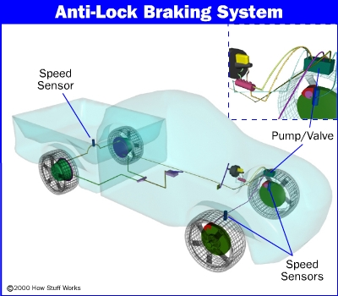
Information classes—action
Class | Description
Action | Creation of action (e.g., industrial robots)

Slide 20
Information & organizational change
Organizations are goal seeking
Information supports goal seeking

Slide 21
Goal setting information
Anchoring and adjusting
Planning
  Demographic trends
  Economic forecasts
Benchmarking
  Competitors’actions

Slide 22
Gap information
Problem identification
  A gap between expectations and performance
Scorekeeping
  Quantitative
  Qualitative
  Use of critical success factors to determine variables to measure

Slide 23
Gap information
Detecting the gap
Problem identification
  Exception reports
Scorekeeping
  Routine reports

Slide 24
Scorekeeping
Orders | Number of current customers
 | Average order size
 | Batting average (orders to calls)
Sales volume | Dollar sales volume
 | Unit sales volume
 | By customer type
 | By product category
 | Translated to market share
 | Quota achieved
Margins | Gross margin
 | Net profit
 | By customer type
 | By product
Customers | Number of new accounts
 | Number of lost accounts
 | Percentage of accounts sold
 | Number of accounts overdue
 | Dollar value of receivables
 | Collection of receivables

Slide 25
Change information
Closing the gap
Problem solution
  Determining the cause(s)
  Identifying alternatives
  Analysis of alternatives

Slide 26
Information as a means of change
Information can be a source of competitive advantage
Information can be built into products and services
Marketing
  Frequent flyer programs
Customer service
  Information systems used to improve service
Empowerment
  Sharing information with employees
  Giving employees freedom to make decisions

Slide 27
Managerial work
Managers implement organizational change
Managerial work is:
  Fragmented
  Brief
  Frequently disturbed
  High velocity
  Action oriented rather than contemplative

Slide 28
Exercise
Identify some products that incorporate information as a differentiating feature

Slide 29
Managerial communication
Preference for oral communication
Extensive use of networks
  Information source
  Way of getting things done
Formal reporting systems
  Infrequently used
  Source of confirming information

Slide 30
Managerial information requirements
Expect relevant information
Expectations continually change

Slide 31
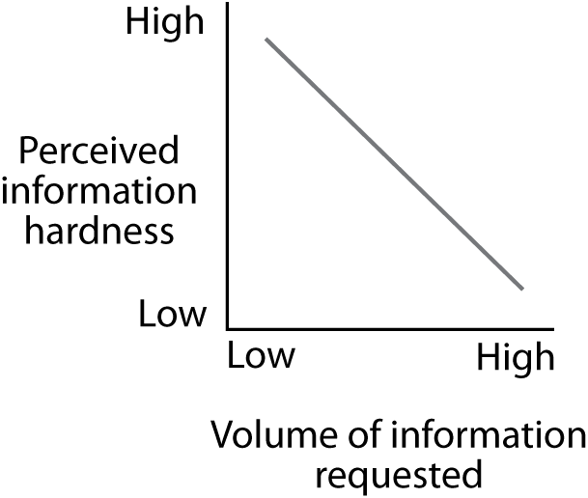
Demand varies with hardness of information
Use multiple sources in search of reliability

Slide 32
Demand varies with responsibilities
Short-term orientation
Medium-term orientation
Long-term orientation
Operational manager
Senior executive

Slide 33
Information satisficing
Decision overload is a problem
Satisficing
  Accept first satisfactory decision
  Collect enough information to make a satisfactory decision
Lowers quality of decision making

Slide 34
Information delivery systems
Organizational memory | Delivery systems
People | Conversation
 | Electronic mail
 | Meeting
 | Report
 | Groupware
Files | Management information system (MIS)
Documents | Office automation system (OAS)
Images | Imaging process system (IPS)
Graphics | Computer aided design (CAD)
 | Geographic information system (GIS)
Voice | Voice mail
 | Voice recording system
Mathematical model | Decision Support System (DSS)
Knowledge | Expert System (ES)
Decisions | Conversation
 | Electronic mail
 | Meeting
 | Report
 | Groupware

Slide 35
Information systems drivers
Drive | Definition | Example
Ubiquity | The drive to access information unconstrained by time and space | Internet, WiFi, 5G, smart watch
Uniqueness | The drive to know precisely the characteristics and location of a person or entity | GPS, SIM, RFID, augmented reality, parallel reality
Unison | The drive for information consistency | Cloud computing, ERP
Universality | The drive to overcome the friction of information systems’ incompatibilities | Smart phone, smart card, ATM card
Notes:
Junglas, I. A., & Watson, R. T. (2006). The U-constructs: Four information drives. Communications of AIS, 17, 569-592.

Slide 36
Organizational memory is fragmented
Notes:
Information System (IS), Content Management System (CMS)

Slide 37
The ideal system

Slide 38
Organizational knowledge
Cognitive knowledge
Advanced skills
System understanding and trained intuition
Self-motivated creativity
Know what
Know how
Know why
Care why

Slide 39
Skills values vs. training expenditure
Value to the firm
Training expenditure
Cognitive skills (know what)
Advanced skills (know how)
System understanding (know why)
Motivated creativity (care why)

Slide 40
Types of knowledge
Explicit
  Codified and transferable
Tacit
  Personal, experience, judgment
  Difficult to codify
  Difficult to transfer

Slide 41
Conclusion
We are about 60 years into the information age
Information-based organizations are the growth engines of advanced economies
Everyone needs information systems skills

