Slide 1
Managing Data
All the value of this company is in its people. If you burned down all our plants, and we just kept our people and our information files, we should soon be as strong as ever.
Thomas Watson, Jr. Former chairman of IBM

Slide 2
Individual data management
Individual internal memory is limited
External memory extends internal memory

Slide 3
Data management
Data management, requires skills in designing, using, and managing organizational memory
Data managers need to see the organization as a social system and to understand data management technology
A socio-technical perspective is a prerequisite for successful data management.
Today's organizations are data-driven, and decisions are increasingly based on insights arising from data analytics.

Slide 4
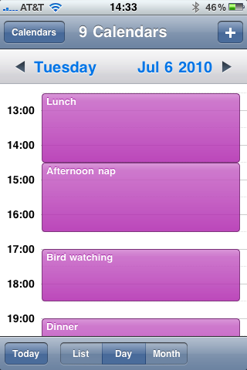
Calendar
Organizing principles
  Set amount of space
  Ordering
  Rapid access

Slide 5
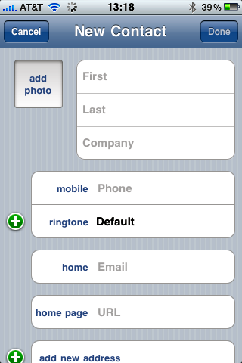
Address book
Organizing principles
  Pre-formatted storage space
  Ordering
  Rapid access

Slide 6
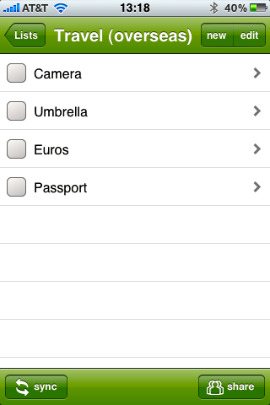
To do list
Organizing principles
  Structure
  Rapid scan support

Slide 7
Comparison of data management systems
Internal
  Small
  Fast for limited retrieval
  Convenient
External
  Large
  Slow for limited retrieval
    Overhead of using a device
  Need to have handy
Much smaller creatures than humans could not develop the complexity necessary for intelligence; much larger ones would be limited by the time it takes information to travel across their brains
Notes:
… the physical size of human beings is roughly midway on the logarithmic scale between the so-called Planck lengthﾑthe smallest meaningful increment of distance, about 10 to the minus 33 centimeters, and the distance to the edge of the visible universe, the largest meaningful distance, about 10 to the 28 centimeters. Much smaller creatures than we are could not develop the complexity necessary for intelligence; much larger ones would be limited by the time it takes information to travel across their brains. http://www.smithsonianmagazine.com/issues/2006/july/cosmos.php

Slide 8
Organizational data management
Organizations, like people, need to remember many things
Deciding where and how to store data frequently involves a trade-off
Organizational data are used by a variety of information systems

Slide 9
Types of information systems
Type of IS | System's purpose
TPS | Transaction processing system: Collects and stores data from routine transactions
MIS | Management information system: Converts data from a TPS into information for planning, controlling, and managing an organization
DSS | Decision support system: Supports managerial decision making by providing models for processing and analysing data
EIS | Executive information system: Provides senior management with information necessary to monitor organizational performance, and develop and implement strategies
OLAP | Online analytical processing: Presents a multidimensional, logical view of data
Data mining | Uses statistical analysis and artificial intelligence techniques to identify hidden relationships in data
BI | Business intelligence: Systems for gathering, storing, analyzing, and accessing data to improve decision-making

Slide 10
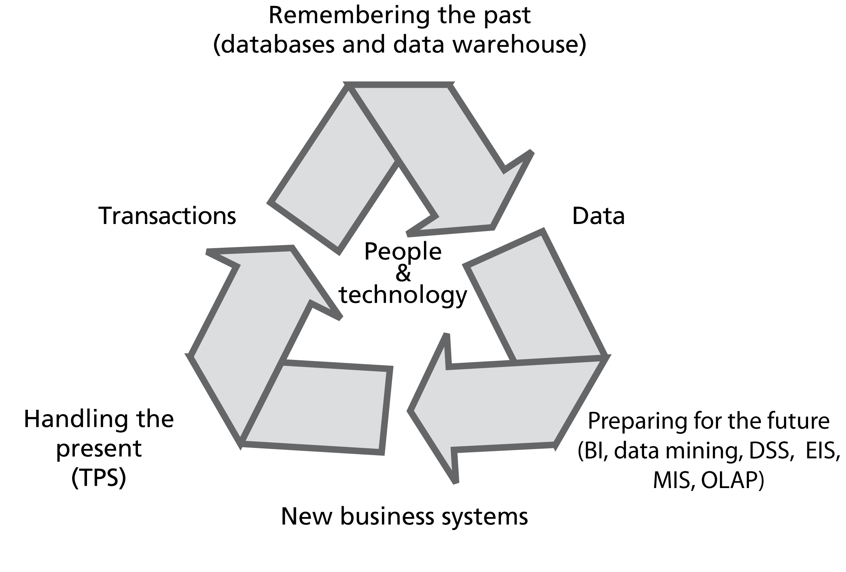
The information systems cycle

Slide 11
Fundamental systems
System | Focus | Examples
Engagement | Coordination | Email
Production | Create | Assembly line
Framing | Influence/Reputation | Facebook
Record | Remember | Database
Inquiry | Discover | SQL

Slide 12
Desirable attributes of a data management system
Shareable
Transportable
Secure
Accurate
Timely
Relevant

Slide 13
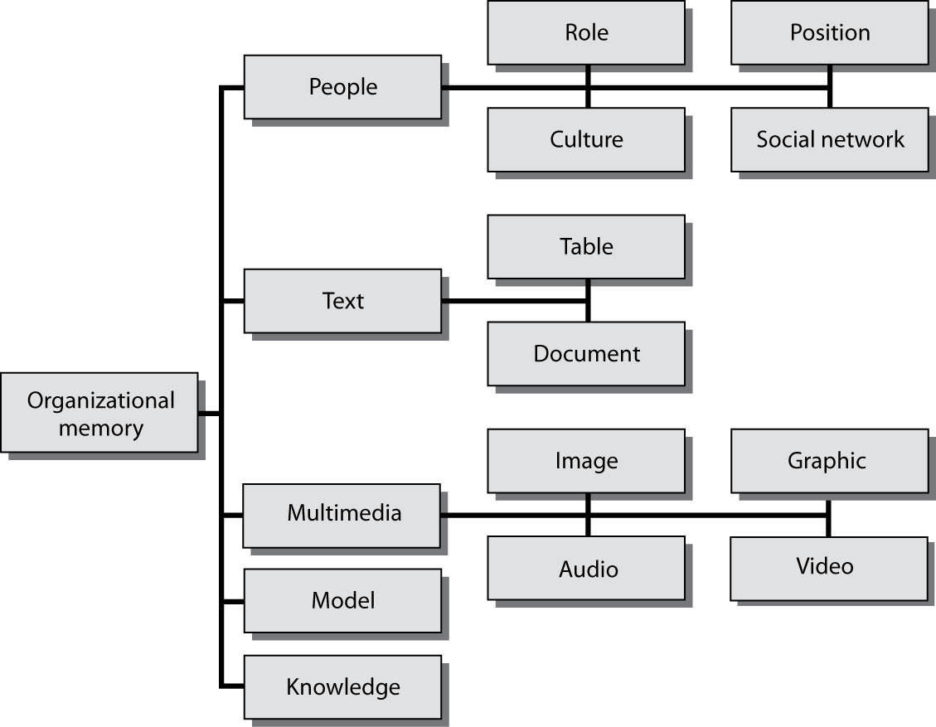
Components of organizational memory

Slide 14
People
The linchpin
  Create, maintain, evolve, and use organizational memory
Role and position
Organizational culture
Social networks
Standard operating procedures

Slide 15
Table
Product | Price
Pocket knife - Nile | 4.50
Compass | 10.00
Geo positioning system | 500.00
Map measure | 4.90

Slide 16
Content Management
Reports
Manuals
Brochures
Memos
Letters
Email

Slide 17

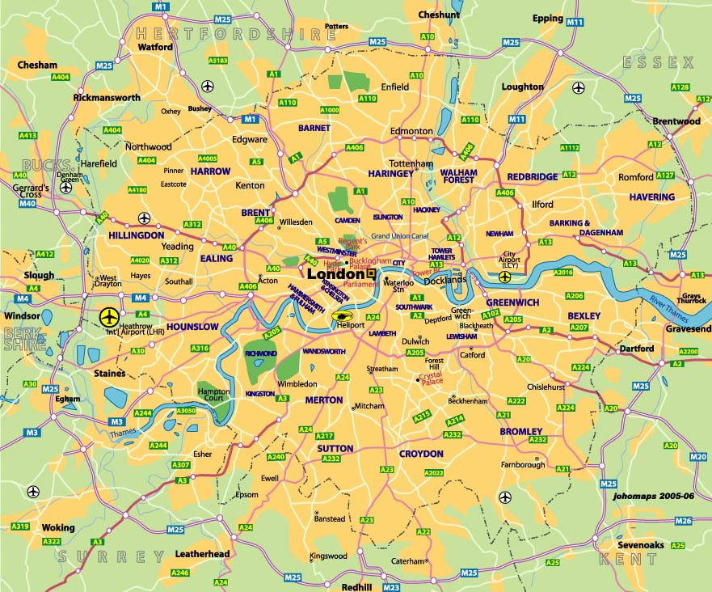
Multimedia Management
Images
Graphics
Audio
Video
Image
Graphic

Slide 18
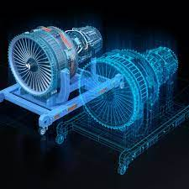
Models
Decision support systems
  Mathematical models
  Digital twins

Slide 19
Knowledge
Expert systems
Rules

Slide 20
Decisions
Decision making is the central activity of modern organizations
Minutes of a meeting
  Usually not an audit trail of decisions
Reusable decisions
  Take advantage of past deliberations

Slide 21
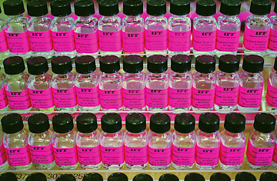

Specialized memories
Smells
Colors
Notes:
http://www.time.com/time/specials/2007/perfume/article/0,28804,1618617_1618614_1618581,00.html
http://www.pantone.com/pages/pantone/category.aspx?ca=1

Slide 22
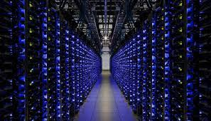
External memories
External to the organization
Information services

Slide 23
Problems with data management systems
Redundancy
Lack of data control
Poor interface
Delays
Lack of reality
Lack of data integration

Slide 24
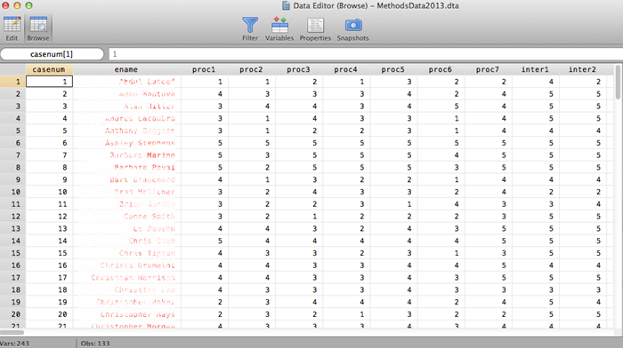
Data, information & knowledge
Data
  Raw, unsummarized, and unanalyzed facts

Slide 25
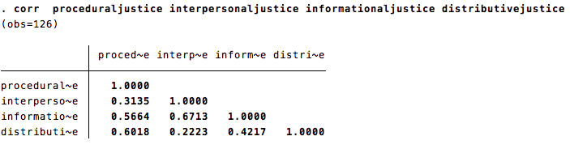
Data, information & knowledge
Information
  Data processed into a meaningful form
  One person's information can be another's data

Slide 26
Data, information & knowledge
Knowledge
  Knowing what information is required
  Knowing what the information means

Slide 27
Data, information & knowledge

Slide 28
Key points
Organizations that effectively use data, information, and knowledge are more successful
The challenge is to develop data management and exploitation skills across an organization
Many organizations do not make effective use of the data they already have
  Data rich – information poor
Data management is an enduring problem for nearly all organizations and societies

