Slide 1
Data Administration
Bad administration, to be sure, can destroy good policy; but good administration can never save bad policy
Adlai Stevenson, 1952

Slide 2
Data administration
Data are the lifeblood of organizations
Data need to be managed
Data administration is concerned with the management of organizational memories

Slide 3
Data are generated by stakeholders
Employees
Customers
Shareholders
Investors
Suppliers
Government

Slide 4
Data management problems
Redundancy
Inconsistent representations
Multiple definitions of data items
Essential data missing
Inaccurate or incomplete data
Uncaptured data
Data that cannot be located

Slide 5
Goals of data management
Enable clients and customers to access the data they need in the most suitable format
Maintain data integrity

Slide 6
Chief Data Officer (CDO)
A new C-level position
Responsible for the strategic management of data systems and ensuring that the organization fully seizes data-driven opportunities
In 2003, Capital One was perhaps to first firm to appoint a CDO

Slide 7
CDO role dimensions
Collaboration direction
Inward or outward
Data management focus
Traditional transaction or big data
Value orientation
Service or strategy

Slide 8
Three dimensions of the CDO

Slide 9
Inward collaboration
Initiatives might include developing data quality assessment methods, establishing data products standards, creating procedures for managing metadata, and establishing data governance
The goal is to ensure consistent data delivery and quality inside the organization

Slide 10
Outward collaboration
An outwardly-focused CDO will strive to cooperate with an organization’s external stakeholders
One CDO led a program for “global unique product identification” to improve collaboration with external global partners
Another might pay attention to improving the quality of data supplied to external partners

Slide 11
Traditional data management
Traditional data are still the foundation of many organization’s operations
There remains in many firms a need for a CDO with a transactional data orientation
Traditional data are typically managed with a relational databases

Slide 12
Big data management
Big data promises opportunities for improving operations or developing new business strategies based on analyses and insights not available from traditional data
A CDO attending to big data can provide leadership in helping a business gain deeper knowledge of its key stakeholders

Slide 13
Service orientation
If the top management team is mainly concerned with oversight and accountability, then the CDO should pay attention to improving existing data-related processes

Slide 14
Strategy orientation
If the senior team actively seeks new data-driven strategic value, then the CDO needs to be similarly aligned and might look at how to exploit digit data streams
One strategy-directed CDO, led an initiative to identify new information products for advancing the firm’s position in the financial industry

Slide 15
CDO archetypes
 | Inward | Outward | Traditional data | Big data | Strategy | Service
Coordinator
Reporter
Architect
Ambassador
Analyst
Marketer
Developer
Experimenter

Slide 16
CDO archetypes
Archetype | Definition
Coordinator | Fosters internal collaboration using transactional data to support business services
Reporter | Provides high quality enterprise data delivery services for external reporting
Architect | Designs databases and internal business processes to create new opportunities for the organization
Ambassador | Develops internal data policies to support business strategy and external collaboration using traditional data sources
Analyst | Improves internal business performance by exploiting big data to provide new services
Marketer | Develops relationships with external data partners and stakeholders to improve externally provided data services using big data
Developer | Navigates and negotiates with internal enterprise divisions in order to create new services by exploiting big data
Experimenter | Engages with external parties, such as suppliers and industry peers, to explore new, unidentified markets and products based on insights derived from big data

Slide 17
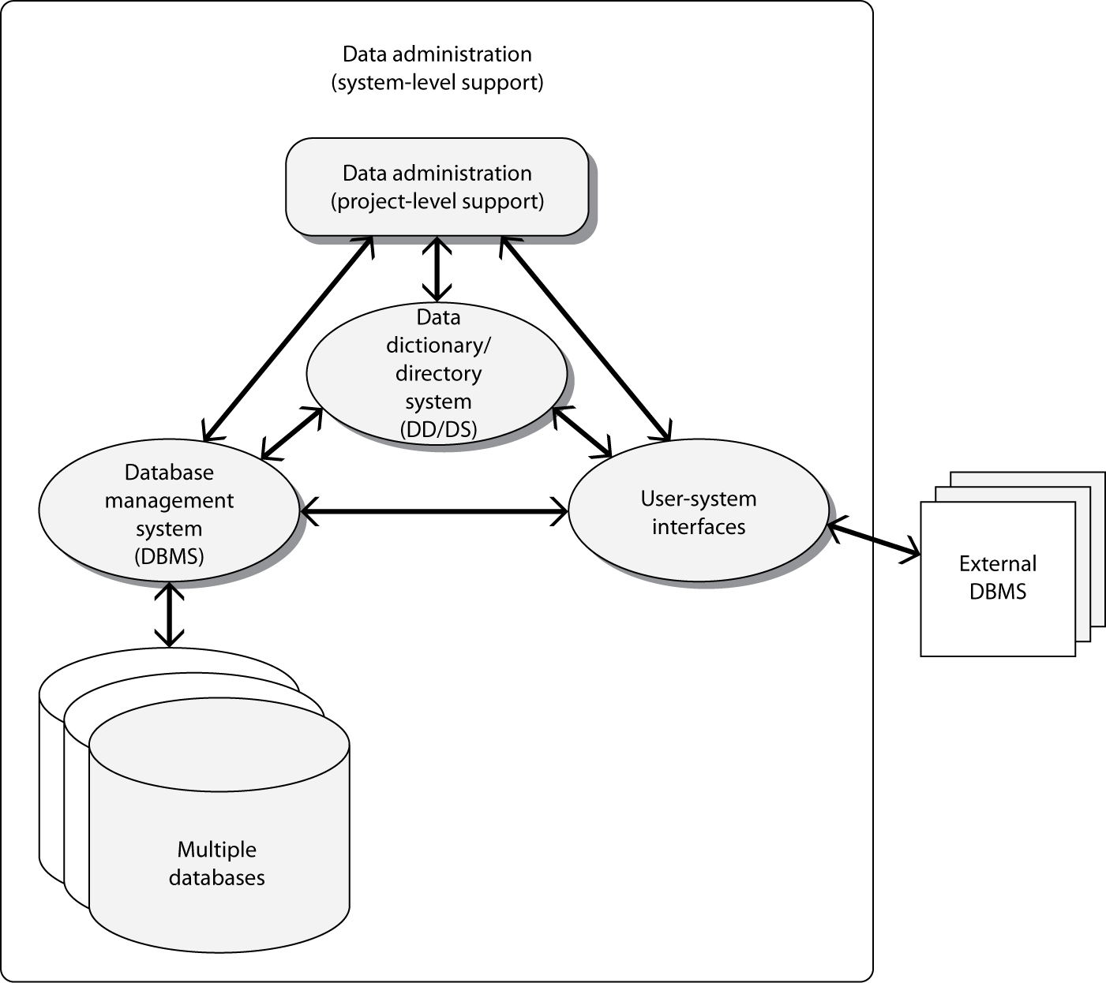
Management of the database environment

Slide 18
Components of the database environment
Databases
User interface
Data dictionary
External databases

Slide 19
Data administration
System
Environment wide management issues
Planning
Data standards and policy
Data integrity
Resolving data conflicts
Managing the DBMS
Data dictionary
Benchmarking
Project
Defining user requirements
Data modeling
Training and consulting
Monitoring integrity and usage
Change management

Slide 20
Data administration vs. database administration
Not an appropriate distinction
System
Data administration
Project
Database administration
Think in terms of system and project rather than data and database
Data administration can refer to both system and project level functions

Slide 21
Data administration functions and roles
A function is a set of activities to be performed
Individuals are assigned roles to perform certain activities
Data administration functions may be performed by a:
Data administrator
Data administration staff
Database development
Database consultant
Database analyst

Slide 22
Data steward
Responsible for managing all corporate data for a critical business entity or product
Cuts across functional boundaries
Aligns data management with organizational goals

Slide 23
Database use levels
Personal
Workgroup
Organizational
More users means greater complexity

Slide 24
Personal databases
Notebook computers
Personal digital assistants (PDAs)
Personal information managers (PIMs)
Cell phones
Music players (iPod)
Information appliances

Slide 25
Workgroup and organizational databases
Shared by many people
Greater complexity
Require more planning and co-ordination than personal databases

Slide 26
System level data administration
Planning
Development of data standards and policies
Data integrity
Data conflict resolution
Managing the DBMS
Establishing and maintaining the Data Dictionary
Selection of hardware and software
Benchmarking
Managing external databases
Internal marketing

Slide 27
Selection of hardware and software
How many users will simultaneously access the database?
Will the database need to be geographically distributed?
What is the maximum size of the database?
How many transactions per second can the DBMS handle?
What kind of support for on-line transaction processing is available?
What are the initial and ongoing costs of using the product?
What is the extent of training required, will it be provided, and what are the associated costs?

Slide 28
Project level data administration functions
Meeting the needs of individual applications and users
Support and development of a specific database system

Slide 29
Systems Development Life Cycle
Application Development Life Cycle (ADLC) | Database Development Life Cycle (DDLC)
Project planning | Project planning
Requirements definition | Requirements definition
Application design | Database design
Application construction
Application testing | Database testing
Application implementation | Database implementation
Operations | Database usage
Maintenance | Database evolution

Slide 30
Strategies for system development
Database and applications developed independently
Applications developed for existing databases
Database and application development proceed simultaneously

Slide 31
Development roles
Database Development Phase | Database Developer | Data Administrator | User
Project planning | Does | Consults | Provides information
Requirements definition | Does | Consults | Provides requirements
Database design | Does | Consults Data integrity | Validates data models
Database testing | System and user testing | Consults Data integrity | Does user testing
Database implementation | System related activities | Consults Data integrity | Does user activities
Database usage | Consults | Data integrity monitoring | Uses
Database evolution | Does | Change control | Provides additional requirements

Slide 32
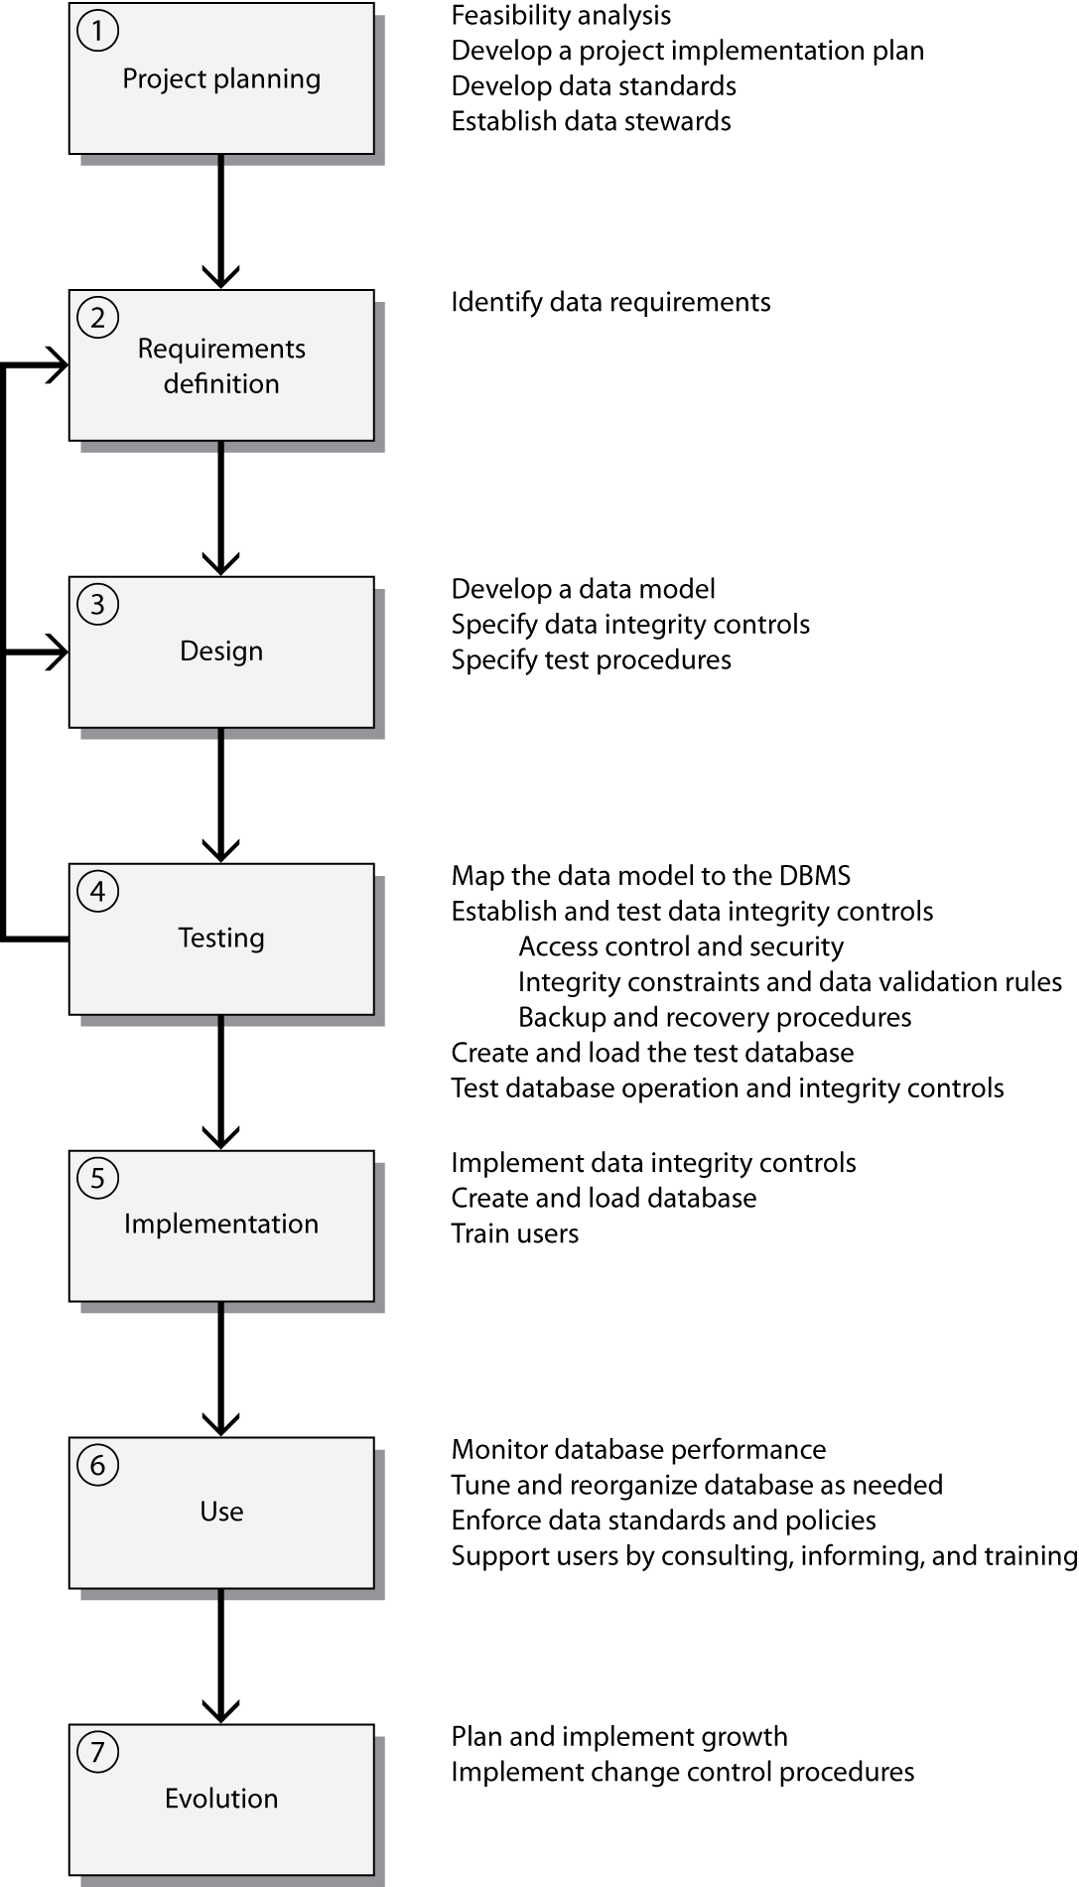
Database development cycle

Slide 33
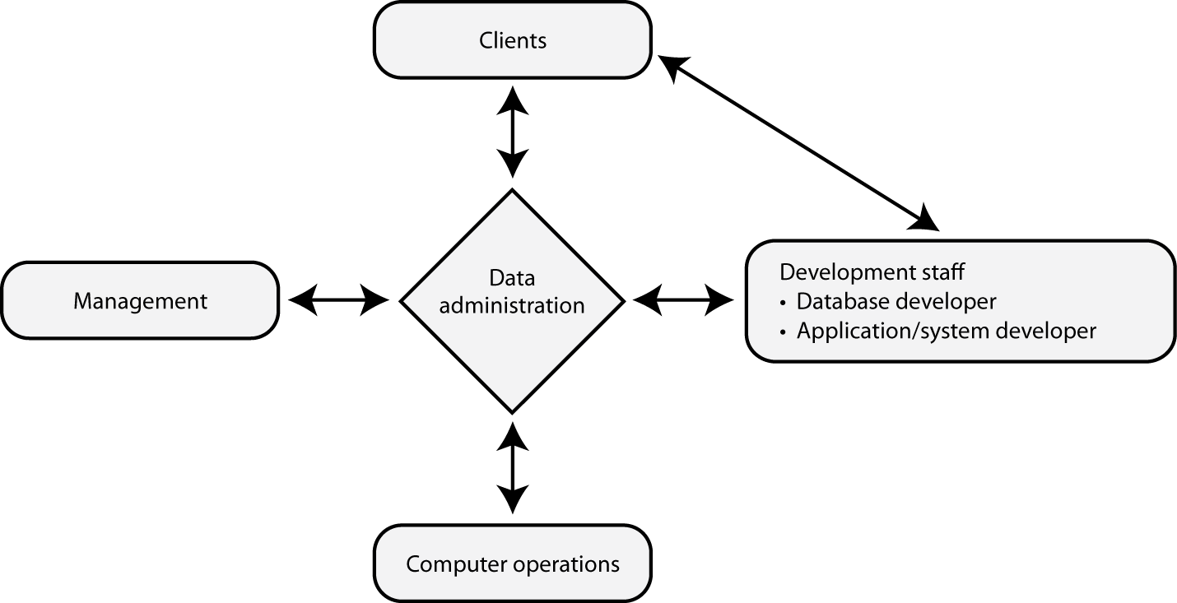
Data administration interfaces

Slide 34
Data administration interfaces
Management
Sets the agenda and goals
Users
Seek satisfaction of goals
Development
Co-operation
Computer operations
Establishing and monitoring procedures for operating databases

Slide 35
Data administration tools
Database development phase | Data Dictionary (DD) | Database Management System (DBMS) | Performance monitoring | Case tools
1. Project planning | Document Data map Design aid |  |  | Estimation tools
2. Requirements definition | Document Design aid |  |  | Document Design aid
3. Database design | Document Design aid Data map Schema generator |  |  | Document Design aid Data map
4.Database testing | Data map Design aid Schema generator | Define, create, test, data integrity | Impact analysis | Test data generator Design aid
5.Database implementation | Document Change control | Data integrity Implement Design | Monitor Tune
6. Database use | Document Data map Schema generator Change control | Provide tools for retrieval and update Enforce integrity controls and procedures | Monitor Tune
7. Database evolution | Document Data map Change control | Redefine | Impact analysis

Slide 36
Use of the data dictionary
Documentation support
Data maps
Design aid
Schema generation
Change control

Slide 37
Data integration
Lack of data integration is a common problem
Examples
Different identifiers for the same instance of an entity
The same data stored in multiple systems
Related data stored in different databases
Different methods of calculation for the same business indicator in different systems

Slide 38
Data integration
 | Red division | Blue division
partnumber (code for green widget) | 27 | 27
customerid (code for UPS) | 53 | 53
Definition of salesdate | The date the customer signs the order | The date the customer signs the order

Slide 39
Lack of data integration
 | Red division | Blue division
partnumber (code for green widget) | 27 | 10056
customerid (code for UPS) | 53 | 613
Definition of salesdate | The date the customer signs the order | The date the customer receives the order

Slide 40
Goals of data integration
A standard meaning and format for all data elements
A standard format for each and every data element
A standard coding system
A standard measurement system
A single corporate data model for each major business entity

Slide 41
Data integration strategies
Environmental turbulence |  | High | Low | Moderate
 |  | Low | Moderate | High
 |  |  | Low | High
 |  |  | Unit interdependence

Slide 42
Organizing the data administration function
Creation of the function
Selecting staff and assigning roles
Locating the function

Slide 43
Conclusion
Data administration is
Critical to the success of most organizations
Necessary for data-driven decision making
Growing in complexity
Increasingly requires the appointment of a CDO to ensure appropriate strategic attention

