Slide 1
Data Visualization
The commonality between science and art is in trying to see profoundly - to develop strategies of seeing and showing
Edward Tufte

Slide 2
Visualization skills
Humans are exceptionally skilled at the visual processing of information
An innate capability
Our ancestors were those who were efficient visual processors and quickly detected threats and used this information to make effective decisions

Slide 3
A graphical representation of Napoleon Bonaparte's invasion of and subsequent retreat from Russia during 1812. The graph shows the size of the army, its location and the direction of its movement. The temperature during the retreat is drawn at the bottom of figure, which was drawn by Charles Joseph Minard in 1861 and is generally considered to be one of the finest graphs ever produced.

Slide 4
Wilkinson’s grammar of graphics
Data
  A set of data operations that create variables from datasets
Trans
  Variable transformations
Scale
  Scale transformations
Coord
  A coordinate system
Element
  Graph and its aesthetic attributes
Guide
  One or more guides

Slide 5
ggplot
An implementation of the grammar of graphics in R
The grammar describes the structure of a graphic
A graphic is a mapping of data to a visual representation
ggplot2
Notes:
http://had.co.nz/ggplot/

Slide 6
Data
Spreadsheet approach
  Use an existing spreadsheet or create a new one
  Export as CSV file
Database
  Execute SQL query

Slide 7
Transformation
A transformation converts data into a format suitable for the intended visualization
# compute a new column in carbon containing the relative change in CO2
carbon$relCO2 = (carbon$CO2-280)/280

Slide 8
Coord
A coordinate system describes where things are located
Most graphs are plotted on a two-dimensional (2D) grid with x (horizontal) and y (vertical) coordinates
ggplot2 currently supports six 2D coordinate systems
The default coordinate system is Cartesian

Slide 9
Element
An element is a graph and its aesthetic attributes
Build a graph by adding layers
library(tidyverse)
url <- 'http://www.richardtwatson.com/data/carbonMeans.txt'
carbon <- read_delim(url, delim=',')
# Select year(x) and CO2(y) to create a x-y point plot
# Specify red points, as you find that aesthetically pleasing
ggplot(carbon,aes(year,CO2)) + geom_point(color='red')
# Add some axes labels
# Notice how ‘+’ is used for adding grammar components
ggplot(carbon,aes(year,CO2)) + geom_point(color='red') +
xlab('Year') + ylab('CO2 ppm of the atmosphere')

Slide 10
Element

Slide 11
Element
ggplot(carbon,aes(year,CO2)) + geom_point(color='red') +
xlab('Year') + ylab('CO2 ppm of the atmosphere') +
ylim(0,500)

Slide 12
Element
# compute a new column in carbon containing the relative change in CO2
carbon$relCO2 = (carbon$CO2-280)/280
ggplot(carbon,aes(year,relCO2)) + geom_line(color='salmon') +
xlab('Year') + ylab('Relative change of atmospheric CO2') + ylim(0,.5)

Slide 13
Guides
Axes and legends are both forms of guides
Helps the viewer to understand a graphic

Slide 14
Exercise
Create a line plot using the data in the following table.
Year | 1804 | 1927 | 1960 | 1974 | 1987 | 1999 | 2012 | 2022 | 2037
Population (billions) | 1 | 2 | 3 | 4 | 5 | 6 | 7 | 8 | 9
Notes:
https://en.wikipedia.org/wiki/World_population_milestones

Slide 15
Histogram
Counts observations
library(measurements)
url <- 'http://www.richardtwatson.com/data/centralparktemps.txt'
t <- read_delim(url, delim=',')
t$C <- conv_unit(t$temperature,'F','C')
ggplot(t,aes(C)) + geom_histogram(fill='skyblue') +
xlab('Celsius')

Slide 16
Bar chart
Counts observations
library(tidyverse)
library(DBI)
library(RMySQL)
conn <- dbConnect(RMySQL::MySQL(),
dbname = "ClassicModels",
host = "www.richardtwatson.com",
user = "student",
password = rstudioapi::askForPassword("Database password"))
d <- as_tibble(tbl(conn, 'Products'))
# Plot the number of product lines by specifying the appropriate column name
ggplot(d,aes(productLine)) +
geom_bar(fill='chocolate')

Slide 17
Column chart
Reports counts
conn <- dbConnect(RMySQL::MySQL(), ”www.richardtwatson.com", dbname="ClassicModels", user="student", password="student")
# Query the database and create file for use with R
d <- dbGetQuery(conn,"SELECT * from Products;")
da <- d %>%
group_by(productLine) %>%
summarize(count = n())
ggplot(da,aes(productLine,count)) +
geom_col(fill='chocolate')

Slide 18
Bar chart
ggplot(d,aes(productLine)) +
geom_bar(fill='gold') +
coord_flip()

Slide 19
Radar plot
d <- dbGetQuery(conn,"SELECT productLine from Products;")
ggplot(d,aes(x=productLine)) + geom_histogram(fill='bisque') +
coord_polar() + ggtitle("Number of products in each product line") +
expand_limits(x=c(0,10))

Slide 20
Exercise
Create a bar chart using the data in the following table
  Use population as the weight value rather than y coordinate
Year | 1804 | 1927 | 1960 | 1974 | 1987 | 1999 | 2012 | 2022 | 2037
Population (billions) | 1 | 2 | 3 | 4 | 5 | 6 | 7 | 8 | 9

Slide 21
Scatterplot
# Get the monthly value of orders
d <- dbGetQuery(conn,"SELECT MONTH(orderDate) AS orderMonth, sum(quantityOrdered*priceEach) AS orderValue FROM Orders JOIN OrderDetails ON Orders.orderNumber = OrderDetails.orderNumber GROUP BY orderMonth;")
# Plot data orders by month
# Show the points and the line
ggplot(d,aes(x=orderMonth,y=orderValue)) + geom_point(color='red') + geom_line(color='blue')

Slide 22
Scatterplot
library(scales)
# Get the value of orders by year and month
d <- dbGetQuery(conn,"SELECT YEAR(orderDate) AS orderYear, MONTH(orderDate) AS Month, sum((quantityOrdered*priceEach)) AS Value FROM Orders, OrderDetails WHERE Orders.orderNumber = OrderDetails.orderNumber GROUP BY orderYear, Month;")
# Plot data orders by month and grouped by year
# ggplot expects grouping variables to be character, so convert
# load scales package for formatting as dollars
library(scales)
d$Year <- as.character(d$orderYear)
ggplot(d,aes(x=Month,y=Value,group=Year)) +
geom_line(aes(color=Year)) +
# Format as dollars
scale_y_continuous(labels = dollar)

Slide 23
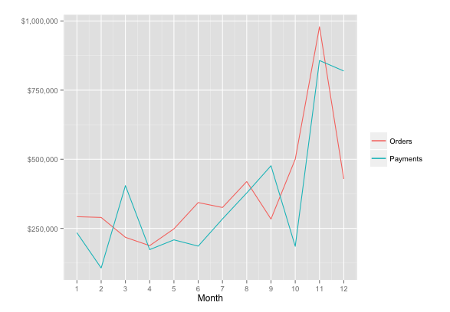
Scatterplot
library(scales)
library(ggplot2)
orders <- dbGetQuery(conn,"SELECT MONTH(orderDate) AS month, sum((quantityOrdered*priceEach)) AS orderValue FROM Orders, OrderDetails WHERE Orders.orderNumber = OrderDetails.orderNumber and YEAR(orderDate) = 2004 GROUP BY Month;")
payments <- dbGetQuery(conn,"SELECT MONTH(paymentDate) AS month, SUM(amount) AS payValue FROM Payments WHERE YEAR(paymentDate) = 2004 GROUP BY MONTH;")
ggplot(orders,aes(x=month)) +
geom_line(aes(y=orders$orderValue, color='Orders')) +
geom_line(aes(y=payments$payValue, color='Payments')) +
xlab('Month') + ylab('') +
# Format as dollars and show each month
scale_y_continuous(label = dollar) + scale_x_continuous(breaks=c(1:12)) +
# Remove the legend
theme(legend.title=element_blank())

Slide 24
Scatterplot
library(RMySQL)
library(DBI)
library(lubridate)
conn <- dbConnect(RMySQL::MySQL(), "www.richardtwatson.com", dbname="Weather", user="student", password="student")
t <- dbGetQuery(conn,"SELECT timestamp, Temperature from record;")
t$year <- year(t$timestamp)
t$month <- month(t$timestamp)
t$hour <- hour(t$timestamp)
t$day <- day(t$timestamp)
t2 <- t %>% filter(year == 2011 & hour== 17 & month == 8)
ggplot(t2,aes(day, Temperature)) + geom_point(color='blue')

Slide 25
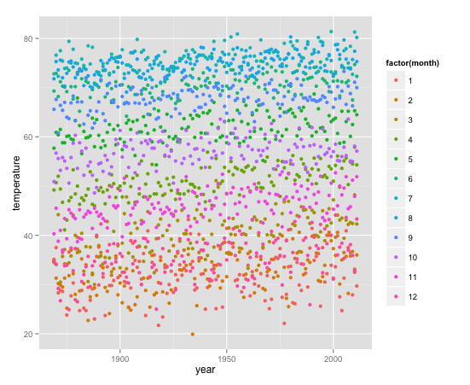
Scatterplot
url <- "https://www.richardtwatson.com/data/centralparktemps.txt"
t <- read_delim(url, , delim = ',')
ggplot(t,aes(x=year,y=temperature,color=factor(month))) + geom_point()

Slide 26
Smooth
url <- 'http://www.richardtwatson.com/data/centralparktemps.txt'
t <- read_delim(url, delim=',')
# select the August data
ta <- t %>% filter(month == 8)
ggplot(ta,aes(year,temperature)) +
geom_line(color="red") +
geom_smooth()

Slide 27
Exercise
National GDP and fertility data have been extracted from a web site and saved as a CSV file
Compute the correlation between GDP and fertility
Do a scatterplot of GDP versus fertility with a smoother
Log transform both GDP and fertility and repeat the scatterplot

Slide 28
Box plot
factor(0) because no x variable
conn <- dbConnect(RMySQL::MySQL(), "www.richardtwatson.com", dbname="ClassicModels", user="student", password="student")
d <- dbGetQuery(conn,"SELECT * from Payments;")
# Boxplot of amounts paid
ggplot(d,aes(factor(0),amount)) +
geom_boxplot(outlier.colour='red') + xlab("") + ylab("Check")

Slide 29
Fluctuation plot
# Get product data
d <- dbGetQuery(conn,"SELECT * from Products;")
# Plot product lines
ggfluctuation(table(d$productLine,d$productScale)) + xlab("Scale") + ylab("Line")

Slide 30
Heatmap
d <- dbGetQuery(conn,"SELECT * from Products;")
da <- d %>% group_by(productLine, productScale) %>%
summarize(count = n())
ggplot(da,aes(productLine,productScale)) +
geom_tile(aes(fill=count)) +
scale_fill_gradient(low="light blue", high="dark blue") +
xlab('Line') + ylab('Scale')

Slide 31
Parallel coordinates
library(lattice)
d <- dbGetQuery(conn,"SELECT quantityOrdered*priceEach AS orderValue, YEAR(orderDate) AS year, productLine FROM Orders, OrderDetails, Products WHERE Orders.orderNumber = OrderDetails. orderNumber AND Products.productCode = OrderDetails.productCode AND YEAR(orderDate) IN (2003,2004);")
# convert productLine to a factor for plotting
d$productLine <- as.factor(d$productLine)
parallelplot(d)

Slide 32
Geographic data
ggmap supports multiple mapping systems, including Google maps
Need to get a Google API key
  https://cloud.google.com/maps-platform/#get-started
library(ggplot2)
library(ggmap)
library(mapproj)

Slide 33
Set up an API key file
R > New File > Text File
Read key prior to using map functions
key
your key
t <- read_csv("~/Dropbox/0Documents/R/GoogleAPIkey.txt")
register_google(key = t$key)

Slide 34
Geographic data
library(ggplot2)
library(ggmap)
library(mapproj)
library(DBI)
library(RMySQL)
conn <- dbConnect(RMySQL::MySQL(), "www.richardtwatson.com", dbname="ClassicModels", user=”student", password="student")
# Google maps requires lon and lat, in that order, to create markers
d <- dbGetQuery(conn,"SELECT ST_Y(officeLocation) AS lon, ST_X(officeLocation) AS lat FROM Offices;")
t <- read_csv("~/Dropbox/0Documents/R/GoogleAPIkey.txt")
register_google(key = t$key)
# show offices in the United States
# vary zoom to change the size of the map
map <- get_googlemap('united states',marker=d,zoom=4)
ggmap(map) +
labs(x = 'Longitude', y = 'Latitude') +
ggtitle('US offices')

Slide 35
Map

Slide 36
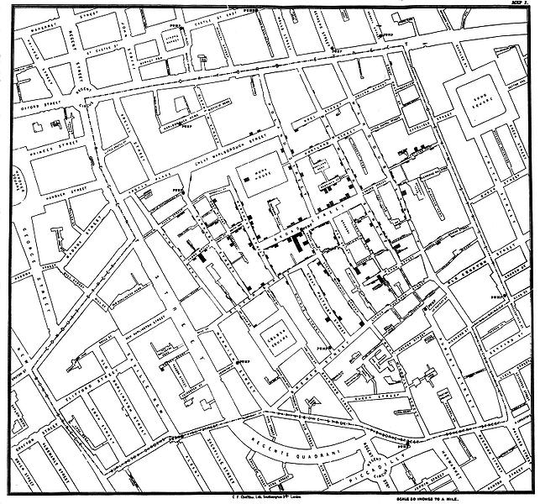
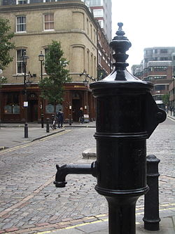
John Snow: 1854 Broad Street cholera map
Water pump
Notes:
http://en.wikipedia.org/wiki/File:Snow-cholera-map-1.jpg
http://en.wikipedia.org/wiki/File:John_Snow_memorial_and_pub.jpg

Slide 37
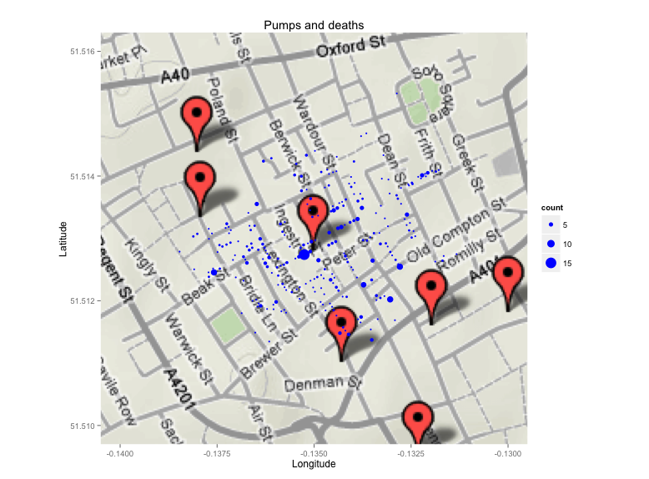
Cholera map
(now Broadwick Street)
library(ggplot2)
library(ggmap)
library(mapproj)
library(readr)
url <- 'http://www.richardtwatson.com/data/pumps.csv'
pumps <- read_delim(url, delim=',')
url <- 'http://www.richardtwatson.com/data/deaths.csv'
deaths <- read_delim(url, delim=',')
map <- get_googlemap('broadwick street, london, united kingdom',markers=pumps,zoom=15)
ggmap(map) + labs(x = 'Longitude', y = 'Latitude') + ggtitle('Pumps and deaths') +
geom_point(aes(x=longitude,y=latitude,size=count),color='blue',data=deaths) +
xlim(-.14,-.13) + ylim(51.51,51.516)

Slide 38
Snow’s less famous map shows the closest walkable pump
Notes:
https://cran.r-project.org/web/packages/cholera/vignettes/pump.neighborhoods.html

Slide 39
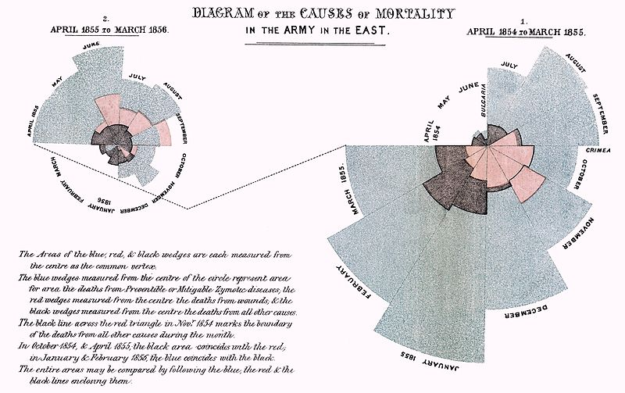
Florence Nightingale
Notes:
http://en.wikipedia.org/wiki/File:Nightingale-mortality.jpg

Slide 40
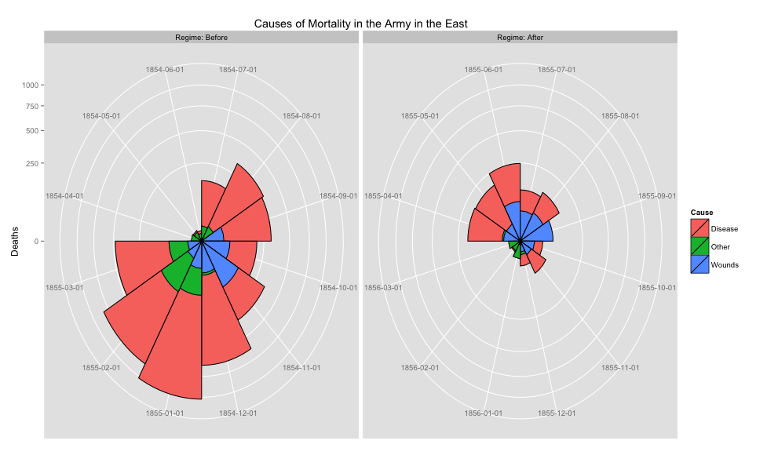
Florence Nightingale

Slide 41
Key points
ggplot is based on a grammar of graphics
  Very powerful and logical
You can visualize the results of SQL queries using R
The combination of MySQL, R, and maps provides a strong platform for data reporting

