Slide 1
Organizational intelligence technologies
There are three kinds of intelligence: one kind understands things for itself, the other appreciates what others can understand, the third understands neither for itself nor through others. This first kind is excellent, the second good, and the third kind useless.
Machiavelli, The Prince, 1513.

Slide 2
Organizational intelligence
Organizational intelligence is the outcome of an organization’s efforts to collect store, process, and interpret data from internal and external sources
Intelligence in the sense of gathering and distributing information

Slide 3
Types of information systems
 | Type of information system | System’s purpose
TPS | Transaction processing system | Collects and stores data from routine transactions
MIS | Management information system | Converts data from a TPS into information for planning, controlling, and managing an organization
DSS | Decision support system | Supports managerial decision making by providing models for processing and analyzing data
BI | Business Intelligence | Enables the business to develop a better understanding of its key stakeholders and organizational environment
OLAP | On-line analytical processing | Presents a multidimensional, logical view of data to the analyst with no requirements as to how the data are stored
 | Data mining & data analytics | Uses statistical analysis and artificial intelligence techniques to identify hidden relationships in data

Slide 4
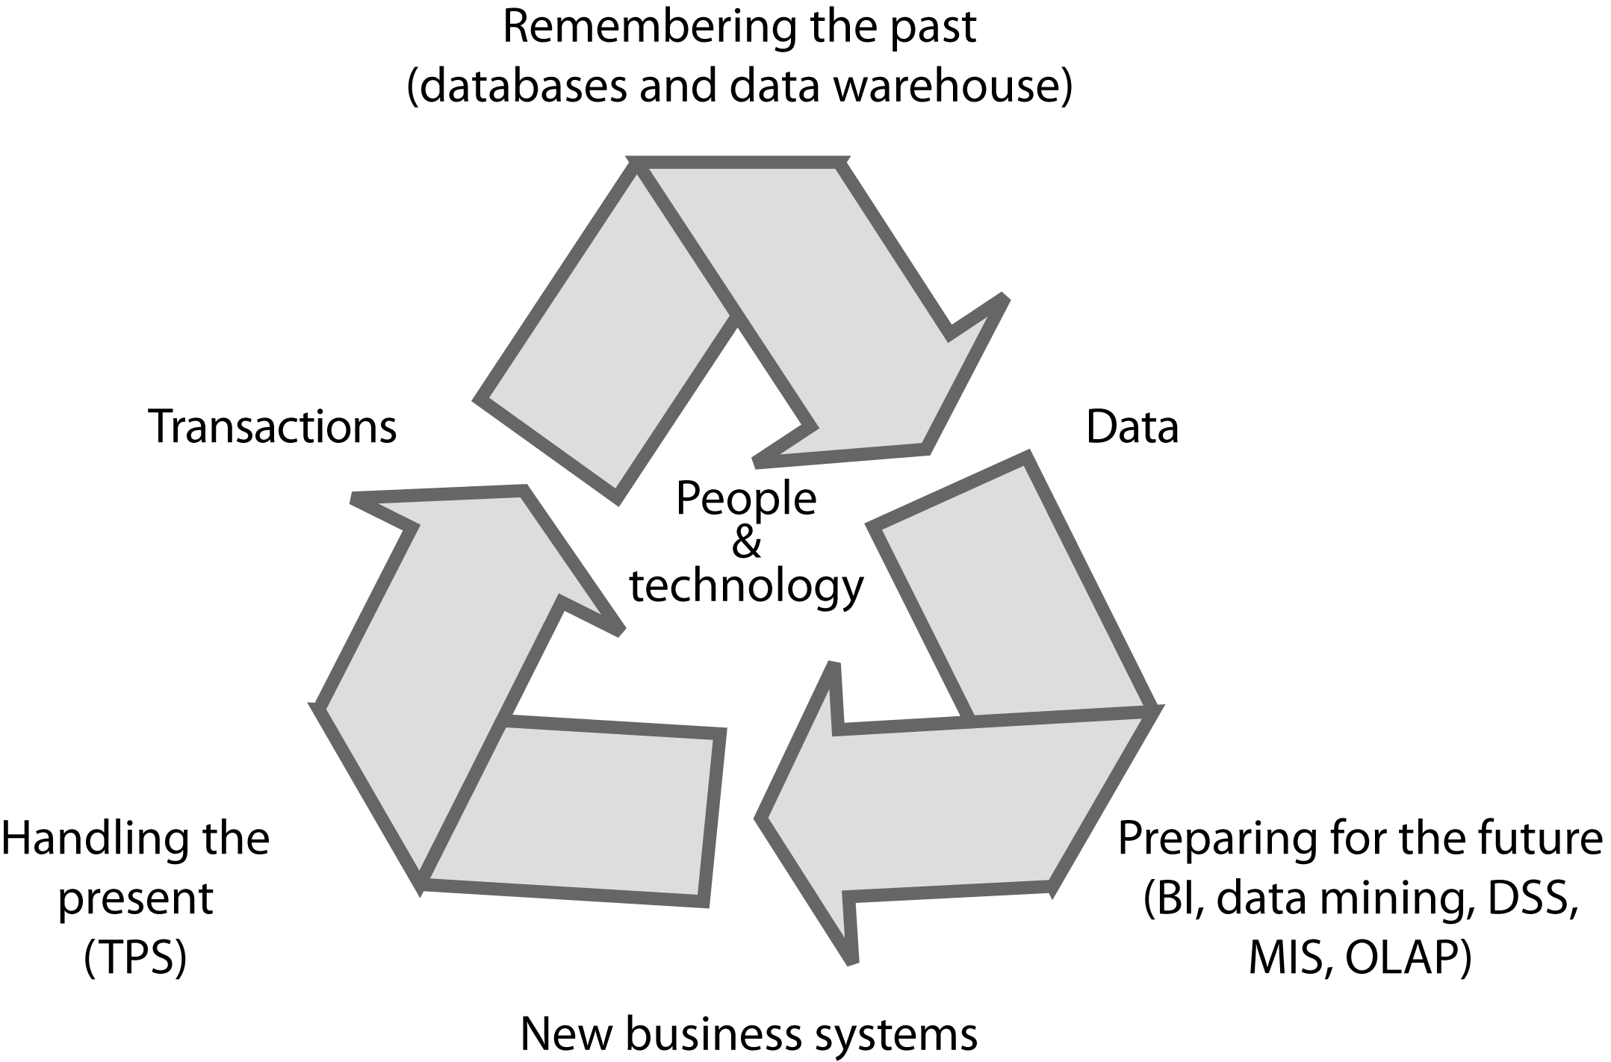
The information systems cycle

Slide 5
Transaction processing systems (TPS)
Can generate huge volumes of data
A telephone company may generate several hundred million records per day
Raw material for organizational intelligence

Slide 6
The problem
Organizational memory is fragmented
  Different systems
  Different database technologies
  Different locations
An underused intelligence system containing undetected key facts about customers and relationship patterns

Slide 7
The data warehouse or data lake
A repository of organizational data
Can be measured in petabytes (10¹⁵)

Slide 8
Managing the data warehouse
Extraction
Transformation
Cleaning
Loading
Scheduling
Metadata

Slide 9
Extraction
Pulling data from existing systems
Operational systems were not designed for extraction to load into a data warehouse
Applications are often independent entities
Time consuming and complex
An ongoing process

Slide 10
Transformation
Encoding
  m/f, male/female to M/F
Unit of measure
  inches to cms
Field
  sales-date to salesdate
Date
  dd/mm/yy to yyyy/mm/dd

Slide 11
Cleaning
Same record stored in different departments
Multiple records for a company
Multiple entries for the same organization
Misuse of data entry fields

Slide 12
Scheduling
A trade-off
  Too frequent is costly
  Infrequently means old data

Slide 13
Metadata
A data dictionary containing additional facts about the data in the warehouse
  Description of each data type
  Format
  Coding standards
  Meaning
  Operational system source
  Transformations
  Frequency of extracts

Slide 14
Warehouse architectures
Centralized
Federated
Tiered

Slide 15
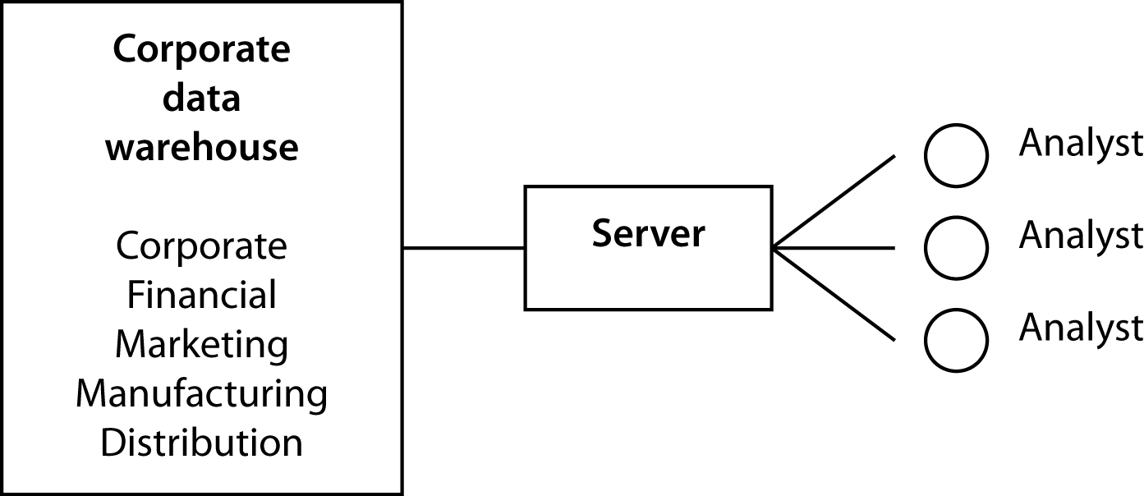
Centralized data warehouse

Slide 16
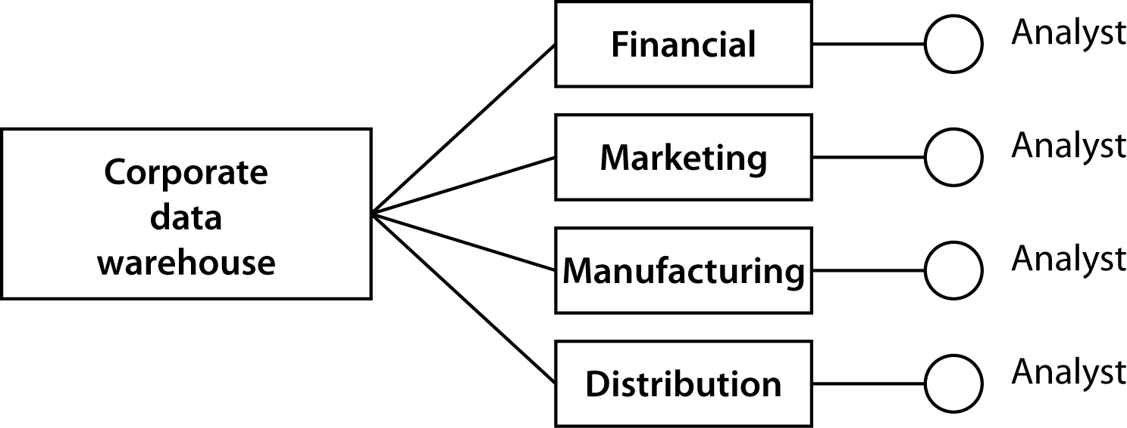
Federated data warehouse

Slide 17
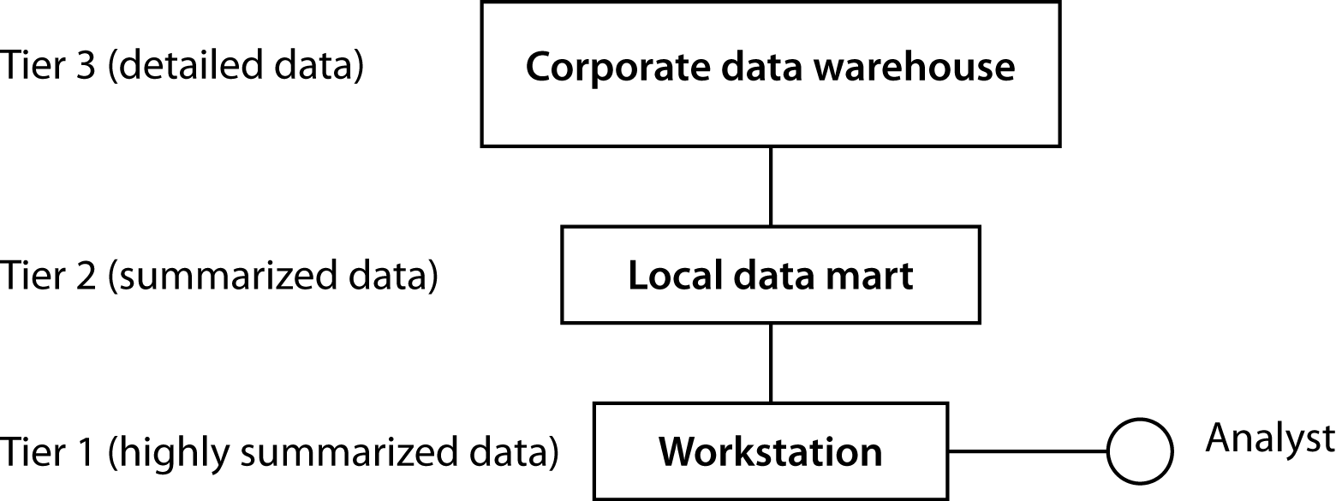
Tiered data warehouse

Slide 18
The hardware/software decision
The current default is
  Cloud/Hadoop for file management
  R/Python and Spark for data processing
  Commodity nodes for processing

Slide 19
Exploiting data stores
Verification and discovery
Data mining
OLAP
Machine learning

Slide 20
Verification and discovery
Verification | Discovery
What is the average sale for in-store and catalog customers? | What is the best predictor of sales?
What is the average high school GPA of students who graduate from college compared to those who do not? | What are the best predictors of college graduation?

Slide 21
OLAP
Relational model was not designed for data synthesis, analysis, and consolidation
This is the role of spreadsheets and other special purpose software
Need to complement RDBMS technology with a multidimensional view of data

Slide 22
TPS versus OLAP
TPS | OLAP
Optimize for transaction volume | Optimize for data analysis
Process a few records at a time | Process summarized data
Real time update as transactions occur | Batch update (e.g., daily)
Based on tables | Based on hypercubes
Raw data | Aggregated data
SQL | MultiDimensional eXpressions (MDX)

Slide 23
ROLAP
A relational OLAP
A multidimensional model is imposed on a relational structure
Relational is a mature technology with extensive data management features
Not as efficient as OLAP

Slide 24
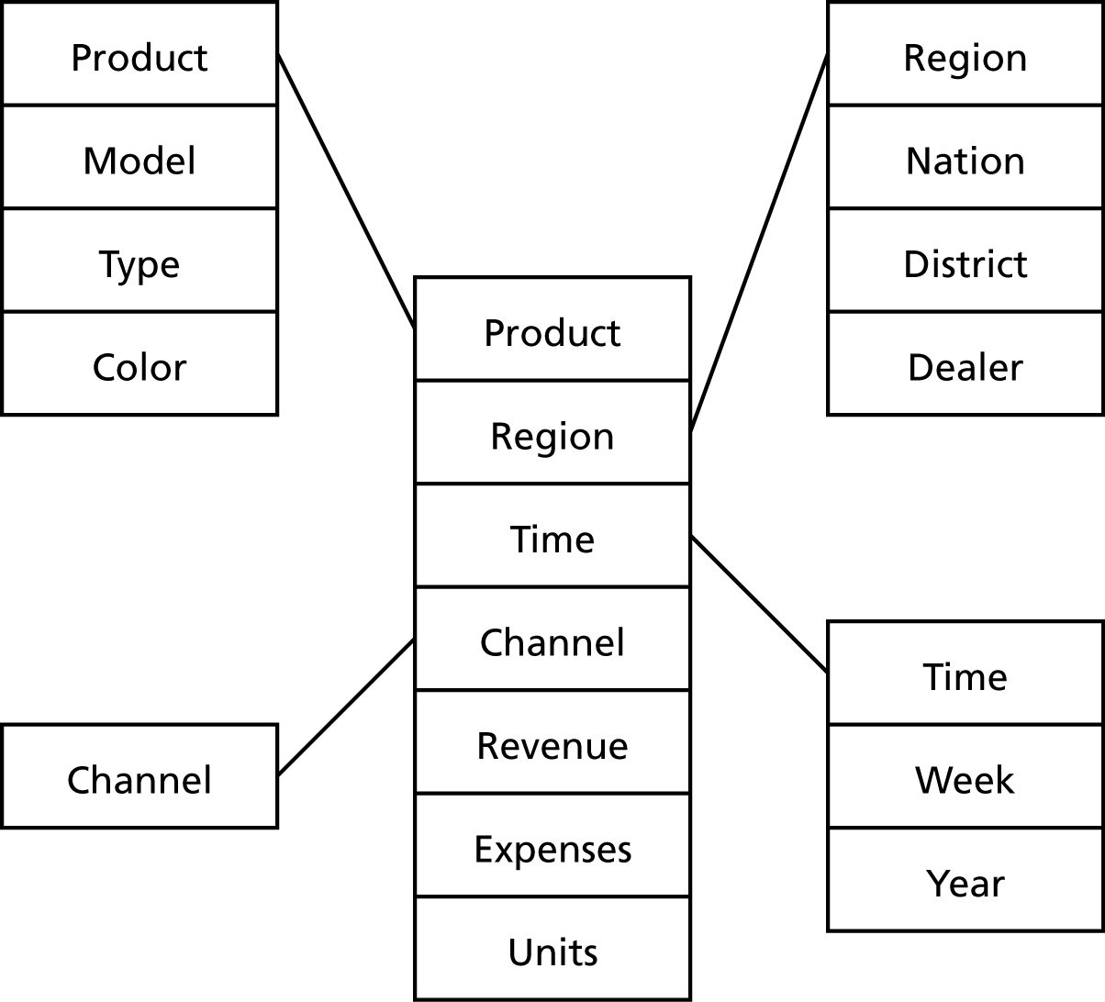
The star structure
A central fact table is connected to multiple dimensional tables
A single join can relate the fact table with any one of the dimensional tables

Slide 25
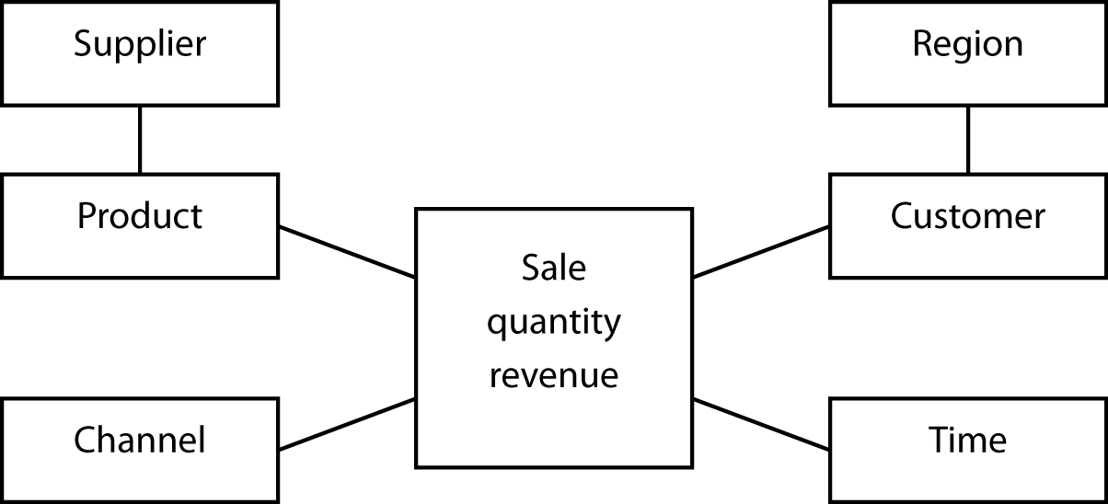
The snowflake structure
An extension of the star schema to handle very large dimensional tables
Multiple joins might be required to fetch data.

Slide 26
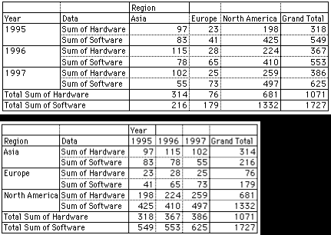
Rotation

Slide 27
 |  | Region
Year | Data | Asia | Europe | North America | Grand total
1995 | Sum of hardware | 97 | 23 | 198 | 318
 | Sum of software | 83 | 41 | 425 | 549
1996 | Sum of hardware | 115 | 28 | 224 | 367
 | Sum of software | 78 | 65 | 410 | 553
1997 | Sum of hardware | 102 | 25 | 259 | 386
 | Sum of software | 55 | 73 | 497 | 625
Total sum of hardware |  | 314 | 76 | 681 | 1071
Total sum of software |  | 216 | 179 | 1332 | 1727
Region |  | 1995 | 1996 | 1997 | Grand total
Asia | Sum of hardware | 97 | 115 | 102
 | Sum of software | 83 | 78 | 55
Europe | Sum of hardware | 23 | 28 | 25
 | Sum of software | 41 | 65 | 73
North America | Sum of hardware | 198 | 224 | 259
 | Sum of software | 425 | 410 | 497
Total sum of hardware |  | 318 | 367 | 386 | 1071
Total sum of software |  | 549 | 553 | 625 | 1727

Slide 28
Drill down
Region | Sales variance
Africa | 105%
Asia | 57%
Europe | 122%
North America | 97%
Pacific | 85%
South America | 163%
Nation | Sales variance
China | 123%
Japan | 52%
India | 87%
Singapore | 95%

Slide 29
A hypercube

Slide 30
A three-dimensional hypercube display
Page |  |  |  |  | Columns
Region: North |  |  |  |  | Sales
 |  |  | Red blob | Blue blob | Total
 |  | 1996
Rows |  | 1997
Year |  | Total

Slide 31
A six-dimensional hypercube
Dimension | Example
Brand | Mt. Airy
Store | Atlanta
Customer segment | Business
Product group | Desks
Period | January
Variable | Units sold

Slide 32
A six-dimensional hypercube display
Page |  |  |  |  |  |  | Columns
Month Segment |  |  |  |  |  |  | Product group Variable
 |  | March | Business | Desks |  | Chairs
 |  |  |  | Units | Revenue | Units | Revenue
 |  | Carolina | Atlanta
 |  |  | Boston
Rows |  | Mt. Airy | Atlanta
Brand |  |  | Boston
Store |  | Totals

Slide 33
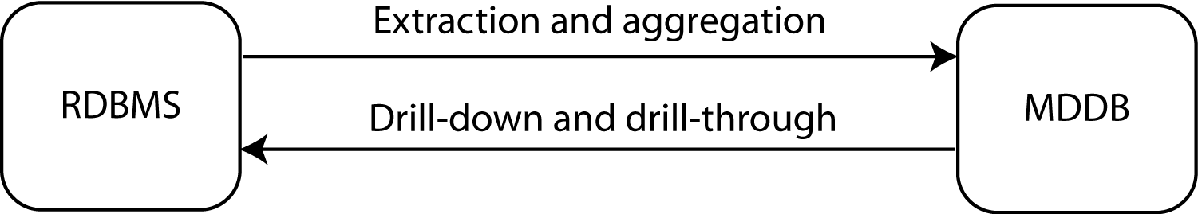
The link between RDBMS and MDDB

Slide 34
MDDB design
Key concepts
  Variable dimensions
    What is tracked
      Sales
  Identifier dimensions
    Tagging what is tracked
      Time, product, and store of sale

Slide 35
Prompts for identifying dimensions
Prompt | Example
When? | June 5, 2013, 10:27am
Where? | Paris
What? | Tent
How? | Catalog
Who? | Young adult woman
Why? | Camping trip to Bolivia
Outcome? | Revenue of €624.00
Transaction data
Face recognition or credit card co.
Social media
Transaction data

Slide 36
Variables and identifiers
Identifier time (hour) | Variable sales (dollars)
10:00 | 523
11:00 | 789
12:00 | 1,256
13:00 | 4,128
14:00 | 2,634
Identifier hit | Variable time (hh:mm:ss)
1 | 9:34:45
2 | 9:34:57
3 | 9:36:12
4 | 9:41:56

Slide 37
Exercise
An international hotel chain has asked you to design a multidimensional database for its marketing department.
What identifier and variable dimensions would you select?

Slide 38
Analysis and variable type
 |  | Identifier dimension
 |  | Continuous | Nominal or ordinal
Variable dimension | Continuous | Regression and curve fitting Sales over time | Analysis of variance Sales by store
 | Nominal or ordinal | Logistic regression Customer response (yes or no) to the level of advertising | Contingency table analysis Number of sales by region

Slide 39
Data mining functions
Association
  85 percent of customers who buy a certain brand of wine also buy a certain type of pasta
Sequential pattern
  32 percent of female customers who order a red jacket within six months buy a gray skirt
Classifying
  Frequent customers as those with incomes about $50,000 and having two or more children
Clustering
  Market segmentation
Predicting
  Predict the revenue value of a new customer based on that person’s demographic variables

Slide 40
Data mining technologies
Association rules
Decision trees
K-means
Machine learning with neural networks
Data visualization

Slide 41
SQL-99 and OLAP
SQL can be tedious and inefficient
The following questions require four queries
  Find the total revenue
  Report revenue by location
  Report revenue by channel
  Report revenue by location and channel

Slide 42
SQL-99 extensions
GROUP BY extended with
  GROUPING SETS
  ROLLUP
  CUBE
MySQL supports only ROLLUP and in a slightly different format

Slide 43
ROLLUP
An extension to GROUP BY
Gives multiple levels of analysis
Cannot use with ORDER BY
SELECT location, channel, SUM(revenue)
FROM exped
GROUP BY location, channel WITH ROLLUP;

Slide 44
ROLLUP
Location | Channel | Revenue
null | null | 483465
London | null | 214334
New York | null | 39123
Paris | null | 143303
Sydney | null | 29989
Tokyo | null | 56716
London | Catalog | 50310
London | Store | 151015
London | Web | 13009
New York | Catalog | 8712
New York | Store | 28060
New York | Web | 2351
Paris | Catalog | 32166
Paris | Store | 104083
Paris | Web | 7054
Sydney | Catalog | 5471
Sydney | Store | 21769
Sydney | Web | 2749
Tokyo | Catalog | 12103
Tokyo | Store | 42610
Tokyo | Web | 2003

Slide 45
Exercises
Using ClassicModels
  Compute total payments by country without and with ROLLUP
  Compute total payments by country and year without and with ROLLUP
  Compute total value of orders by country, and product line without and with ROLLUP

Slide 46
SQL OLAP extensions
Useful
Not as powerful as MDDB tools

Slide 47
Conclusion
Data management is an evolving discipline
Data managers have a dual responsibility
  Manage data to be in business today
  Manage data to be in business tomorrow
Data managers now need to support organizational intelligence technologies

