Slide 1
Graph databases
When we use a network, the most important asset we get is access to one another.
Clay Shirky
Cognitive Surplus: Creativity and Generosity in a Connected Age, 2010

Slide 2
Graph database
A graph is a set of nodes (entities) and edges (relationships) that connect them
Nodes and edges can have labels and properties
A property graph database
A group of nodes with a common label is similar to an entity
A node is similar to an instance of an entity
A relationship is explicitly defined to connect a pair of nodes
In the relational database model, a relationship is represented by a pair of primary and foreign keys

Slide 3
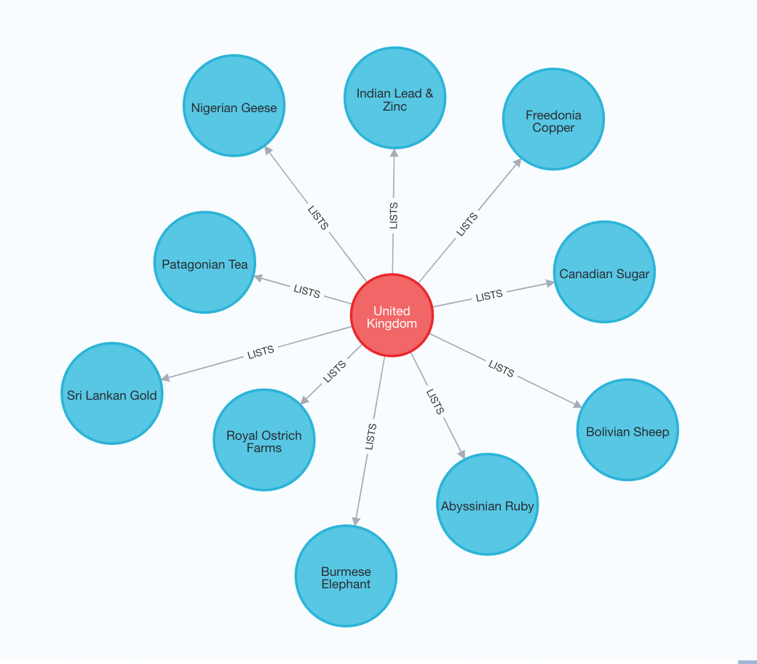
A portion of a graph

Slide 4
Advantages of a graph database
Does not require joins
Joins are defined when creating the relationships
A graph database is flexible
A relationship could change from 1:m to m:m simply by adding relationships
New additions can be made without the need to rewrite existing queries or recode applications.

Slide 5
Cypher
Cypher is both graph description language (GDL) and graph query languages (GQL)
Cypher, like SQL, is a declarative, textual query language, but for graphs.
SQL like

Slide 6
Getting started with Neo4j
Install Neo4j Desktop
https://neo4j.com/download-center/#desktop
Mac
https://www.youtube.com/watch?v=cTZ_Z3KfLyE
Windows
https://www.youtube.com/watch?v=RSbhmVF_ccs
Set up a database
Browser
http://localhost:7474

Slide 7
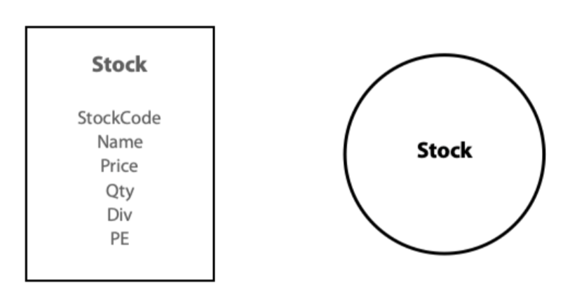
A single node
Properties
CREATE (:Stock {StockCode: "AR", Firm: "Abyssinian Ruby", Price: 31.82, Qty: 22020, Div: 1.32, PE: 13});

Slide 8
Populate the database
LOAD CSV WITH HEADERS FROM "https://www.richardtwatson.com/data/stock.csv" AS row CREATE (s:Stock {StockCode: row.stkcode, Firm: row.stkfirm, Price: toFloat(row.stkprice), Qty: toInteger(row.stkqty), Div: toFloat(row.stkdiv), PE: toInteger(row.stkpe)}) RETURN count(s);
Notes:
Before we do this, match(n) delete n

Slide 9
Querying a node
Displaying data for nodes with the same label
List all Stock nodes
MATCH (s:Stock) RETURN s;

Slide 10
Querying a node
Reporting properties
Report a firm’s name and price-earnings ratio.
MATCH (s:Stock) RETURN s.Firm AS Firm, s.PE AS PE;

Slide 11
Querying a node
Reporting nodes
Get all firms with a price-earnings ratio less than 12.
MATCH (s:Stock) WHERE s.PE < 12 RETURN s;

Slide 12
Querying a node
Reporting properties and nodes
List the name, price, quantity, and dividend of each firm where the share holding is at least 100,000.
MATCH (s:Stock) WHERE s.Qty > 100000 RETURN s.Firm AS Firm, s.Price AS Price, s.Qty AS Quantity, s.Div AS Dividend;

Slide 13
Querying a node
IN for a list of values
Report data on firms with of FC, AR, or SLG.
MATCH (s:Stock) WHERE s.StockCode IN ['FC','AR','SLG’] RETURN s;

Slide 14
Querying a node
Ordering rows
List all firms where the PE is at least 10, and order the report in descending PE. Where PE ratios are identical, list firms in alphabetical order.
MATCH (s:Stock) WHERE s.PE >= 10 RETURN s.PE AS PE, s.Firm AS Firm ORDER BY s.PE DESC, s.Firm;

Slide 15
Querying a node
Derived data
Get firm name, price, quantity, and firm yield.
MATCH (s:Stock) RETURN s.Firm AS Firm, s.Price AS Price, s.Qty AS Quantity, s.Div/s.Price*100 AS Yield;

Slide 16
Aggregate functions
COUNT
How many firms are there in the portfolio?
MATCH (s:Stock) RETURN count(s);

Slide 17
Aggregate functions
AVG
What is the average yield for the portfolio? MATCH (s:Stock) RETURN avg(s.Div/s.Price*100) As `Average yield`;

Slide 18
String handling
CONTAINS
List the names of firms with a double ‘e’.
MATCH (s:Stock) WHERE s.Firm CONTAINS 'ee’ RETURN s.Firm;

Slide 19
String handling
Subqueries
Report all firms with a PE ratio greater than the average for the portfolio
MATCH (s:Stock) WITH AVG(s.PE) AS AvgPE MATCH (s:Stock) WHERE s.PE > AvgPE RETURN s.Firm AS FIRM, s.PE as PE;

Slide 20
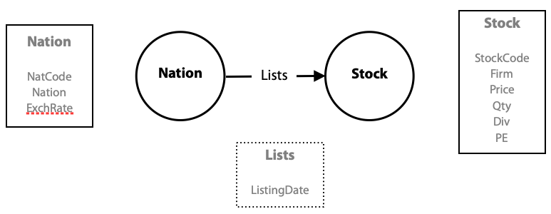
A relationship between nodes

Slide 21
Specifying relationships in Cypher
Relationships are represented in Cypher using an arrow, either -> or <-, between two nodes.
In Neo4j, all relationships are directed
The Cypher code for stating that Bombay Duck was listed in India on 2019-11-10 is:
MATCH (s:Stock), (n:Nation) WHERE s.StockCode = "BD" AND n.NationCode = "IND” CREATE (n)-[r:LISTS {Listed: date('2019-11-10')}]->(s) RETURN r;

Slide 22
Add Nation Nodes and Specifying Relationships
LOAD CSV WITH HEADERS FROM "https://www.richardtwatson.com/data/nation.csv" AS row CREATE (n:Nation {NationCode: row.natcode, Nation: row.natname, ExchRate: toFloat(row.exchrate)}) RETURN count(n);
LOAD CSV WITH HEADERS FROM "https://www.richardtwatson.com/data/stock.csv" AS row MATCH (n:Nation {NationCode: row.natcode}) MATCH (s:Stock {StockCode: row.stkcode}) CREATE (n)-[r:LISTS]->(s) RETURN r;

Slide 23
Querying relationships
Report the value of each stockholding in UK pounds. Sort the report by nation and firm.
MATCH (n:Nation)-[:LISTS]->(s:Stock) RETURN n.Nation AS Nation, s.Firm AS Firm, s.Price AS Price, s.Qty as Quantity, round(s.Price*s.Qty*n.ExchRate) AS Value ORDER BY Nation, Firm

Slide 24
WITH—reporting by groups
Report by nation the total value of stockholdings.
MATCH (n:Nation)-[:LISTS]->(s:Stock) WITH n, round(sum(s.Price*s.Qty*n.ExchRate)) as Value RETURN n.Nation AS Nation, Value;

Slide 25
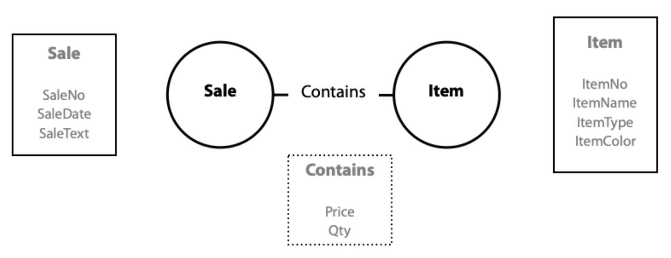
Querying m:m relationships

Slide 26
Sale Item Relationship Database
LOAD CSV WITH HEADERS FROM "https://www.richardtwatson.com/data/item.csv" AS row CREATE (i:Item {ItemNo: toInteger(row.itemno), ItemName: row.itemname, ItemType: row.itemtype, ItemColor: row.itemcolor}) RETURN count(i);
LOAD CSV WITH HEADERS FROM "https://www.richardtwatson.com/data/sale.csv" AS row CREATE (s:Sale {SaleNo: toInteger(row.saleno), SaleDate: date(row.saledate), SaleText: row.saletext}) RETURN count(s);
LOAD CSV WITH HEADERS FROM "https://www.richardtwatson.com/data/receipt.csv" AS row MATCH (s:Sale {SaleNo: toInteger(row.saleno)}) MATCH (i:Item {ItemNo: toInteger(row.itemno)}) CREATE (s)-[r:CONTAINS]->(i) SET r.Price = toFloat(row.receiptprice), r.Qty = toInteger(row.receiptqty);

Slide 27
Sale Item Relationship Database
List the name, quantity, price, and value of items sold on January 16, 2011.
MATCH (s: Sale)-[r:CONTAINS]->(i: Item) WHERE s.SaleDate = date('2011-01-16') RETURN i.ItemName AS Item, r.Qty as Quantity, r.Price as Price, r.Qty*r.Price AS Total;
MATCH (s: Sale {SaleDate: date('2011-01-16')})-[r:CONTAINS]->(i: Item) RETURN i.ItemName AS Item, r.Qty as Quantity, r.Price as Price, r.Qty*r.Price AS Total;

Slide 28
Does a relationship exist?
Report all clothing items (type “C”) for which a sale is recorded.
MATCH (s: Sale)-[:CONTAINS]->(i:Item {ItemType: 'C'}) RETURN DISTINCT i.ItemName AS Item, i.ItemColor AS Color;

Slide 29
Does a relationship exist?
Report all clothing items that have not been sold.
MATCH (s: Sale)-[:CONTAINS]->(i:Item {ItemType: 'C'}) WITH COLLECT (DISTINCT i.ItemNo) AS SoldItems MATCH (i: Item) WHERE i.ItemType = 'C' AND NOT (i.ItemNo IN SoldItems) RETURN DISTINCT i.ItemName AS Item, i.ItemColor AS Color;
MATCH (i:Item {ItemType: 'C'}) WHERE NOT (: Sale)-[:CONTAINS]->(i) RETURN DISTINCT i.ItemName AS Item, i.ItemColor AS Color;

Slide 30
Recursive relationships

Slide 31
Recursive relationships
LOAD CSV WITH HEADERS FROM "https://www.richardtwatson.com/data/monarch.csv" AS row CREATE (m: Monarch {Type: row.montype, Name: row.monname, Number: row.monnum}) RETURN count(m);
MATCH (p:Monarch), (s:Monarch) WHERE p.Name = 'William' AND p.Number = 'IV' AND s.Name = 'Victoria' AND s.Number = 'I’ CREATE (s)-[r:SUCCEEDED]->(p) SET r.Date = date('1837-06-20’) RETURN(r);
Notes:
https://www.richardtwatson.com/open/Reader/_book/graph-databases.html#a-relationship-between-nodes

Slide 32
Query a recursive relationship
Who preceded Victoria I?
MATCH (s)-[r:SUCCEEDED]->(p) WHERE s.Name = 'Victoria' RETURN (p.Type + ' ' + p.Name + ' ' + p.Number);
Who succeeded Victoria I?
MATCH (s)-[r:SUCCEEDED]->(p) WHERE p.Name = 'Victoria' RETURN (s.Type + ' ' + s.Name + ' ' + s.Number);

Slide 33
Query a recursive relationship
Who was Elizabeth II’s predecessor’s predecessor?
MATCH (s)-[r:SUCCEEDED*2]->(p) WHERE s.Name = 'Elizabeth' and s.Number = 'II’ RETURN (p.Type + ' ' + p.Name + ' ' + p.Number);

Slide 34
Query a recursive relationship
Who were Elizabeth II’s three immediate predecessors?
MATCH (s)-[r:SUCCEEDED*1..3]->(p) WHERE s.Name = 'Elizabeth' and s.Number = 'II' RETURN (p.Type + ' ' + p.Name + ' ' + p.Number);

Slide 35
Constraint
To ensure all nation codes are unique
CREATE CONSTRAINT ON (n:Nation) ASSERT n.NatCode IS UNIQUE;

Slide 36
Remove duplicates
DISTINCT
MATCH (s:Stock) RETURN DISTINCT s.PE AS PE;

Slide 37
Delete all nodes and relationships
MATCH (a) OPTIONAL MATCH (a)-[r]-() DELETE a, r
Match (a) DETACH DELETE a

Slide 38
Exercises
The graph database has the following relationships:
(order)-[:CONTAINS]->(product)
(employee)-[:SOLD]->(order)
(customer)-[:PURCHASED]->(order)
(supplier)-[:SUPPLIES]->(product)
(product)-[:PART_OF]->(category)
(employee)-[:REPORTS_TO]->(manager)

Slide 39
Exercises
Write Cypher code for the following queries
How many employees are there in the company?
Prepare a list of employees by last name, first name, and job title. Sort by last name.
List the products that contain ‘sauce’ in their product description.

